Slide 1

The Monolithic 3D-IC
A Disruptor to the Semiconductor Industry

Slide 2
Interconnects Dominate with Scaling [Source: ITRS]
 | 90nm (2005) | 45nm (2010) | 22nm (2015) | 12nm (2020)
Transistor Delay | 1.6ps | 0.8ps | 0.4ps | 0.2ps
Delay of 1mm long Interconnect | 5x10²ps | 2x10³ ps | 1x10⁴ ps | 6x10⁴ ps
Ratio | 3x10² | 3x10³ | 4x10⁴ | 3x10⁵
Transistors keep improving
Surface scattering, grain boundary scattering and diffusion barrier degrade RC delay
Low k helps, but not enough to change trend
MonolithIC 3D™ Inc. Patents Pending
2

Slide 3
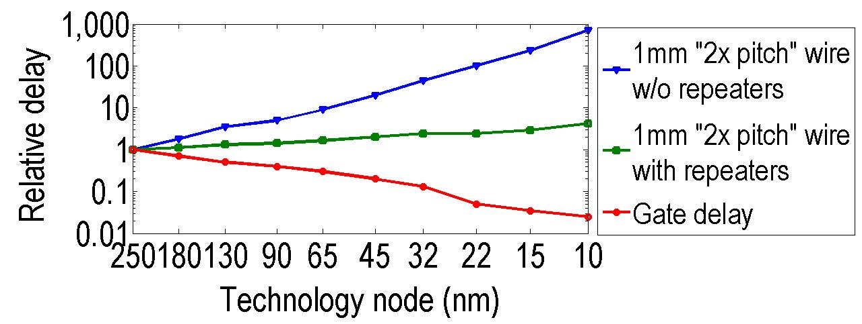
Interconnect delay a big issue with scaling
Source: ITRS
Transistors improve with scaling, interconnects do not
Even with repeaters, 1mm wire delay ~50x gate delay at 22nm node
MonolithIC 3D™ Inc. Patents Pending
3

Slide 4
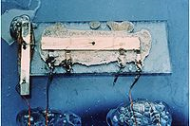
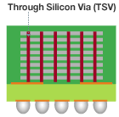
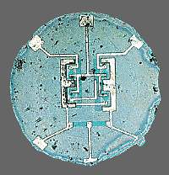
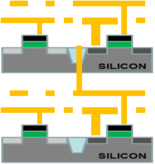
The Solution - 3D IC
1950s
Too many interconnects to manually solder → interconnect problem
Solution: The (2D) integrated circuit
Today
Interconnects dominate performance and power and diminish scaling advantages → interconnect problem
Solution: The 3D integrated circuit
Kilby version:
Connections not integrated
3D with TSV: TSV-3D IC
Connections not integrated
Noyce version (the monolithic idea):
Connections integrated
Monolithic 3D: Nu-3D IC
Connections integrated

Slide 5
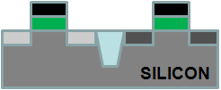
Monolithic 10,000 x Vertical Connectivity vs. TSV
 | TSV | Monolithic
Layer Thickness | ~50μ | ~50nm
Via Diameter | ~5μ | ~50nm
Via Pitch | ~10μ | ~100nm
Wafer (Die) to Wafer Alignment | ~1μ | Alignment => Will keep scaling
TSV size typically ~5um:
Limited by alignment accuracy and silicon thickness
Processed Top Wafer
Align and bond
Processed Bottom Wafer

Slide 6
The Monolithic 3D Challenge
A process on top of copper interconnect should not exceed 400ºC
    How to bring mono-crystallized silicon on top at less than 400ºC
    How to fabricate advanced transistors below 400ºC
Misalignment of pre-processed wafer to wafer bonding step is ~1μ
    How to achieve 100nm or better connection pitch
    How to fabricate thin enough layer for inter-layer vias of ~50nm
MonolithIC 3D™ Inc. Patents Pending
6

Slide 7
Path 1 - RCAT
A process on top of copper interconnect should not exceed 400ºC
    How to bring mono-crystallized silicon on top at less than 400ºC
    How to fabricate advanced transistors below 400ºC
MonolithIC 3D™ Inc. Patents Pending
7

Slide 8

Step 1. Donor Layer Processing
step 1 - Implant and activate unpatterned N+ and P- layer regions in standard donor wafer at high temp. (~900ºC) before layer transfer. Oxidize top surface (CVD)
SiO2 Oxide layer (~100nm) for oxide –to-oxide bonding with device wafer: planarize with CMP or plasma.
P
-
N+
P-
step 2 - Implant H+ to form cleave plane for the ion cut
P
-
N+
H+ Implant Cleave Line in N+ or below
P-
-
MonolithIC 3D™ Inc. Patents Pending
8
Notes:
8
8

Slide 9
step 3 - Bond and Cleave: Flip Donor Wafer and Bond to Processed Device Wafer
Cleave along
H+ implant line using 400ºC anneal or sideways mechanical force.
Polish with CMP.
-
Silicon
N+
<200nm)
SiO2 bond layers on base and donor wafers (alignment not an issue with blanket wafers)
P-
Processed Base IC
MonolithIC 3D™ Inc. Patents Pending
9
Notes:
9
9

Slide 10
step 4 - Etch and Form Isolation and RCAT Gate
Litho patterning with features aligned to bottom layer.
Etch shallow trench isolation (STI) and gate structures
Deposit SiO² in STI
Grow gate with ALD, etc. at low temp
(<350º C oxide or high-K metal gate)
Gate
Oxide
Isolation
Gate
+N
Ox
Ox
Advantage: Thinned donor wafer is transparent to litho, enabling direct alignment to device wafer alignment marks: no indirect alignment.
P-
Processed Base IC
MonolithIC 3D™ Inc. Patents Pending
10
Notes:
10
10

Slide 11

step 5 – Etch Contacts/Vias to Contact the RCAT
Complete transistors, interconnect wires on ‘donor’ wafer layers
Etch and fill connecting contacts and vias from top layer aligned to bottom layer
+N
P-
Processed Base IC
MonolithIC 3D™ Inc. Patents Pending
11
Notes:
11
11

Slide 12
Path 2 – Leveraging Gate Last + Innovative Alignment
Misalignment of pre-processed wafer to wafer bonding step is ~1μ
    How to achieve 100nm or better connection pitch
    How to fabricate thin enough layer for inter-layer vias of ~50nm
MonolithIC 3D™ Inc. Patents Pending
12

Slide 13
A Gate-Last Process for Cleave and Layer Transfer
NMOS
PMOS
Poly
Oxide
Donor wafer
Fully constructed transistors attached to each other; no blanket films.
proprietary methods align top layer atop bottom layer
Device wafer
Notes:
13

Slide 14
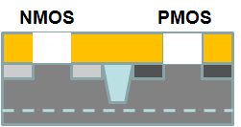
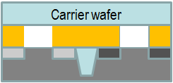
A Gate-Last Process for Cleave and Layer Transfer
Step 3.
Implant H for cleaving
H+ Implant Cleave Line
Step 4.
Bond to temporary carrier wafer
(adhesive or oxide-to-oxide)
Cleave along cut line
CMP to STI
Carrier
STI
CMP to STI
Notes:
14

Slide 15
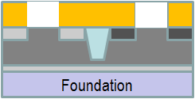
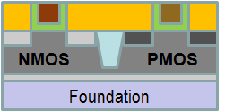
A Gate-Last Process for Cleave and Layer Transfer
Step 5.
Low-temp oxide deposition
Bond to bottom layer
Remove carrier
Carrier
Oxide-oxide bond
Remove (etch) dummy gates, replace with HKMG
Step 6. On transferred layer:
Etch dummy gates
Deposit gate dielectric and electrode
CMP
Etch tier-to-tier vias thru STI
Fabricate BEOL interconnect
Notes:
15

Slide 16
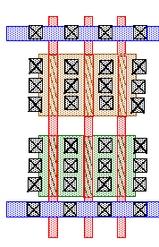
Novel Alignment Scheme using Repeating Layouts
Oxide
Landing pad
Through-layer connection
Bottom layer
layout
Top layer
layout
Even if misalignment occurs during bonding → repeating layouts allow correct connections.
Above representation simplistic (high area penalty).
Notes:
16

Slide 17
A More Sophisticated Alignment Scheme
Oxide
Landing pad
Through-layer connection
Bottom layer
layout
Top layer
layout
Notes:
17

Slide 18
Scaling with 3D or Conventional 0.7x Scaling?
Analysis with 3DSim Same blocked scaled | 2D-IC @22nm | 2D-IC @ 15nm | 3D-IC 2 Device Tiers @ 22nm
Frequency | 600MHz | 600MHz | 600MHz
Metal Levels | 10 | 12 | 10
Die Size (Active silicon area) | 50mm² | 25mm² | 24mm²
Average Wire Length | 6um | 4.2um | 3.1um
Av. Gate Size | 6 W/L | 4 W/L | 3 W/L
Power | 1.6W | 0.7W | 0.8W
3D can give you similar benefits vis-à-vis a generation of scaling!
Notes:
18

Slide 19
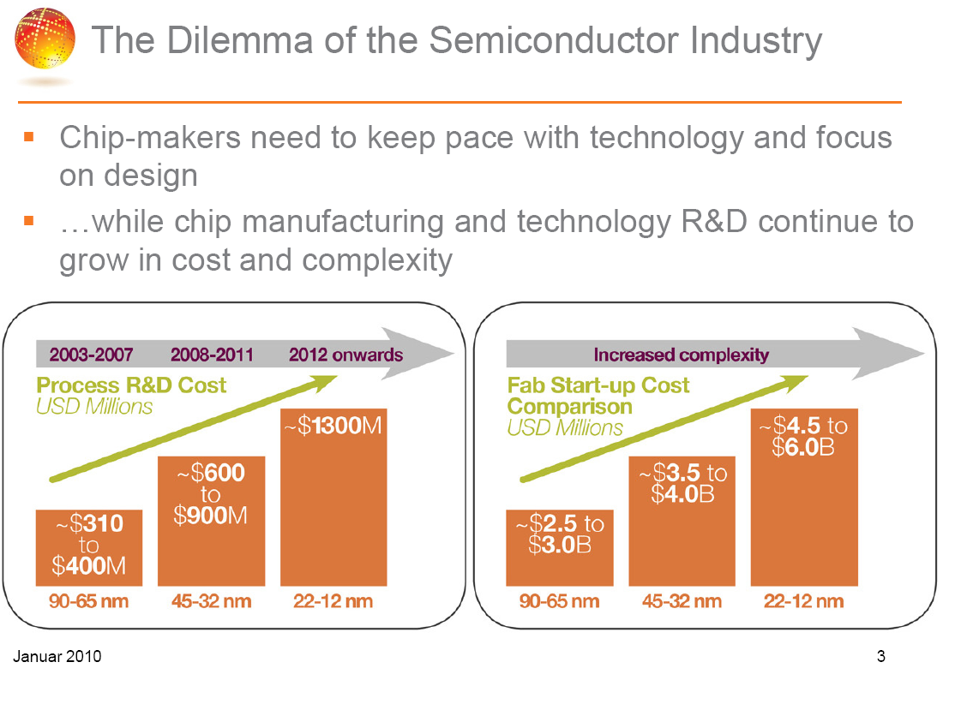
Courtesy: GlobalFoundries
Notes:
19

Slide 20
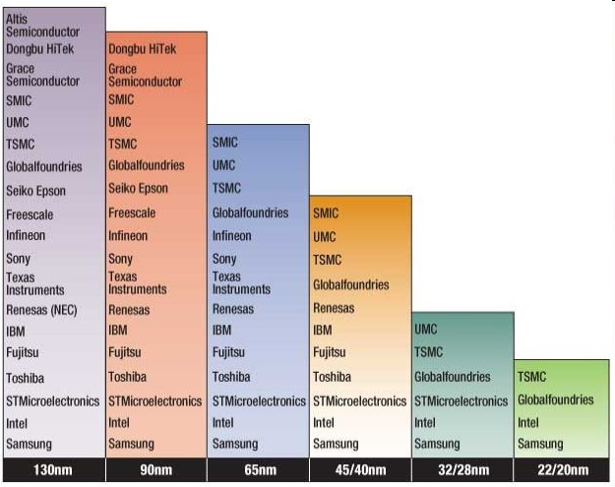
Severe Reduction in Number of Fabs
(Source: IHS iSuppli)

Slide 21
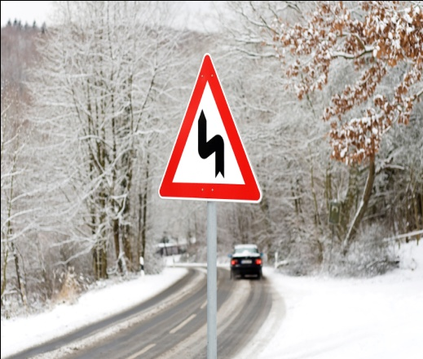

The Next Generation Dilemma:
Going Up or Going Down?
x0.7 Scaling
Monolithic 3D
Scale Down 0.7x
Scale Up 2D →3D
Cost: Capital > $4B
R&D Cost > $1B
Benefits: Logic Die Size → 0.5x
Power → 0.5x
for Speed → No Change
Cost: Capital < $100M
R&D Cost < $100M
Benefits: Logic Die Size → 0.5x
Power → 0.5x
for Speed → No Change
Notes:
21

Slide 22
Summary
Monolithic 3D is possible and practical
Monolithic 3D provides the equivalence of one process node for each folding
  Older Fabs can re-invent themselves and compete with leading edge
  Leading edge fabs could add significant value

Slide 23
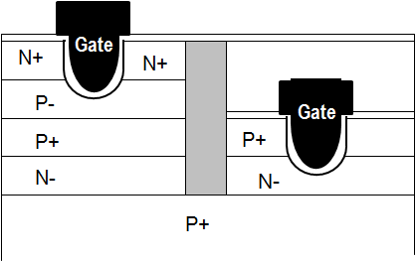
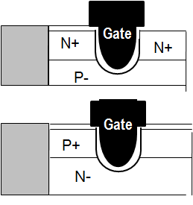
Backup: 3D CMOS Approach:
Build transistor layers above wiring layers monolithically @ <400ºC
Gate electrode
nMOS and pMOS recessed channel devices on the same wafer
n+
n+
p- Si
Silicon dioxide
Requires novel transistors for logic:
Recessed channel transistors.
Sub-400ºC stacking possible.
Used in DRAM and TFT applications today.
nMOS and pMOS recessed channel devices on stacked wafers
MonolithIC 3D™ Inc. Patents Pending
23
Notes:
23
23

