Slide 1
Enabling the Next Generation of
Supercomputers with Wafer-Scale Integration
This Analysis: Deepak
Inventor of this idea: Zvi

Slide 2
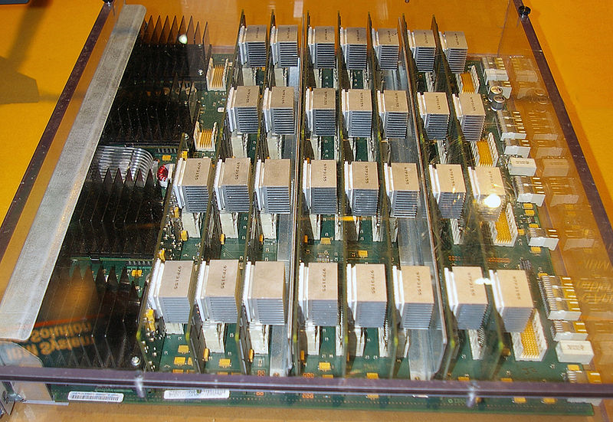
How does IBM’s famous Blue Gene Supercomputer look?
Each node: ASIC with just 850MHz., <2W. But 65000 of them, massively parallel. Highly energy efficient
Long wires → Determine performance
If we get 100x functionality in each node without yield issues
→ short wires
→ dramatic boost in performance
→ next generation supercomputers

Slide 3
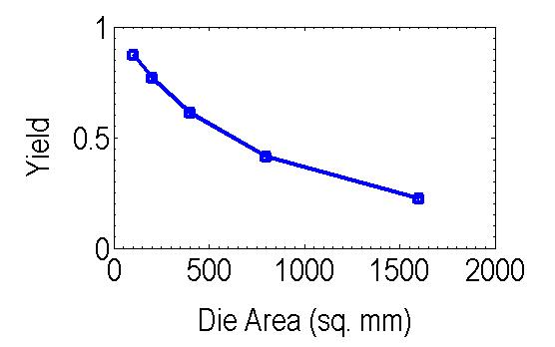
Yield: The show-stopper for die size > 400 sq. mm
Yield drops below 50% when die size > 400 sq. mm
Negative binomial yield model used (defect density = 1395/cm², cluster parameter = 2, same as ITRS)

Slide 4
Review of the yield repair idea
Duplicate copy of any circuit located above existing circuit → can swap without performance penalty
12321
12322
D
Q
D
1
Logic
D
Q
D
1
12325
Control
SI
D
0
12323
SI
D
0
Logic
12320
12324
Layer
2
Layer
1
12311
12312
D
Q
D
1
Logic
D
Q
D
1
12315
Control
SI
D
0
12313
SI
D
0
Logic
12310
12314
12300

Slide 5
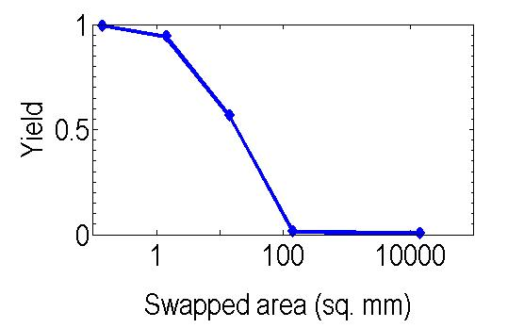
Sophisticated yield modeling done, similar to [Koren, et al. Proc. IEEE, 1998]… had to figure out the final yield with a computer program
Die size = 140 sq. cm, compared to 1.4 sq. cm of today’s chips, 100x more functionality
Idea works → close to 100% yield for 140 sq. cm die!!!
Swapping at relatively coarse grain level (1 sq. mm) →95% yield → Mature TSV technology can enable this scheme as well, don’t necessarily need monolithic 3D.
Good for our publication, ICCAD may accept simulation paper if we use mature TSV technology

Slide 6
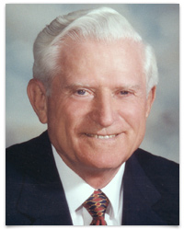
Conclusions
Gene Amdahl (of Amdahl’s law fame)
Founder of Trilogy, a wafer scale integration company in the 1980s
Can enable Wafer-Scale Integration with 100% yield!!
May use mature TSV technology for this
Careful yield modeling done to get these results
Could have tremendous implications for the United States’ supercomputer plans.
Just 20 years from Amdahl’s prediction ☺
“Wafer scale integration will only work with 99.99% yield, which won’t happen for 100 years”
Source: Wikipedia

Slide 7
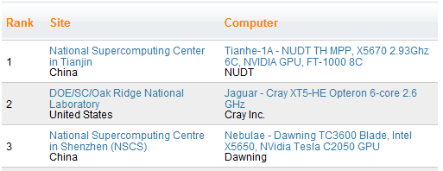
Relevance to the Government
President Barack Obama, State of the Union Address, 2011
“The U.S. is falling behind in innovation, education and infrastructure, Obama said. China scored two coups in R&D in 2010, Obama noted. It opened the world's largest solar R&D facility and it commissioned the world's most powerful supercomputer.”

