Slide 1
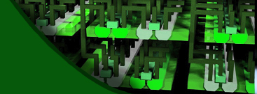
The Short, Medium and Long-Term Path to the 3D Ecosystem
Panel Discussion at EDPS
A Monolithic 3D-IC Perspective
Deepak C. Sekar

Slide 2
Two Types of 3D Technology
3D-TSV
Transistors made on separate wafer @ high temperature, then thin + align + bond
Monolithic 3D
Transistors made monolithically atop wiring (@ sub-400ºC for logic)
100 nm
10um-
50um
TSV pitch > 1um*
TSV pitch ~ 50-100nm
* [Reference: P. Franzon: Tutorial at IEEE 3D-IC Conference 2011]

Slide 3
A Process Flow for Monolithic 3D: Recessed Channel Transistors with Activation before Layer Transfer
Activate dopants
Layer transfer un-patterned film. No alignment issues.
Oxide
n+
p
p
p
p- Si wafer
n+
H
n+
p- Si wafer
Well-aligned sub-400C RCATs Si thickness < 100nm
Min. feature size TSVs since low Si thickness, no misalignment issues
Steps atop Cu/low k < 400ºC
RCATs used in production DRAM since the 90nm node
→ Adoption easier
n+
p
n+
p
[D. C. Sekar, Z.Or-Bach, “Monolithic 3D-ICs with Single Crystal Silicon Layers”, Proc. IEEE 3DIC Conference 2011 (Invited)]

Slide 4
SRAM-Logic Stacking
SRAM requirements different from logic today. Different number of metal levels, V_{t}, L_{eff}...
Ultra-dense vertical connectivity needed, esp. for small size SRAMs within a logic core → good fit for Monolithic 3D
Optimized SRAM
5 metal levels
can save process cost, and improve performance.
Ultra-dense connectivity
Logic Circuits
12 metal levels
EDA need: Tools to partition designs and stack the SRAM
Ref.: [D. Sekar, PhD Thesis, Georgia Tech]

Slide 5
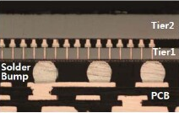
Logic-Logic Stacking with High TSV Density
Today
“Pseudo-3D” EDA Tools
Needed for Monolithic 3D
“Native-3D” EDA Tools
3D routing, placement, floorplanning tools that work for TSVs close to min. feature size
Support for both block-level and gate-level partitioning
DRAM
Logic
Modify existing 2D tools slightly
TSVs in whitespace or modify existing layout slightly for TSVs to stacked layer
OK for today’s 5um TSVs (low density)

Slide 6
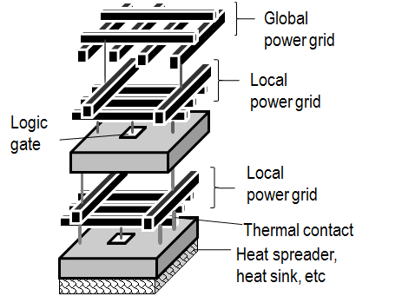
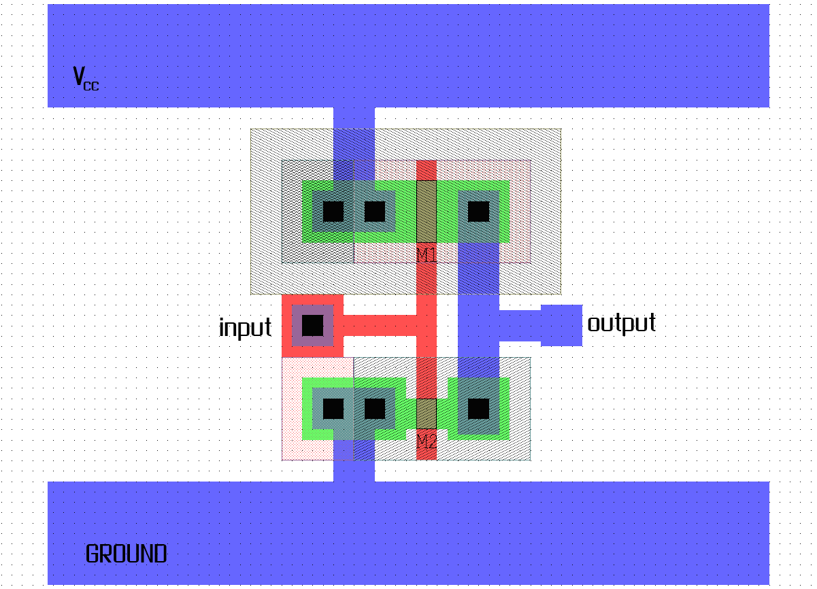
Power Distribution Network Design
Good heat removal
for monolithic 3D
Thermal-Aware Place-and-Route
=
Most logic gates have V_{DD} and GND contacts Low (thermal) resistance power grids → low temp. drop between heat sink and stacked logic gate
Promising simulation results
V_{DD}
GND
EDA need: Integrate power distribution design with (thermal-aware) place-and-route for monolithic 3D
Ref.: [D. Sekar, Z. Or-Bach, US Patent Application #13/041,405]

Slide 7
How will monolithic 3D technology tackle this familiar problem?
Suggestion to the EDA community:
EDA tools for logic-logic stacking starting to be developed for um-scale TSVs.
Make sure your algorithms are scalable to nm-scale TSVs… they might happen someday!!

