Slide 1
FINE-GRAINED 3D INTEGRATION
Deepak C. Sekar, Brian Cronquist, Zvi Or-Bach
MonolithIC 3D Inc.
Presentation at the IEEE CPMT Society, 11th January 2012

Slide 2
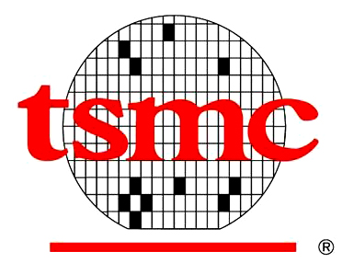
28nm CMOS Technology with TSVs
Symposium on VLSI Technology 2011
28nm
6um
Keep-Out
Zone
5um
Keep-Out
Zone
5um
TSV occupies 6um + 5um + 5um = 16um
On-chip Features = 28nm
Area Ratio = (16000nm/56nm)² ~ 100,000x
TSVs are fat!
TSVs are fat!
2

Slide 3
TSV diameter typically in the 5-50um range...
TSV Diameter = 6um
Keep-Out Zone = 5um
[Ref: 2011 VLSI Symposium]
TSV Diameter = 50um
[Ref: IEDM 2011]
TSV Diameter = 10um
[Ref: 2011 VLSI Symposium]
TSV Diameter = 5um
Keep-Out Zone = 6um
(Digital), 20um (Analog)
[Ref: 2011 VLSI Symposium]

Slide 4
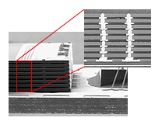
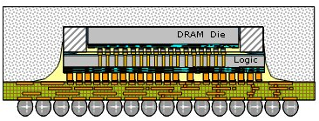
TSVs in the 5-50um range pretty useful
BSI image sensors
Heterogeneous
integration
Logic-DRAM stacks
3D DRAM
Photonics
DRAM
Logic
Logic
This is great.
But what if we can make TSVs smaller? Will it open up new markets?

Slide 5
Fine-Grained 3D Definition: Small TSV diameter, in the 20nm-250nm range
Outline of this Presentation
Motivation for Fine-Grained 3D
How can we make TSVs smaller?
- Evolutionary Methods
- Revolutionary Methods
Note: Face-to-back approaches will be the focus of this presentation as they are extendable to more than two dice

Slide 6
Motivation for TSV diameter in the 20nm-250nm range

Slide 7
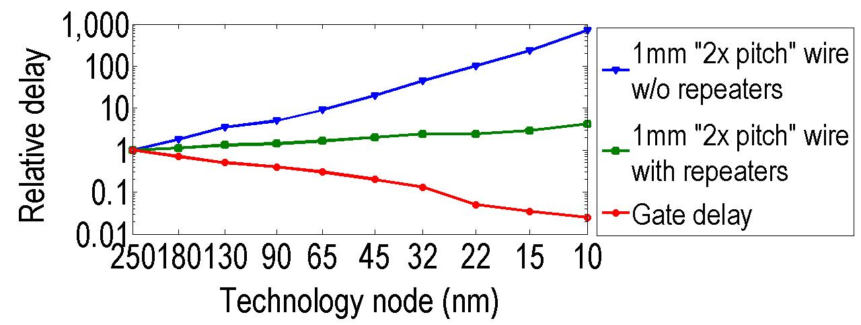
On-chip interconnects: A big issue with scaling
Source: ITRS
Transistors improve with scaling, interconnects do not
Even with repeaters, 1mm wire delay ~50x gate delay at 22nm node
MonolithIC 3D™ Inc. Patents Pending
7

Slide 8
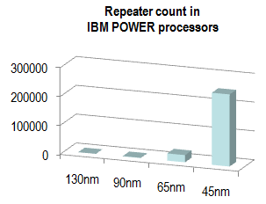
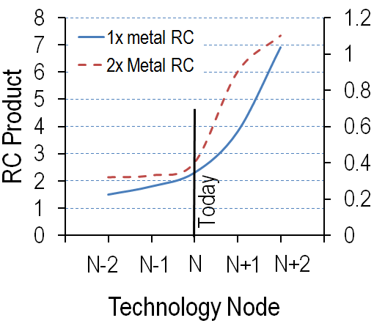
On-chip interconnect issues in commercial chips
Wiring RC in AMD Logic Chips
Ref: [Naffziger, VLSI 2011]
Repeater Count in IBM POWER Processors
Ref: [R. Puri, et al., SRC Forum 2006]
2011 VLSI Symposium Keynote:
Sam Naffziger, AMD Fellow said, “We are at the cusp of a dramatic increase in wire RC delays. Revolutionary solutions may be required.”
Notes:
Due to surface scattering, grain boundary scattering, diffusion barrier effects, low k trend

Slide 9
Situation in nVIDIA’s 28nm chips
COMPUTE
INTERCONNECT
Operation | Energy
Integer Add | 1pJ
Fetching operands for (Integer Add) from
A register file 1mm away | 26pJ
L1 Cache | 50pJ
L2 Cache | 256pJ
L3 Cache | 1,000pJ
Off-Chip DRAM | 16,000pJ
3D can shorten these interconnects
Fine-grained 3D,
small size TSVs,
less on-chip wire problems
Interconnects dominate energy consumption
Logic-DRAM 3D stacks,
micron-scale TSVs,
less off-chip wire problems
Ref.: W. Dally (nVIDIA), Supercomputing 2010

Slide 10
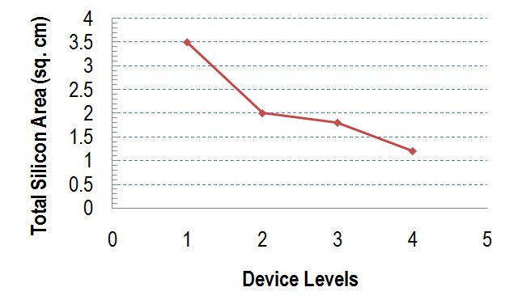
Previous work on Fine-Grained 3D [J. Davis, J. Meindl, K. Saraswat, R. Reif, et al., Proc. IEEE 2001]
Simulation study:
Frequency = 450MHz, 180nm node
ASIC-like chip
For vertical connectivity ~ horizontal connectivity, 3x reduction in total silicon area + 12x reduction in footprint @ 180nm node
But the 180nm node was ages back... What’s the situation today?

Slide 11
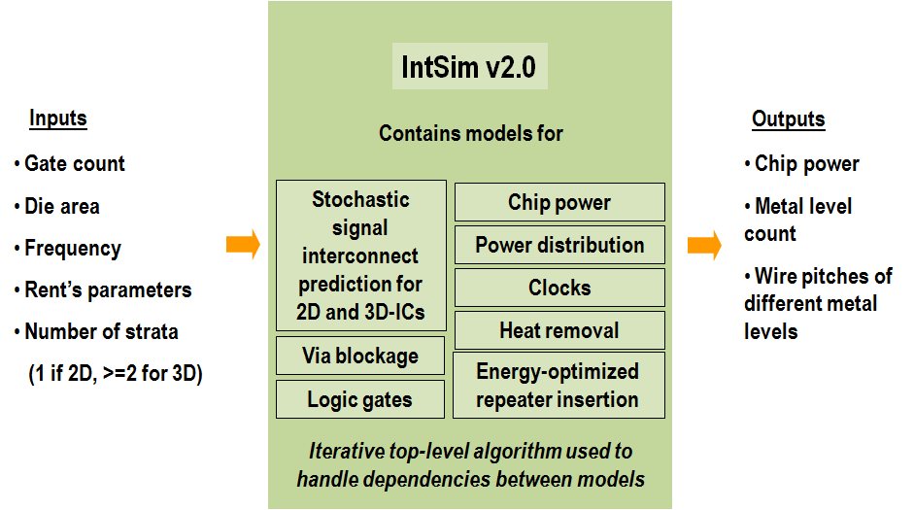
IntSim: The CAD tool used for our simulation study [D. C. Sekar, J. D. Meindl, et al., ICCAD 2007]
Open-source tool, available for use at www.monolithic3d.com
IntSim v1.0: Built at Georgia Tech in Prof. James Meindl’s group
IntSim v2.0: Extended IntSim v1.0 to monolithic 3D using 3D wire length distribution models in the literature

Slide 12
IntSim-based analysis @ 22nm node
22nm node 600MHz logic core | 2D-IC | Fine-Grain 3D 2 Device Layers | Comments
Metal Levels | 10 | 10
Average Wire Length | 6um | 3.1um
Av. Gate Size | 6 W/L | 3 W/L | Since less wire cap. to drive
Optimal Die Size (active silicon area) | 50mm² | 24mm² | 3D-IC → Shorter wires → smaller gates → lower die area → wires even shorter 3D-IC footprint = 12mm²
Power | Logic = 0.21W | Logic = 0.1W | Due to smaller Gate Size
 | Reps. = 0.17W | Reps. = 0.04W | Due to shorter wires
 | Wires = 0.87W | Wires = 0.44W | Due to shorter wires
 | Clock = 0.33W | Clock = 0.19W | Due to less wire cap. to drive
 | Total = 1.6W | Total = 0.8W
3D with sub-50nm TSVs → 2x reduction in power and active silicon area

Slide 13
Scaling with 3D or conventional 0.7x scaling?
Analysis with IntSim v2.0 Same logic core scaled | 2D-IC @22nm | 2D-IC @ 15nm | Fine-Grained 3D 2 Device Layers @ 22nm
Frequency | 600MHz | 600MHz | 600MHz
Metal Levels | 10 | 12 | 10
Footprint | 50mm² | 25mm² | 12mm²
Total Silicon Area (a.k.a “Die size”) | 50mm² | 25mm² | 24mm²
Average Wire Length | 6um | 4.2um | 3.1um
Av. Gate Size | 6 W/L | 4 W/L | 3 W/L
Power | 1.6W | 0.7W | 0.8W
Fine-Grained 3D could provide similar benefits to a generation of scaling
Without the need for costly lithography upgrades
Let’s understand this better…

Slide 14
Theory: 2D Scaling vs. 3D Scaling
 | 2D Scaling (0.7x scaling) |  | Fine-Grained 3D Scaling (2 device layers)
 | Ideal | Today, V_{dd} scales slower
Chip Footprint | 0.5x |  | 0.25x-0.5x (see slide 12)
 | 0.7x |  | 0.5x-0.7x
Long wire capacitance | 0.7x |  | 0.5x-0.7x
Long wire resistance | >1.4x |  | 0.5-0.7x
Gate Capacitance | 0.7x |  | Same
Driver (Gate) Resistance (Vdd/Idsat) | Same | Increases | Same
Overall benefits seen with IntSim have basis in theory
2D scaling scores: Gate capacitance
3D scaling scores: Wire resistance, driver resistance, wire capacitance

Slide 15
Applications of Fine-Grained 3D: Logic-on-Logic Stacking
Single logic core or block split into multiple layers
Focus of our discussion so far
Portion of the
Logic Core
2x less power, 2x less silicon area
for
double the number of device layers
Sub-50nm through-silicon connections
Portion of the
Logic Core
Caveat: CAD tools for designing fine-grained 3D chips need to improve significantly to see the benefits mentioned above

Slide 16
Applications of Fine-Grained 3D: SRAM Stacking Atop Logic
SRAM requirements different from logic. Different V_{t}, L_{eff}, number of metal levels...
Ultra-dense vertical connectivity needed, especially for smaller-size SRAM arrays used within logic cores
Optimized SRAM
4 metal levels
can save process cost, and improve performance.
Ultra-dense connectivity
Logic Circuits
12 metal levels
Ref.: [D. Sekar, PhD Thesis, Georgia Tech]

Slide 17
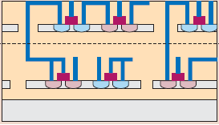
Applications of Fine-Grained 3D: nMOS and pMOS in Stacked Layers
nMOS and pMOS transistors:
- Different implants, strain layers, gate stacks
- Save masks, optimize each separately
- No well-to-well spacing overhead
SRAM: From 84F² to 45F² [Samsung, VLSI’04]
Inverters, 3 input NAND, 3 input NOR: ~40% reduction in area [IBM, CICC’03]
pMOS
nMOS
smaller standard cells
→ short wires.

Slide 18
Evolutionary Methods to Get Fine-Grained 3D

Slide 19
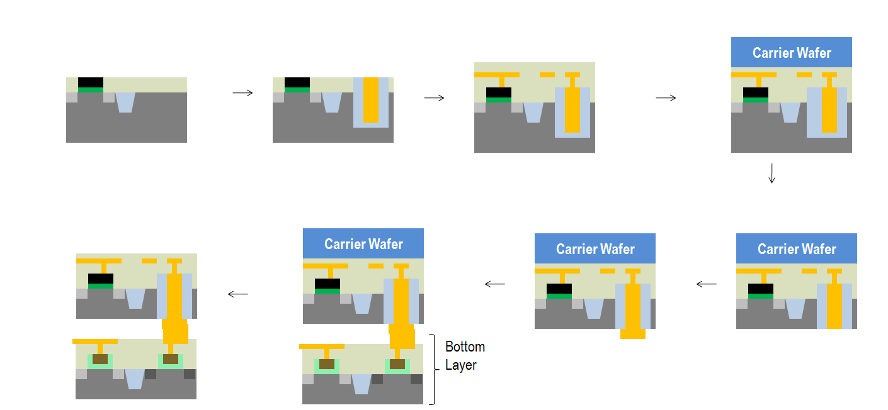
A state-of-the-art 3D TSV process today
FEOL
Cu via
BEOL
Attach to Carrier
Remove Temporary Carrier
Align and Bond to Bottom Layer
Wafer Backside Processing
Wafer Thinning

Slide 20
Why are TSV sizes in the um range today? Reason 1: Wafer-thinning issues
Carrier Wafer
Carrier Wafer
775um
10um +/- 1um
AR limits ~ 10:1 today
For 1um diameter TSVs,
Uniformly thin from 775um to 10um +/- 1um → Hard, esp. at high throughput.
Easier to go from 775um to 50um +/- 5um → 5um diameter TSVs

Slide 21
Why are TSV sizes in the um range today? Reason 2: Misalignment during bonding
Alignment system stability of 3D tools
CTE mismatch between bonded wafers: um-range error possible (For glass carriers, Glass-Si mismatch ☹)
Wafer bow difference for bonded wafers: Bow often 50um for wafers. um-range error possible
Thermal or stress induced flow of temporary bonding adhesives, localized bonding imperfections, etc
Best alignment accuracy ~ 0.5um-1um today
Carrier Wafer
Align and bond
Ref.: [S. Steen, et al., Microelectronic Engineering, 2007] [Tan, Gutmann, Reif, Wafer Level 3D-IC Process Technology, Springer]

Slide 22
Countermeasures for wafer thinning problems: (1) Use SOI wafers and Buried Oxide as etch stop
Carrier Wafer
Carrier Wafer
First grind, then use a Si etch agent like TMAH that is selective to oxide
775um
BOX
200nm
BOX
Used by Sony for its BSI image sensor products
Pros: Very low silicon thickness, excellent uniformity
Cons: SOI a niche, so applications of this technique limited. Expensive.

Slide 23
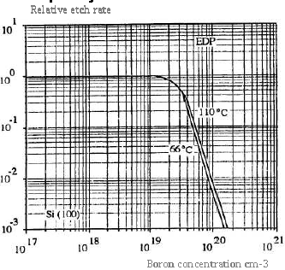
Countermeasures for wafer thinning problems: (2) Use etch stop regions in bulk wafers
Carrier Wafer
EDP Etch
775um
p
p++
p
EDP
Carrier Wafer
Pros: Bulk-Si, well-known MEMS technique
Cons: Cost of epi
1um
p
p++

Slide 24
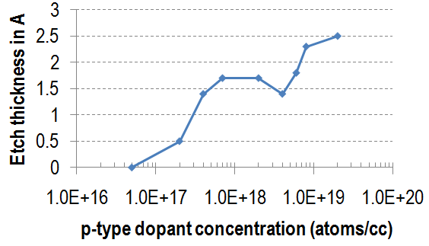
Countermeasures for wafer thinning problems: (2) Use etch stop regions in bulk wafers
Carrier Wafer
HNA [HF, Nitric, Acetic Acids] Etch
775um
p
p++
Use agent like HNA
Carrier Wafer
Pros: Bulk-Si, well-known MEMS technique
Cons: Cost of epi
1um
p

Slide 25
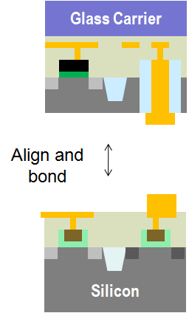
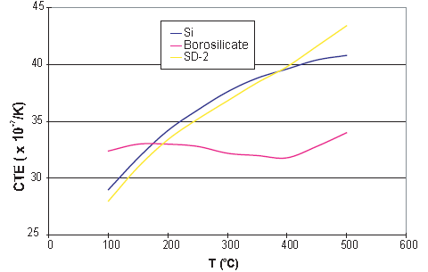
Countermeasures for bonding misalignment problems: (1) If glass carriers, use CTE-matched ones
Sub-100nm
Glass carriers: Transparency → better alignment. Optical debond possible → convenient.
But CTE mismatch: Si = 3.8ppm/ºC, Borosilicate Glass = 3.2ppm/ºC
Delta(300mm wafer diameter at 300ºC) for Si = 314um, Borosilicate Glass = 264um.Error!
Use special glasses with Si-matched CTE curves eg. SD-2. Also, glass needs to be uniform.

Slide 26
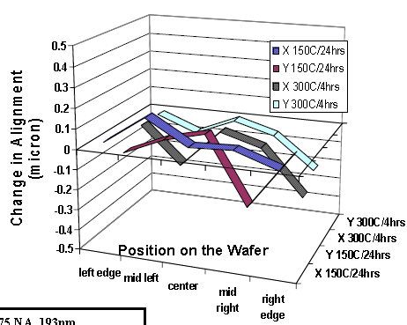
Countermeasures for bonding misalignment problems: (2) Use oxide-oxide bonding
Oxide-Oxide Bonding with Plasma Activation | Align and pre-bond at room temperature Then 200-300ºC anneal. Pre-bond alignment largely maintained – changes by less than 400nm.
Cu-Cu Bonding | 300-400ºC
Room temperature oxide-oxide bonding
Less CTE mismatch issues
Better alignment
Ref.: [A. Topol, et al., IEDM 2005]]

Slide 27
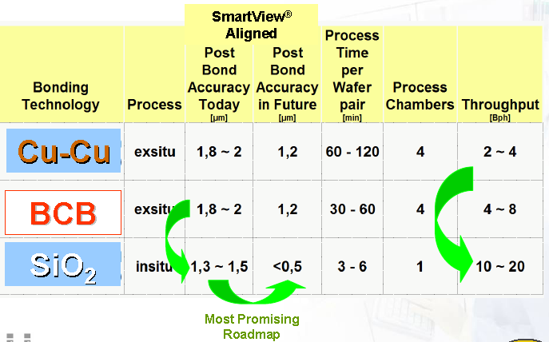
Countermeasures for bonding misalignment problems: (2) Use oxide-oxide bonding (contd.)
Source: EVG
EVG roadmap confirms oxide-oxide bonding gives better alignment

Slide 28
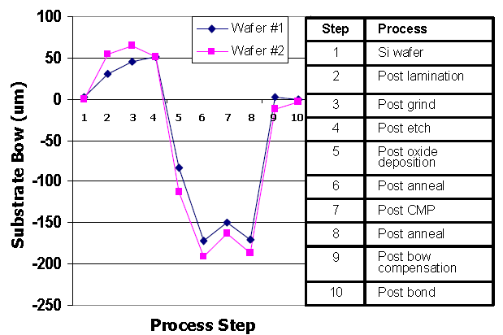
Countermeasures for bonding misalignment problems: (3) Wafer bow compensation
Ref.: [A. Topol, et al., IEDM 2005]
50-100um bow on wafers based on process history
Bow compensation: Deposit films on wafers’ back-sides to make bow smaller

Slide 29
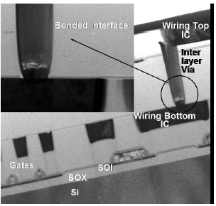
IBM’s work in this area [S. Koester, et al. IBM Journal R&D, 2008] [A. Topol, et al., IEDM 2005]
Borofloat glass carrier – ok CTE match, transparent
Thinning with SOI wafers and BOX etch stop
Low temperature oxide-oxide bonding
Wafer bow compensation
Best demo so far = 6.7um pitch.
IBM: “2um pitch possible if bonder with sub-0.5um misalignment available”

Slide 30
Research Opportunities: Silicon Temporary Carriers for High-Density TSVs?
Reasons for historic preference towards glass
Transparent. Look through and align. Less error.
Temporary bonding adhesives optically de-bondable. Withstand 300-350ºC bumpless bonding.
Why silicon has promise
CTE
Cheap, highly smooth
Emerging high T stable temporary bonding adhesives for silicon
Alignment tools for non-transparent carriers improving fast
$$$ invested in silicon temporary carriers for bump-based 3D-TSV

Slide 31
Research Opportunities in the High-Density TSV Space
Throughput and cost optimization for all process steps
Improved wafer bow compensation schemes
Bonders with better alignment capabilities. A number of ideas from regular litho can be applied to 3D.
Lower thermal budget for bonding
Temporary bonding adhesives

Slide 32
Revolutionary Methods to Get Fine-Grained 3D

Slide 33
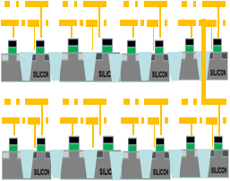
The Monolithic 3D Approach
Today’s 3D-TSV Technology
Monolithic 3D
Process Bottom Wafer with Cu/low k
Top wafer processed at regular temperatures
Then process thin-film layers of devices and wires at less than 400ºC
Align and bond
Bottom wafer processed at regular temperatures

Slide 34
How are all SOI wafers manufactured today?
Hydrogen implant
of top layer
Flip top layer and
bond to bottom layer
Cleave using 400ºC
anneal or sideways
mechanical force. CMP.
Oxide
Activated n Si
Oxide
H
Top layer
Activated n Si
Activated n Si
Top layer
Activated n Si
H
Oxide
Oxide
Oxide
Silicon
Silicon
Silicon
Bottom layer
Using Ion-Cut (a.k.a. Smart-Cut) technology.
Controllable thickness due to uniformity of implant. Silicon can be ~10nm!

Slide 35
Ion-cut (a.k.a Smart-CutTM) → Can also give stacked sub-100nm c-Si layers atop Cu/low k
Hydrogen implant
of top layer
Flip top layer and
bond to bottom layer
Cleave using 400ºC
anneal or sideways
mechanical force. CMP.
Oxide
Activated n Si
Top layer
Oxide
H
Activated n Si
Activated n Si
Activated n Si
H
Oxide
Oxide
Oxide
Bottom layer

Slide 36
Monolithic 3D needs Sub-400ºC Transistors
 | Sub-400ºC possible? | Method
Single Crystal Silicon | Yes | Ion-Cut
STI | Yes | Radical Oxidation, HDP
High k/Metal Gate | Yes | ALD/CVD
Source-Drain Dopant Activation | No | >750ºC anneal
Contacts | Yes | Nickel Silicide
Junction Activation: Key barrier

Slide 37
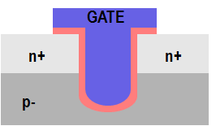
One path to solving the dopant activation problem: Recessed Channel Transistors with Activation before Layer Transfer
Idea 1: Activate dopants before layer transfer
Layer transfer of un-patterned film. No alignment issues.
Oxide
n+ Si
p
p Si
p
p- Si wafer
n+
H
n+
p- Si wafer
Idea 2: Use sub-400C steps to define recessed channel transistors
Idea 3: Thin-film sub-100nm silicon layer allows perfect alignment. TSVs can be minimum feature size
Note:
All steps after Next Layer attached to Previous Layer are @ < 400ºC!
n+
n+
p
p

Slide 38
Recessed channel transistors used in manufacturing today → easier adoption
GATE
GATE
GATE
n+
n+
n+
n+
p
p
RCAT recessed channel transistor:
Used in DRAM production
@ 90nm, 60nm, 50nm nodes
Longer channel length → low leakage, at same footprint
V-groove recessed channel transistor: Used in the TFT industry today
J. Kim, et al. Samsung, VLSI 2003
ITRS

Slide 39
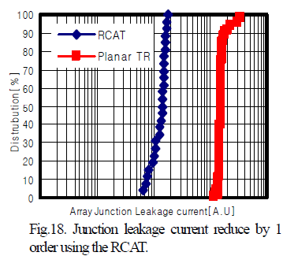
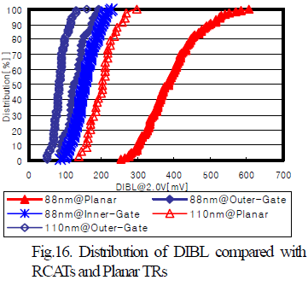
RCATs vs. Planar Transistors: Experimental data from Samsung 88nm devices
From [J. Y. Kim, et al. (Samsung), VLSI Symposium, 2003]
RCATs → Less junction leakage
RCATs → Less DIBL i.e. short-channel effects

Slide 40
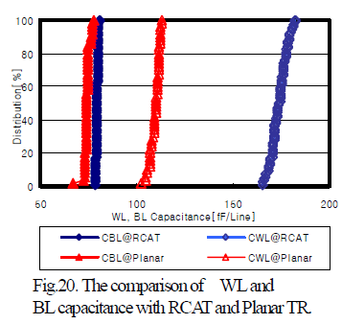
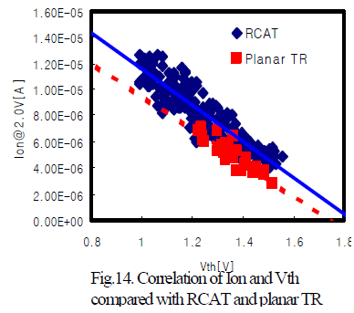
RCATs vs. Planar Transistors (contd.): Experimental data from Samsung 88nm devices
From [J. Y. Kim, et al. (Samsung), VLSI Symposium, 2003]
RCATs → Similar drive current to standard MOSFETs → Mobility improvement (lower doping) compensates for longer L_{eff}
RCATs → Higher I/P capacitance

Slide 41
We talked about logic all this time, but fine-grained 3D can be applied to other areas as well
LOGIC
MEMORY
OPTO-ELECTRONICS
Monolithic 3D Integration with Ion-Cut Technology
3D-CMOS: Monolithic 3D Logic Technology
3D-FPGA: Monolithic 3D Programmable Logic
3D-GateArray: Monolithic 3D Gate Array
3D-Repair: Yield recovery for high-density chips
3D-DRAM: Monolithic 3D DRAM
3D-RRAM: Monolithic 3D RRAM
3D-Flash: Monolithic 3D Flash Memory
3D-Imagers: Monolithic 3D Image Sensor
Can be applied to many market segments

Slide 42
Summary

Slide 43
Summary
Today ~5um TSV diameter. Fine-Grained 3D: 20nm-250nm TSV diameter.
Applications:
Tackles on-chip interconnect problems
Logic core split into 2 stacked layers: 2x power, 2x die area savings possible
SRAM stacking with logic, nMOS and pMOS stacking
How Fine-Grained 3D?
Evolutionary extension of 3D-TSV: 2um pitch possible now, could reduce further
Monolithic 3D: Sub-100nm TSV diameter...

Slide 44
Before we end, a couple of trivia questions...

Slide 45
Trivia Question 1
Commercialization of Fine-Grained 3D:
(A) Is 2 years away
(B) Is 5 years away
(C) Is 10 years away
(D) Will never happen
Answer:
Fine-Grained 3D was commercialized 8 years back!
(Trick question ☺)

Slide 46
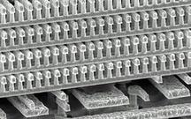
Fine-Grained 3D was commercialized by Matrix Semiconductor in 2003
4-8 monolithically constructed memory layers
130nm commercial product TSV sizes smaller than 180nm
Non-volatile memory: Multiple layers of poly diodes in series with antifuses
Startup acquired by SanDisk in 2006

Slide 47
Trivia Question 2
Will you be buying a Fine-Grained 3D product in 4 years?
(A) Yes
(B) No
(C) Possibly. Is it on someone’s roadmap?
(D) Another trick question?
Answer:
(C) Fine-Grained 3D appears on Toshiba and Samsung’s flash memory product roadmaps within 4 years. Maybe you’ll see it in your next iPhone? Product roadmaps rarely stick to schedule though. So the answer is maybe.

Slide 48
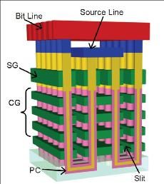
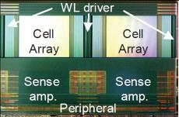
Toshiba’s 32Gb Fine-Grained 3D Prototype Scheduled to go to production within 4 years
16 layers of poly-based monolithic 3D NAND flash memory
60nm feature sizes

Slide 49
Thank you

Slide 50
Backup slide – Temporary carriers

Slide 51
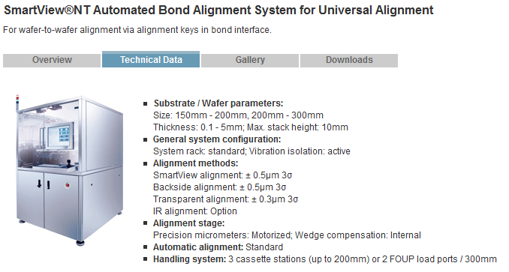
EVG Bonder Performance for Different Alignment Schemes

