Slide 1


THE MONOLITHIC 3D-IC
A DISRUPTOR TO THE SEMICONDUCTOR INDUSTRY
MonolithIC 3D™ Inc. Patents Pending
1

Slide 2
Semiconductor Industry is Facing an
Inflection Point
Dimensional Scaling has reached Diminishing Returns

Slide 3
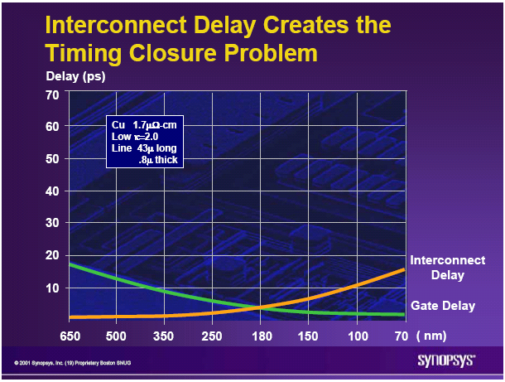
The Current 2D-IC is Facing Escalating Challenges - I
On-chip interconnect is
  Dominating device power consumption
  Dominating device performance
  Penalizing device size and cost

Slide 4
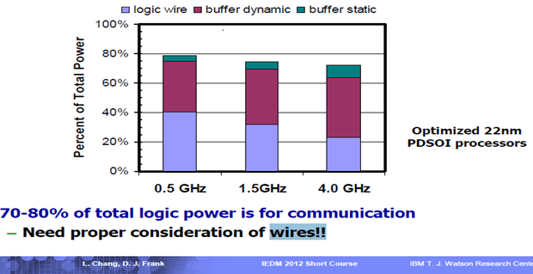
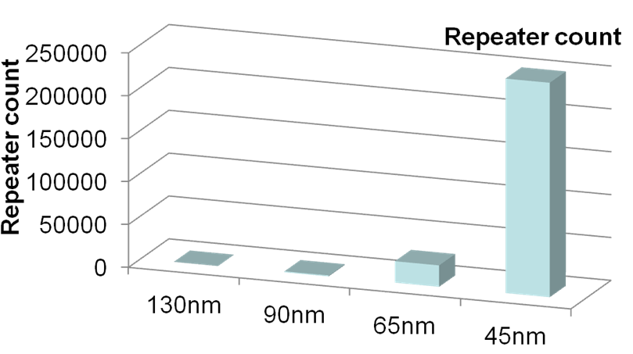
Connectivity Consumes 70-80% of Total Power @ 22nm
Repeaters Consume Exponentially More Power and Area
At 22nm, on-chip connectivity consumes 70-80% of total power
Repeater count increases exponentially
At 45nm, repeaters are > 50% of total leakage
MonolithIC 3D™ Inc. Patents Pending
Source: IBM POWER processors
R. Puri, et al., SRC Interconnect Forum, 2006

Slide 5
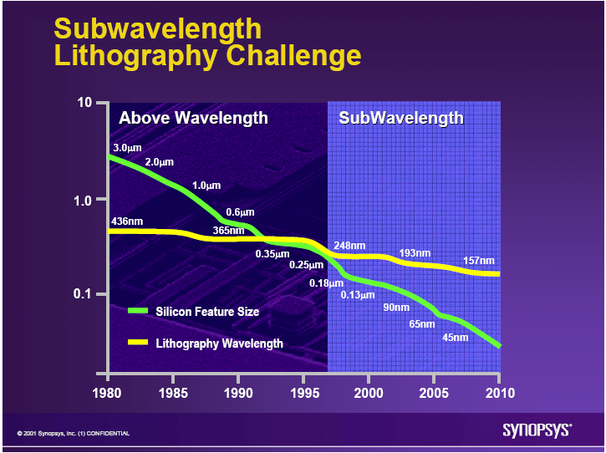
The Current 2D-IC is Facing Escalating Challenges - II
Lithography is
  Dominating Fab cost
  Dominating device cost and diminishing scaling’s benefits
  Dominating device yield
  Dominating IC development costs

Slide 6
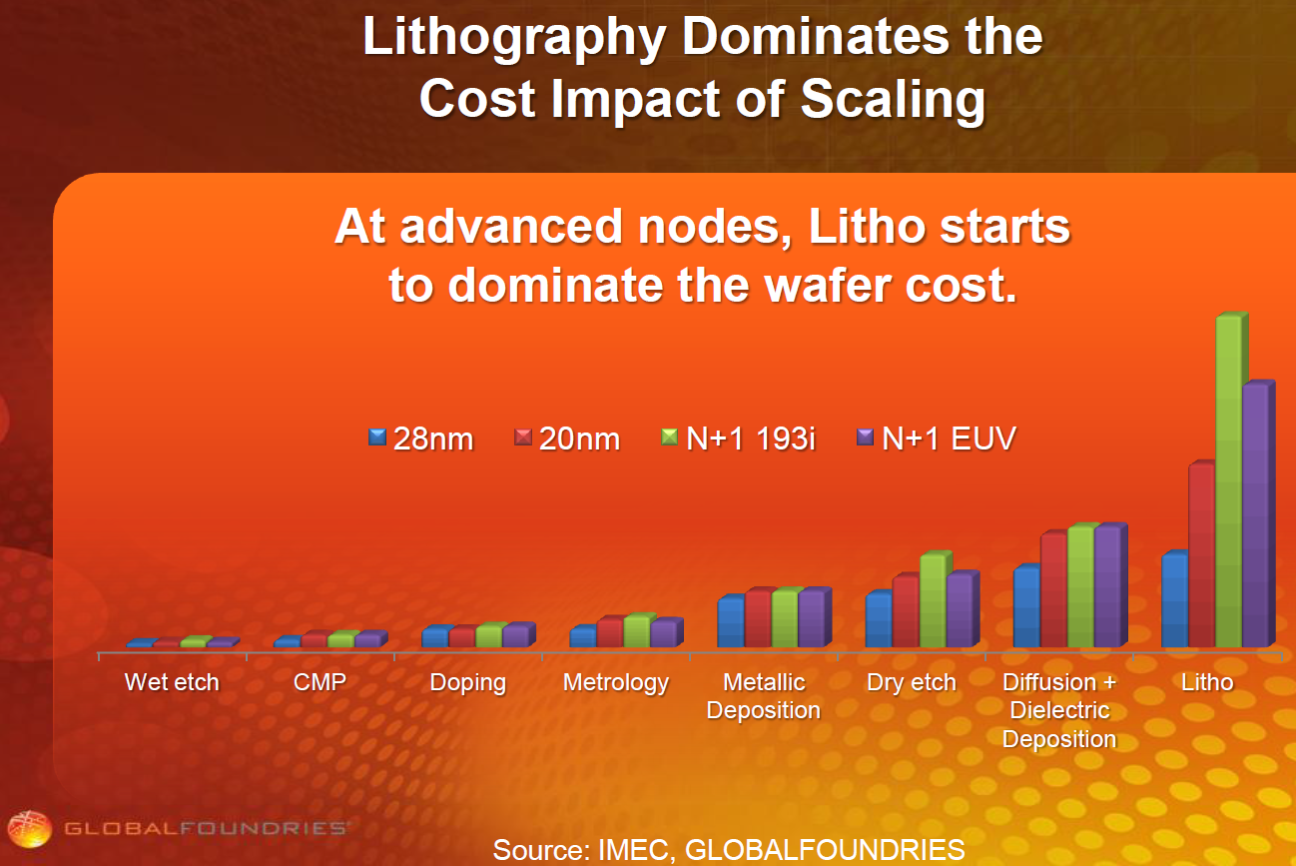
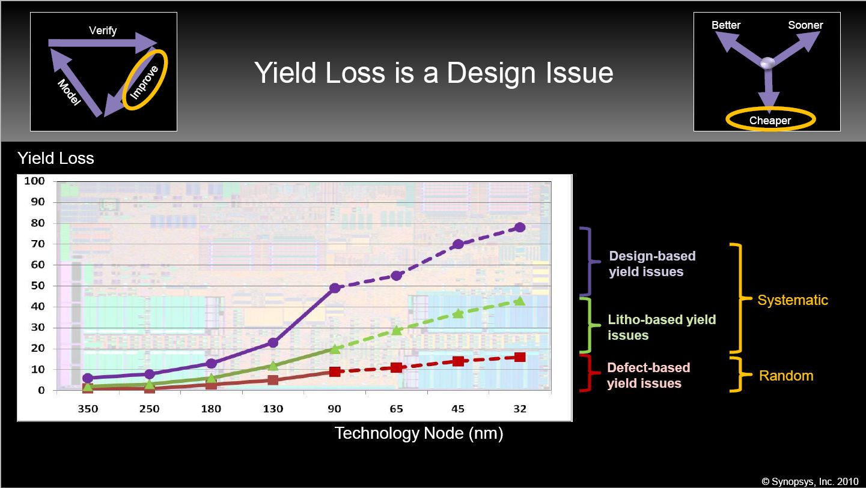
III. Significant Advantages from Using Same Fab, Same Design Tools
Litho. dominates Fab. cost
Litho. escalates Design cost
Litho. dominates Yield loss
Lithography costs over time

Slide 7
III. Significant Advantages from Using Same Fab, Same Design Tools
Dimensional Scaling implies:
  Process R&D > $1B per node
  New Fab Equipment > $5B
  Need to re-ramp up manufacturing and yield
  New design tools and libraries
  => High deprecation costs

Slide 8
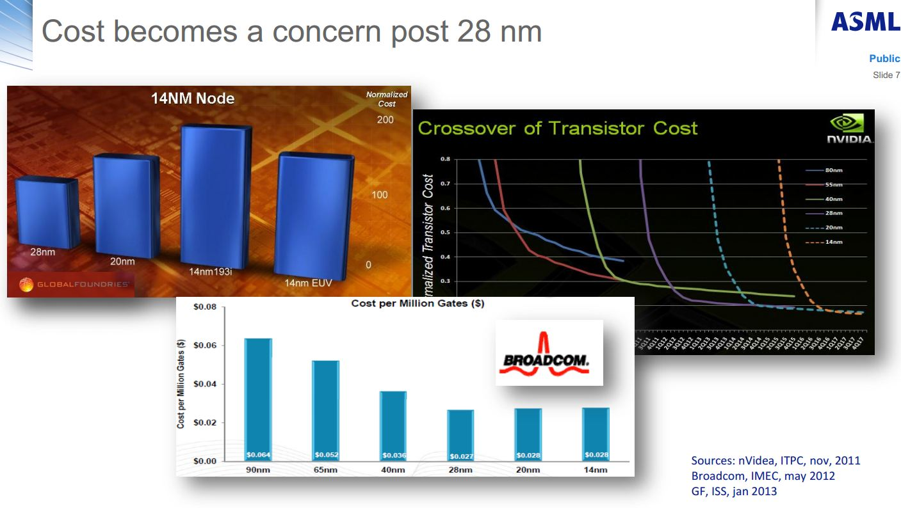
Martin van den Brink -EVP & CTO, ASML
ISSCC 2013 & SemiconWest 2013

Slide 9
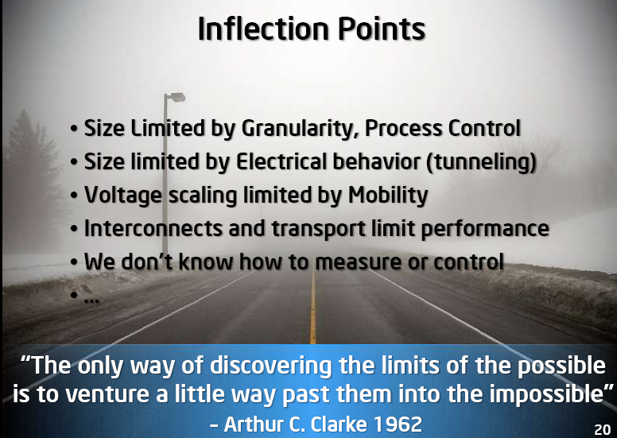

Slide 10
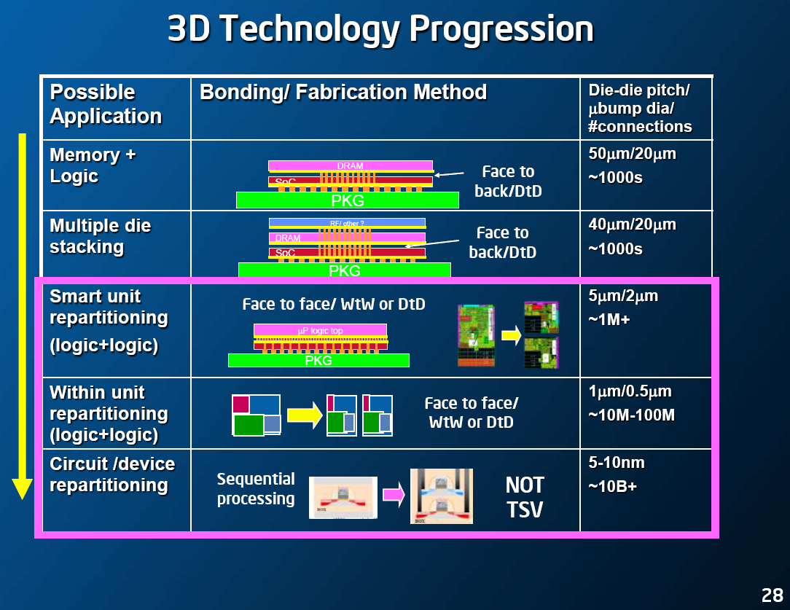

Slide 12
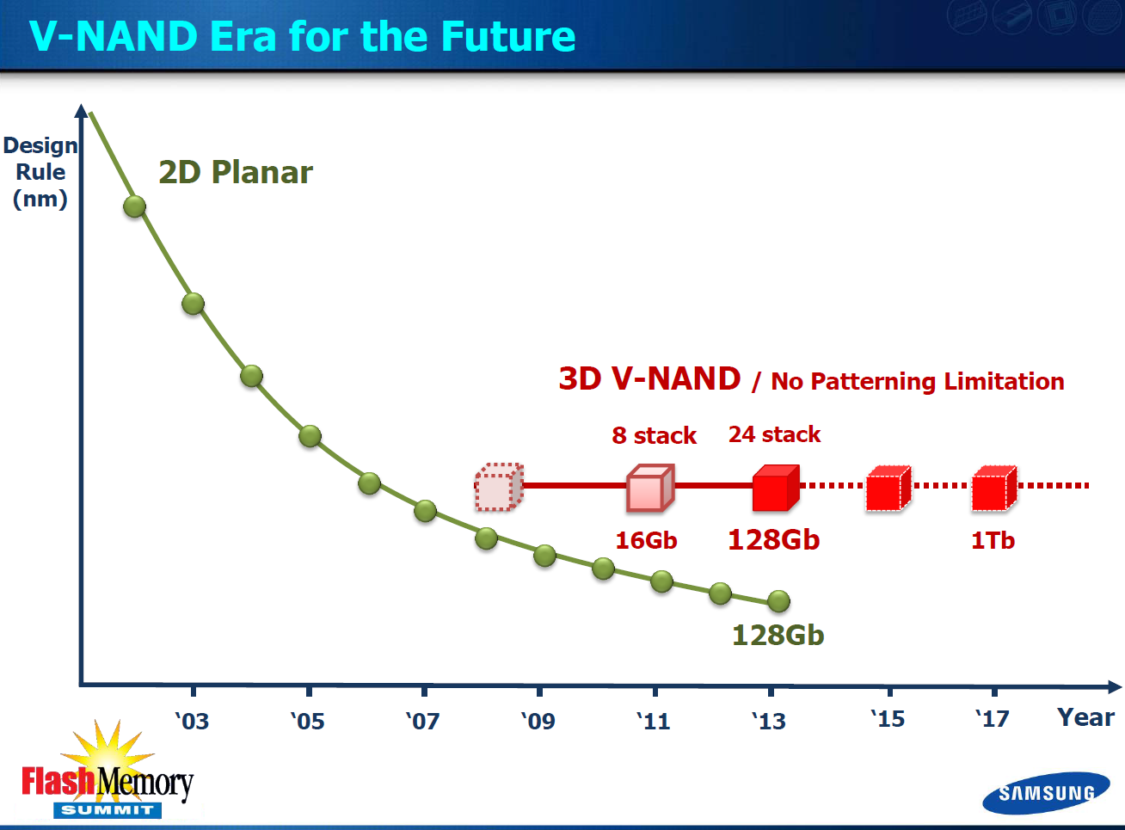

Slide 13
Two Types of 3D Technology
3D-TSV
Transistors made on separate wafers @ high temp., then thin + align + bond
Monolithic 3D
Transistors made monolithically atop wiring (@ sub-400ºC for logic)
10um-
50um
100 nm
TSV pitch > 1um*
TSV pitch ~ 50-100nm
* [Reference: P. Franzon: Tutorial at IEEE 3D-IC Conference 2011]
13
Notes:
13

Slide 14
MONOLITHIC
10,000x the Vertical Connectivity of TSV
 | TSV | Monolithic
Layer Thickness | ∼50μ | ~50nm
Via Diameter | ~5μ | ~50nm
Via Pitch | ~10μ | ~100nm
Wafer (Die) to Wafer Alignment | ~1μ | ~1nm
MonolithIC 3D™ Inc. Patents Pending
14

Slide 15
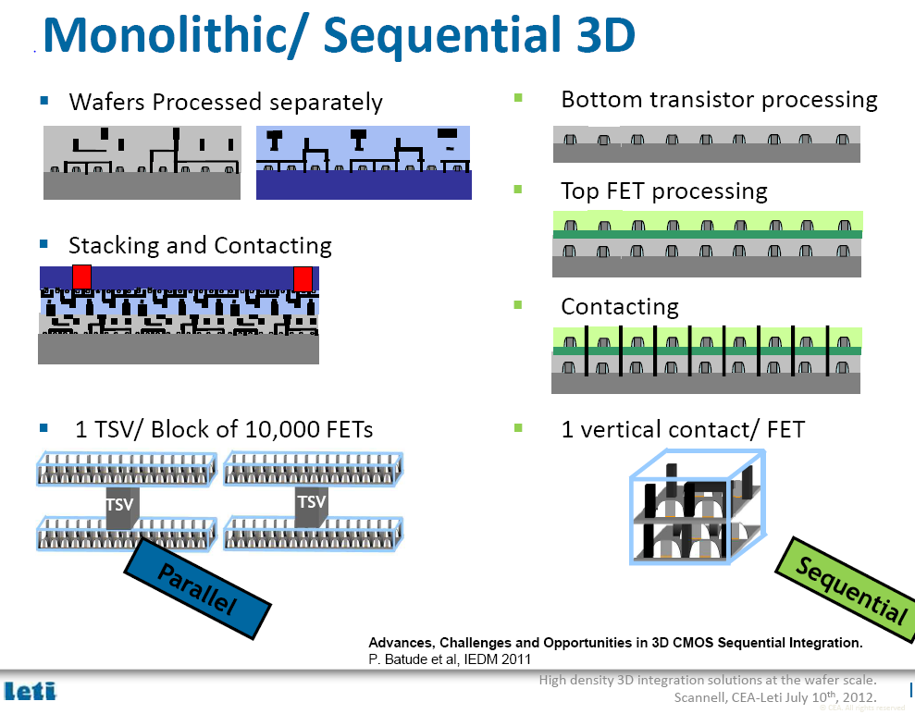

Slide 16
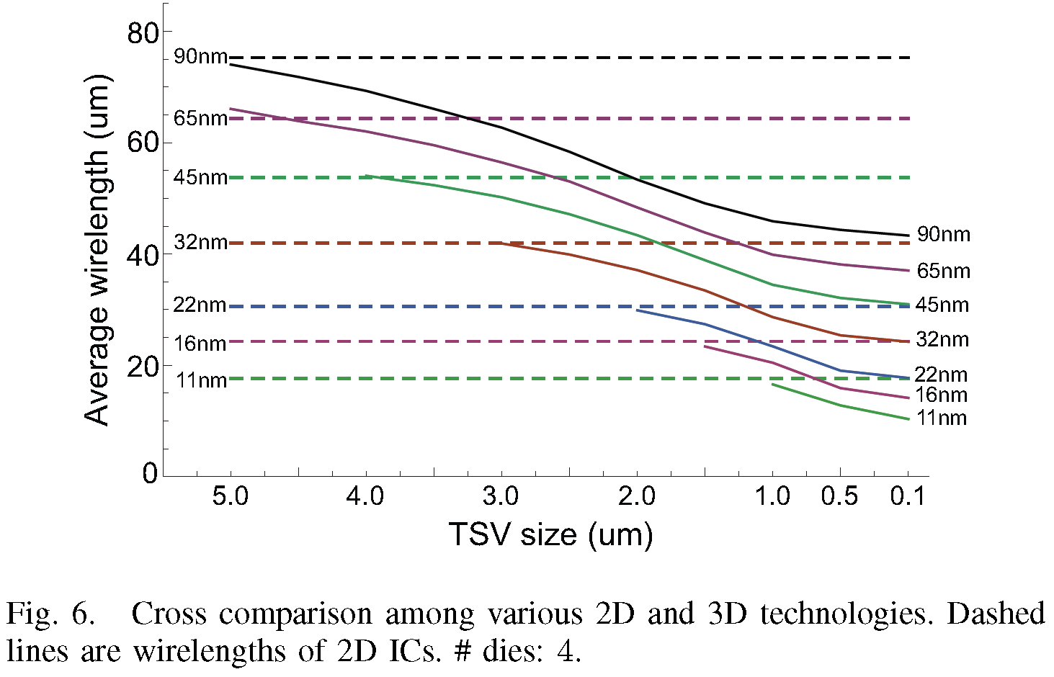
Only Monolithic 3D (TSV size ~0.1 µm) would Provide an Alternative to Dimensional Scaling
*IEEE IITC11 Kim

Slide 17
The Monolithic 3D Challenge
Why is it not already in wide use?
Processing on top of copper interconnects should not exceed 400ºC
    How to bring mono-crystallized silicon on top at less than 400ºC
    How to fabricate advanced transistors below 400ºC
Misalignment of pre-processed wafer to wafer bonding step is ~1um
    How to achieve 100nm or better connection pitch
    How to fabricate thin enough layer for inter-layer vias of ~50nm
17

Slide 18
MonolithIC 3D – Breakthrough
3 Classes of Solutions (3 Generations of Innovation)
RCAT (2009) – Process the high temperature on generic structures prior to ‘smart-cut’, and finish with cold processes – Etch & Depositions
Gate Replacement (2010) (=Gate Last, HKMG) - Process the high temperature on repeating structures prior to ‘smart-cut’, and finish with ‘gate replacement’, cold processes – Etch & Depositions
Laser Annealing (2012) – Use short laser pulse to locally heat and anneal the top layer while protecting the interconnection layers below from the top heat

Slide 19

Layer Transfer (“Ion-Cut”/“Smart-Cut”)
→ The Technology Behind SOI
Cleave using 400ºC
anneal or sideways
mechanical force. CMP.
Hydrogen implant
of top layer
Flip top layer and
bond to bottom layer
Oxide
p- Si
Top layer
Oxide
H
p- Si
H
p- Si
p- Si
Oxide
Oxide
Oxide
Oxide
Oxide
Bottom layer
Similar process (bulk-to-bulk) used for manufacturing all SOI wafers today

Slide 20
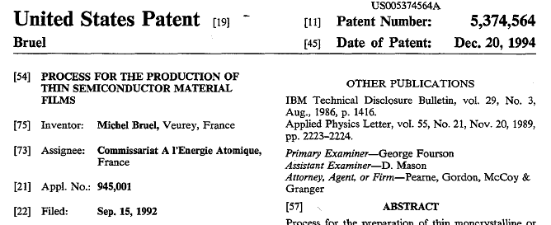
Ion-cut is Great, but will it be Affordable?
Until 2012: Single supplier → SOITEC. Owned basic patent on ion-cut
Our industry sources + calculations → $60 ion-cut cost per $1500-$5000 wafer in a free market scenario (ion cut = implant, bond, anneal).
Free market scenario now
SiGen and Twin Creeks Technologies using ion-cut for solar
Contents:
Hydrogen implant
Cleave with anneal
SOITEC basic patent expired Sep 2012

Slide 21
MonolithIC 3D - 3 Classes of Solutions
RCAT – Process the high temperature on generic structures prior to ‘smart-cut’, and finish with cold processes – Etch & Depositions
Gate Replacement (=Gate Last, HKMG) - Process the high temperature on repeating structures prior to ‘smart-cut’, and finish with ‘gate replacement’, cold processes – Etch & Depositions
Laser Annealing – Use short laser pulse to locally heat and anneal the top layer while protecting the interconnection layers below from the top heat

Slide 22

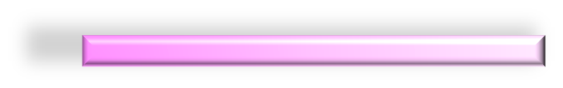

Donor Layer Processing
Step 1 - Implant and activate unpatterned N+ and P- layer regions in standard donor wafer at high temp. (~900ºC) before layer transfer. Oxidize (or CVD oxide) top surface.
SiO₂ Oxide layer (~100nm) for oxide -to-oxide bonding with device wafer.
P-
N+
P-
Step 2 - Implant H+ to form cleave plane for the ion cut
P-
H+ Implant Cleave Line in N+ or below
N+
P-
MonolithIC 3D™ Inc. Patents Pending
22
Notes:
22
22

Slide 23
Bond and Cleave: Flip Donor Wafer and Bond to Processed Device Wafer
Cleave along
H+ implant line using 400ºC anneal or sideways mechanical force.
Polish with CMP.
-
Silicon
N+
<200nm)
P-
SiO₂ bond layers on base and donor wafers (alignment not an issue with blanket wafers)
Processed Base IC
MonolithIC 3D™ Inc. Patents Pending
23
Notes:
23
23

Slide 24
Etch and Form Isolation and RCAT Gate
Litho patterning with features aligned to bottom layer
Etch shallow trench isolation (STI) and gate structures
Deposit SiO₂ in STI
Grow gate with ALD, etc. at low temp
(<350º C oxide or high-K metal gate)
Gate
Oxide
Isolation
Gate
+N
Ox
Ox
Advantage: Thinned donor wafer is transparent to litho, enabling direct alignment to device wafer alignment marks: no indirect alignment. (common for TSV 3DIC)
P-
Processed Base IC
MonolithIC 3D™ Inc. Patents Pending
24
Notes:
24
24

Slide 25

Etch Contacts/Vias to Contact the RCAT
Complete transistors, interconnect wires on ‘donor’ wafer layers
Etch and fill connecting contacts and vias from top layer aligned to bottom layer
‘normal’ via
+N
P-
Processed Base IC
Processed Base IC
MonolithIC 3D™ Inc. Patents Pending
25
Notes:
25
25

Slide 26
MonolithIC 3D - 3 Classes of Solutions
RCAT – Process the high temperature on generic structures prior to ‘smart-cut’, and finish with cold processes – Etch & Depositions
Gate Replacement (=Gate Last, HKMG) - Process the high temperature on repeating structures prior to ‘smart-cut’, and finish with ‘gate replacement’, cold processes – Etch & Depositions
Laser Annealing – Use short laser pulse to locally heat and anneal the top layer while protecting the interconnection layers below from the top heat

Slide 27
Fabricate Standard Dummy Gates with Oxide and Poly-Si; >900ºC, on Donor Wafer
NMOS
Poly
Oxide
PMOS
~700µm Donor Wafer
Silicon
MonolithIC 3D Inc. Patents Pending
27

Slide 28
Implant Hydrogen for Cleave Plane
NMOS
PMOS
H+
~700µm Donor Wafer
Silicon
MonolithIC 3D Inc. Patents Pending
28

Slide 29
Bond Donor Wafer to Carrier Wafer
~700µm Carrier Wafer
H+
~700µm Donor Wafer
Silicon
MonolithIC 3D Inc. Patents Pending
29

Slide 30
Deposit Oxide, ox-ox Bond Carrier to Base Wafer
~700µm
Carrier Wafer
Transferred
Donor Layer
STI
Oxide-oxide bond
Base Wafer
NMOS
PMOS
MonolithIC 3D Inc. Patents Pending
30

Slide 31
Remove Carrier Wafer
Transferred
Donor Layer
Oxide-oxide bond
Base Wafer
NMOS
PMOS
MonolithIC 3D Inc. Patents Pending
31

Slide 32
Replace Dummy Gate with Hafnium Oxide & HK Metal Gate (at low temp.)
Note: Replacing oxide and gate result in oxide and gate that were not damaged by the H+ implant
Transferred
Donor Layer
Oxide-oxide bond
Base Wafer
NMOS
PMOS
MonolithIC 3D Inc. Patents Pending
MonolithIC 3D™ Inc. Patents Pending
32

Slide 33
Add Interconnect
ILV
Transferred
Donor Layer
Oxide-oxide bond
Base Wafer
NMOS
PMOS
MonolithIC 3D Inc. Patents Pending
MonolithIC 3D Inc. Patents Pending
33

Slide 34
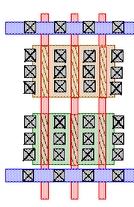
Novel Alignment Scheme using Repeating Layouts
Oxide
Landing pad
Through-layer connection
Bottom layer
layout
Top layer
layout
Even if misalignment occurs during bonding → repeating layouts allow correct connections.
Above representation simplistic (high area penalty).
MonolithIC 3D™ Inc. Patents Pending
34
Notes:
34
34

Slide 35
Smart Alignment Scheme
Oxide
Landing pad
Through-layer connection
Bottom layer
layout
Top layer
layout
MonolithIC 3D™ Inc. Patents Pending
35
Notes:
35
35

Slide 36
MonolithIC 3D - 3 Classes of Solutions
RCAT – Process the high temperature on generic structures prior to ‘smart-cut’, and finish with cold processes – Etch & Depositions
Gate Replacement (=Gate Last, HKMG) - Process the high temperature on repeating structures prior to ‘smart-cut’, and finish with ‘gate replacement’, cold processes – Etch & Depositions
Laser Annealing – Use short laser pulse to locally heat and anneal the top layer while protecting the interconnection layers below from the top heat (More info: Poster 7.12)

Slide 37
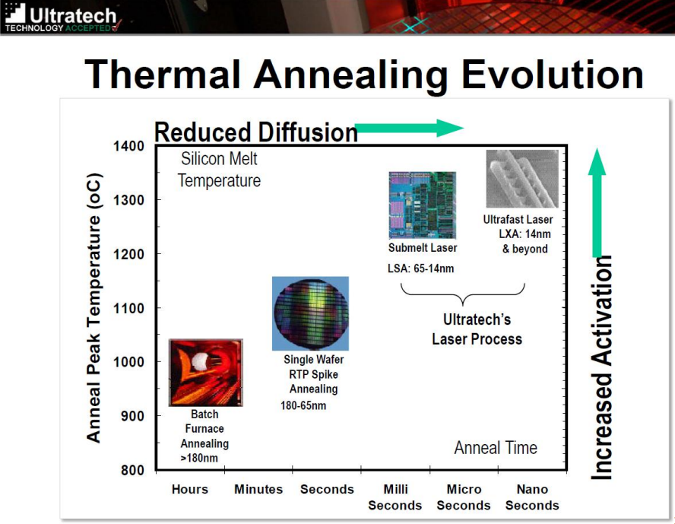
Annealing Trend with Scaling

Slide 38
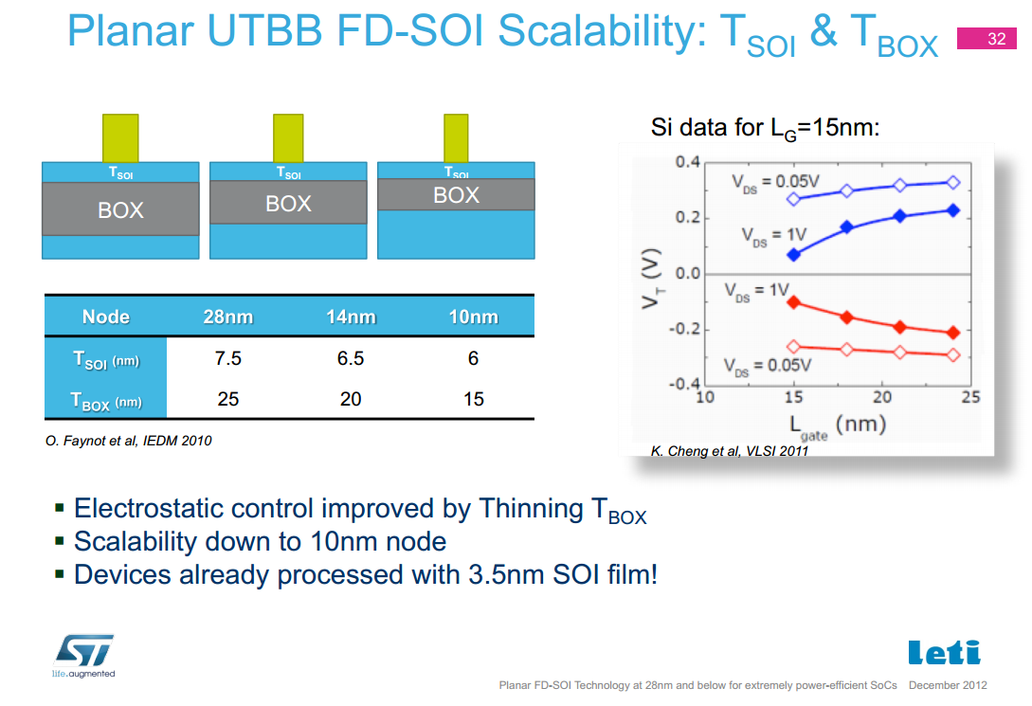

Slide 39
Two Major Semiconductor Trends help make Monolithic 3D Practical
39
As we have pushed dimensional scaling:
  The volume of the transistor has scaled
    Bulk µm-sized transistors FDSOI & FinFet nm transistors
  High temperature exposure times have trended lower
    Shallower & sharper junctions, tighter pitches, etc.
=> Much less to heat and for much shorter time

Slide 40
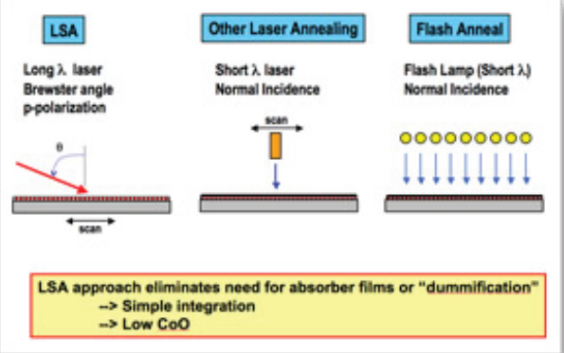
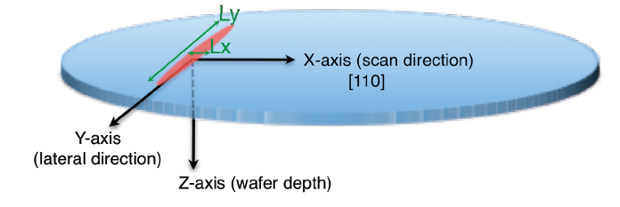
LSA 100A – Short Pulse, Small Spot
Dwell time ~ 275µs

Slide 41
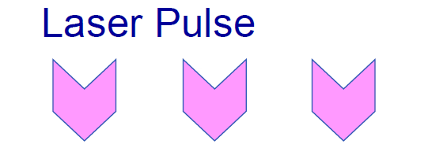
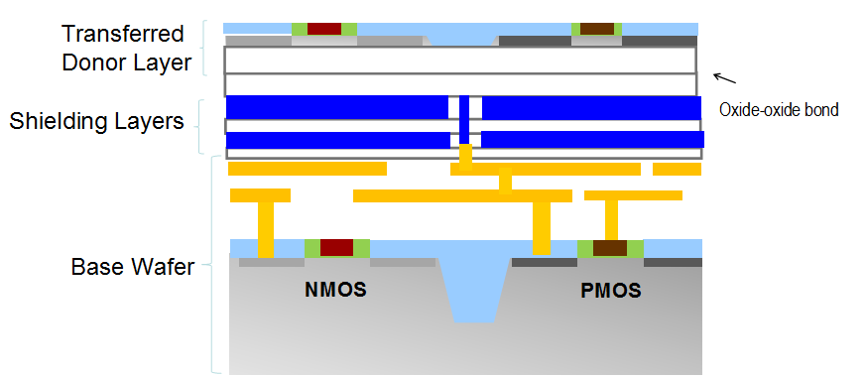
Activate/Anneal at High Temperature >1000°C)
without Heating the Bottom Layers (<400°C)
}
>1000°C
}
<400°C
MonolithIC 3D™ Inc. Patents Pending

Slide 42
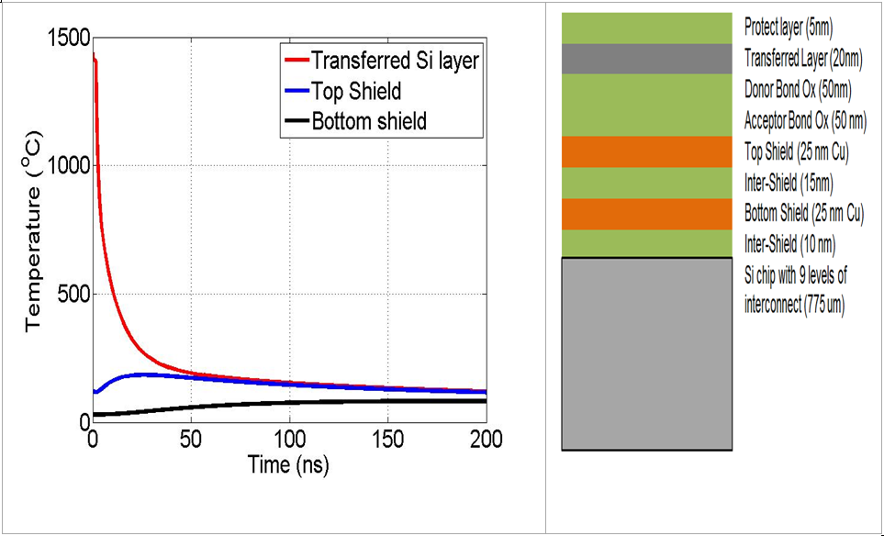
Process Window Set to Avoid Damage
Temperature variation at the 20 nm thick Si source/drain region in the upper active layer during laser annealing.
Note that the shield layers are very effective in preventing any large thermal excursions in the lower layers

Slide 43
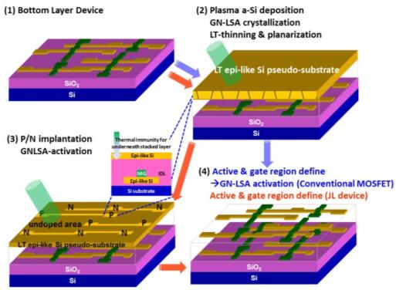
Dopant Activation by Laser: IEDM13 Example
Taiwan National Nano Device Laboratory: IEDM13-Paper #9.3
  ‘green’ laser: HIPPO 532QW Nd/YAG, 532nm wavelength, 13nS pulse width, 25cm/s scanning speed, and 2.7mmx60µm beam size
  “Researchers from Taiwan’s National Nano Device Laboratories avoided the use of TSVs by fabricating a monolithic sub-50-nm 3D chip, which integrates high-speed logic and nonvolatile and SRAM memories... The monolithic 3D architecture demonstrated high performance – 3-ps logic circuits, 1-T 500ns nonvolatile memories and 6T SRAMs with low noise and small footprints”
43

Slide 44
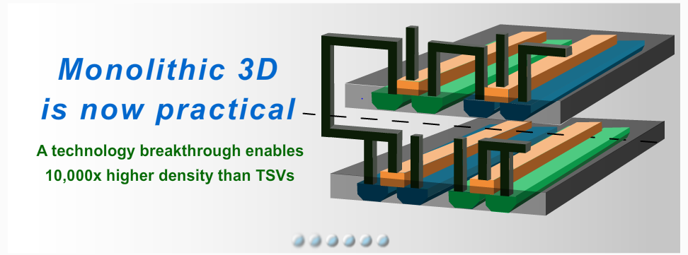
Enabling Technology for the Semiconductor Industry

Slide 45
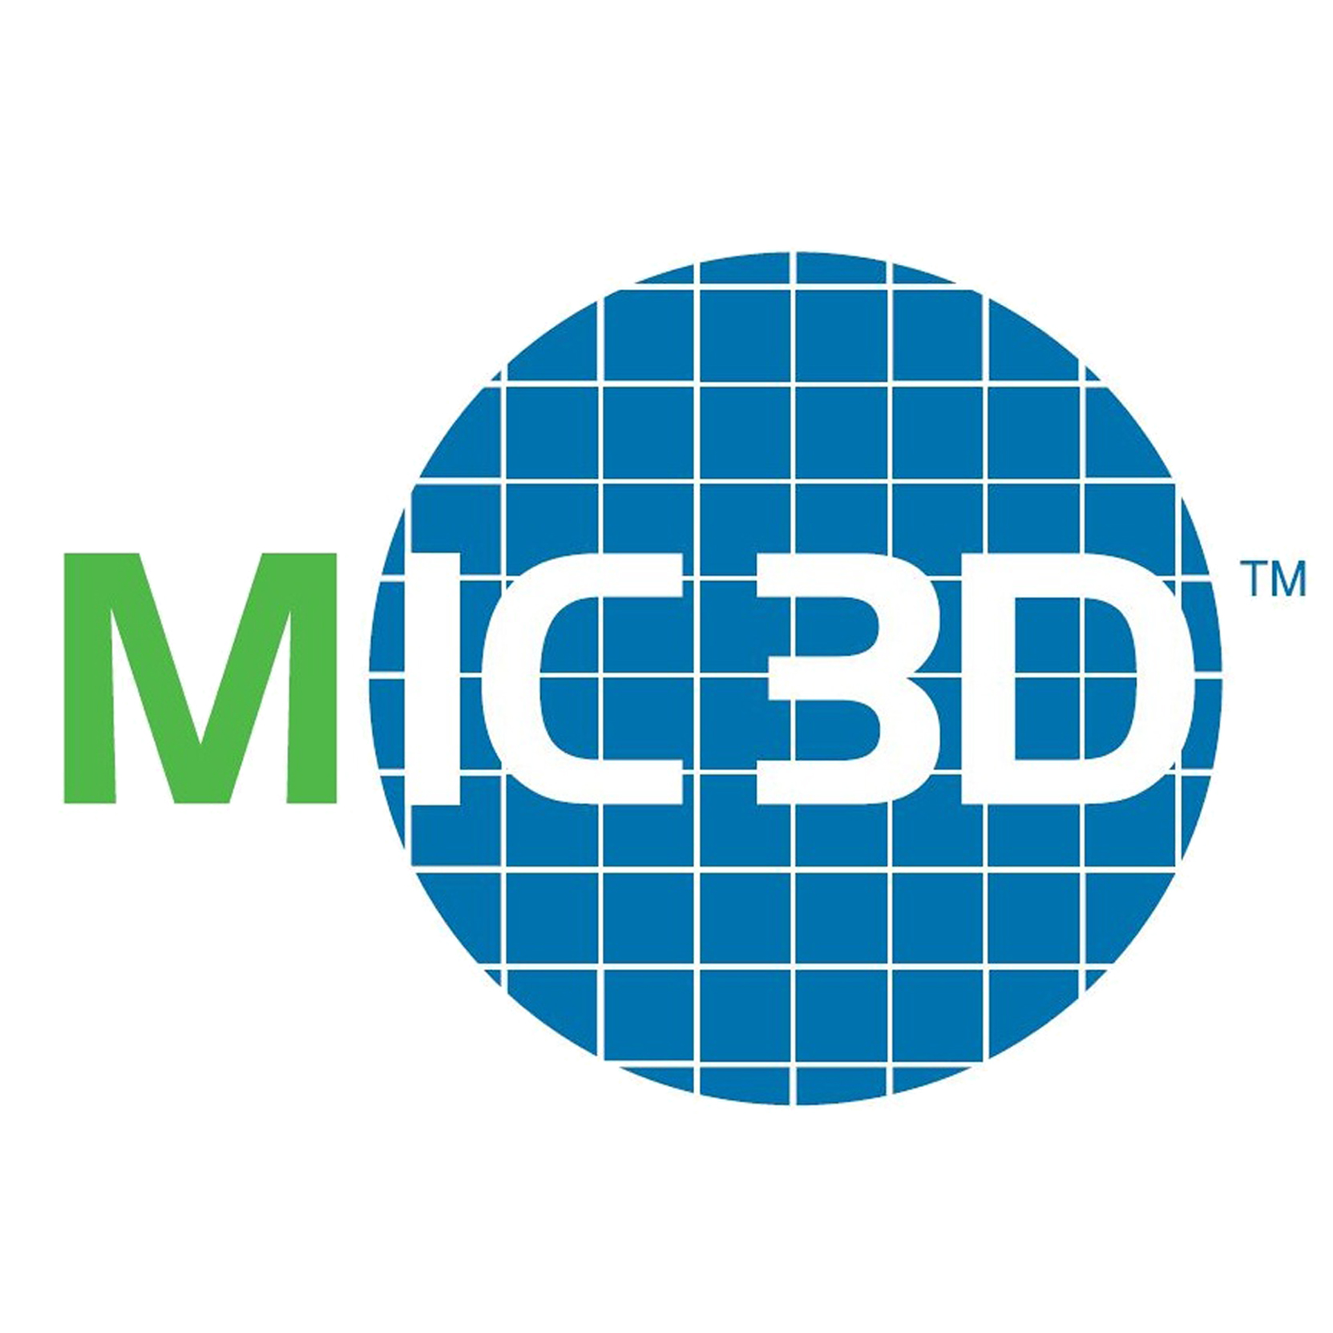
Monolithic 3D Provides an
Attractive Path to…
LOGIC
MEMORY
OPTO-ELECTRONICS
Monolithic 3D Integration with Ion-Cut Technology
3D-CMOS: Monolithic 3D Logic Technology
3D-FPGA: Monolithic 3D Programmable Logic
3D-GateArray: Monolithic 3D Gate Array
3D-Repair: Yield recovery for high-density chips
3D-DRAM: Monolithic 3D DRAM
3D-RRAM: Monolithic 3D RRAM
3D-Flash: Monolithic 3D Flash Memory
3D-Imagers: Monolithic 3D Image Sensor
3D-MicroDisplay: Monolithic 3D Display
3D-LED: Monolithic 3D LED
Can be applied to many market segments

Slide 46
The Monolithic 3D Advantage
  II. Reduction die size and power – doubling transistor count - Extending Moore’s law
  Monolithic 3D is far more than just an alternative to 0.7x scaling !!!
  III. Significant advantages from using the same fab, design tools
  IV. Heterogeneous Integration
  V. Multiple layers Processed Simultaneously - Huge cost reduction (Nx)
  VI. Logic redundancy => 100x integration made possible
  VII. Enables Modular Design
  VIII. Naturally upper layers are SOI
  IX. Local Interconnect above and below transistor layer
  X. Re-Buffering global interconnect by upper strata
  XI. Others
  A. Image sensor with pixel electronics
  B. Micro-display

Slide 47
Reduction of Die Size & Power – Doubling Transistor Count Extending Moore’s law
Reduction of Die Size & Power
IntSim v2.0 free open source >600 downloads

Slide 48
IV. Heterogeneous Integration
Logic, Memories, I/O on different strata
  Optimized process and transistors for the function
  Optimizes the number of metal layers
  Optimizes the litho. (spacers, older node)
Low power, high speed (sequential, combinatorial)
Different crystals – E/O

Slide 49
V. Multiple Layers Processed Simultaneously - Huge Cost Reduction (Nx) –”BICS”
Multiple thin layers can be process simultaneously, forming transistors on multiple layers
Cost reduction correlates with number of layers being simultaneously processed (2, 4, 8, 16, 32, 64, 128, ...)

Slide 50
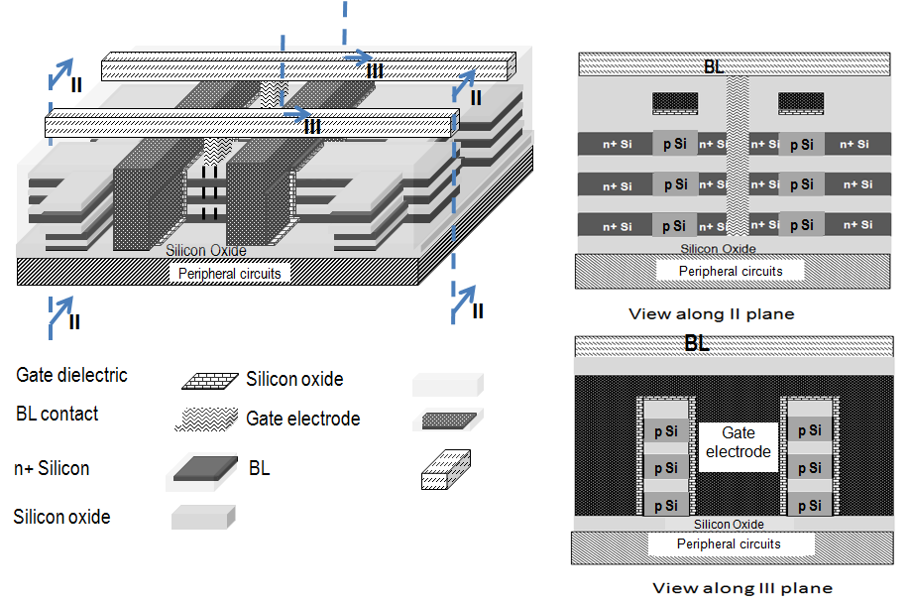
3D DRAM 3.3x Cost Advantage vs. 2D DRAM
 | Conventional stacked capacitor DRAM | Monolithic 3D DRAM with 4 memory layers
Cell size | 6F² | Since non self-aligned, 7.2F²
Density | x | 3.3x
Number of litho steps | 26 (with 3 stacked cap. masks) | ~26 extra masks for memory layers, but no stacked cap. masks)
MonolithIC 3D™ Inc. Patents Pending

Slide 51
VI. Logic Redundancy => 100x Integration Made Possible
It is well known the more we can integrate on one chip with reasonable yield, the better the cost & performance – Moore’s Law
Yield is the dominating criterion when to use PCB rather than on-chip integration

Slide 52
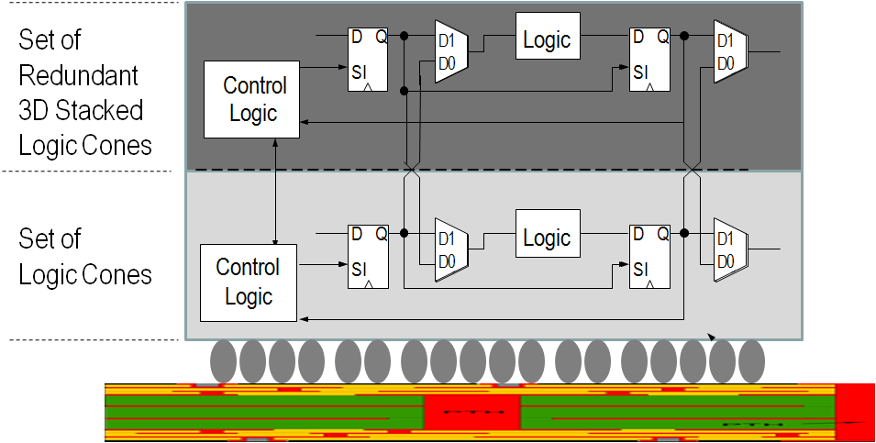
Innovation Enabling ‘Wafer Scale Integration’
– 99.99% Yield with 3D Redundancy
Gene Amdahl -“Wafer scale integration will only work with 99.99% yield, which won’t happen for 100 years” (Source: Wikipedia)
Swap at logic cone granularity
Negligible design and power penalty
Redundant 1μ above, no performance penalty
Server-Farm in a Box
Watson in a Smart Phone
…
MonolithIC 3D™ Inc. Patents Pending

Slide 53
VII. Enables Modular Design
Platform-based design could evolve to:
  Few layers of generic functions like compute, radios, and one layer of custom design
  Few layers of logic and memories and one layer of FPGA
  ...

Slide 54
VIII. Naturally Upper Layers are SOI
SOI wafers provides many benefits with one major drawback: cost of the blank wafer.
In monolithic 3D – all the upper strata are naturally SOI

Slide 55
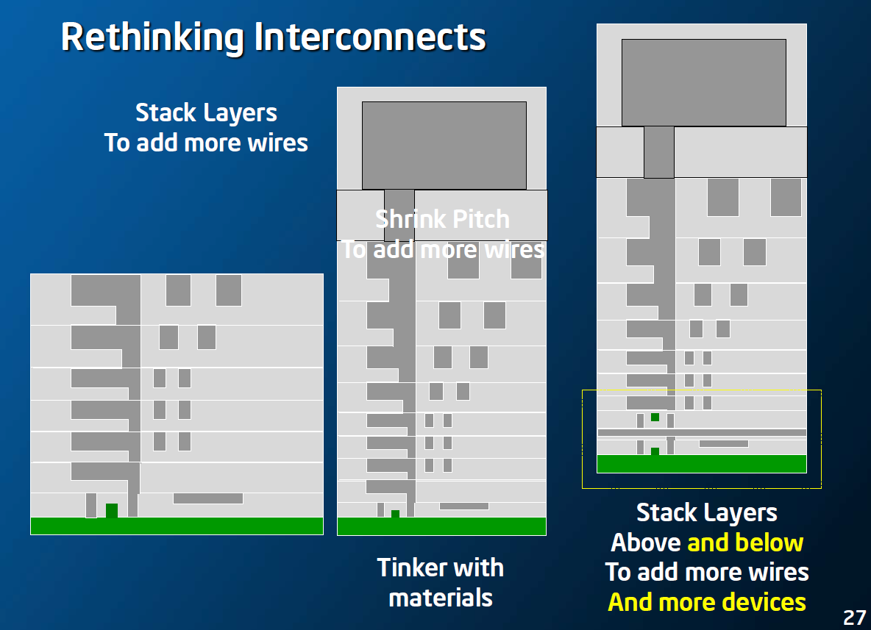
IX. Local Interconnect - Above and Below Transistor Layer
Intel March, 2013
Increased complexity requires increased connectivity. Adding more metal layer increases the challenge of connecting upper layers to the transistor layer below.

Slide 56
X. Re-Buffering Global Interconnect by Upper Strata
Global interconnect is done at the upper and thicker metal layers. It would increase efficiency if these layers could re-buffer instead of connecting to base layer using multiple vias and blocking multiple metal tracks.
  Use the layers above for re-buffering.

Slide 58
XI. Others
A. Image Sensor with Pixel Electronics
With rich vertical connectivity, every pixel of an image sensor could have its own pixel electronics underneath
MonolithIC 3D™ Inc. Patents Pending

Slide 59
XI. Others
B. Micro-display
MonolithIC 3D™ Inc. Patents Pending
Use of three crystal layers to form RGB LED arrays with drive electronics underneath

