Slide 1

Monolithic 3D-ICs
with Single Crystal Silicon Layers
Deepak C. Sekar and Zvi Or-Bach
MonolithIC 3D Inc.
2012 IEEE 3D System Integration Conference

Slide 2

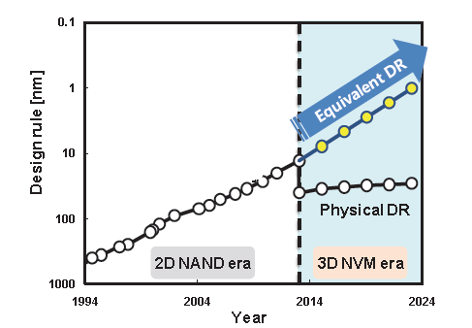
Flash Industry Aggressively Moving Towards
Monolithic 3D Technology
Samsung NAND Flash Roadmap
J. Choi, et al., VLSI 2011
3D NAND may be pulled in to 2013-2014
By David Lammers, July 2011
The advent of 3D NAND memories may be only two or three years away, speakers said at Semicon West in San Francisco. By 2013 the major memory companies developing 3D NAND, including Hynix, Samsung, and Toshiba, may be ready with pilot lines, moving to volume production a year or so later...
0.1
1
10
100
1000
Design Rule (nm)
2004 2014 2024
Year
Multiple layers of polysilicon transistors

Slide 3

This Presentation
Background (and Reasons for Flash Interest in Monolithic 3D)
Single-Crystal Silicon Monolithic 3D Technology for:
- Memory
- Logic
Risks and Challenges
Conclusions

Slide 4
Background
(and Reasons for NAND Flash Move Towards Monolithic 3D)

Slide 5
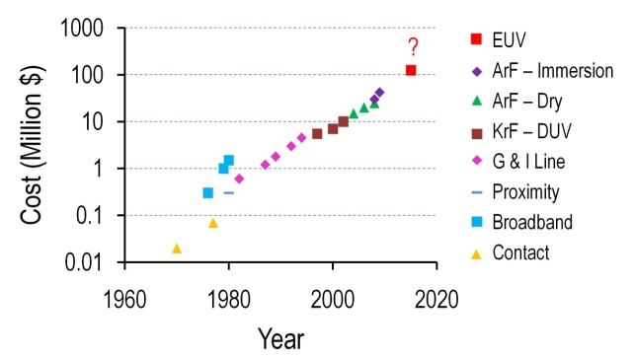
Challenge 1: Lithography
NAND Flash: Quad-patterning next year → costly. EUV delayed, costly.
Can we get benefits of scaling without relying on lithography?

Slide 6
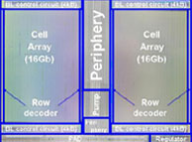
Challenge 2: Interconnect
32nm NAND flash chip
Technology Node | Delay of 1mm wire
90nm | 5x10²ps
45nm | 2x10³ ps
22nm | 1x10⁴ ps
12nm | 6x10⁴ ps
10mm
2.5x every generation
NAND flash memory → 10mm minimum size wires. Wire RC challenge
Can we move to next-generation technology that improves wires?

Slide 7
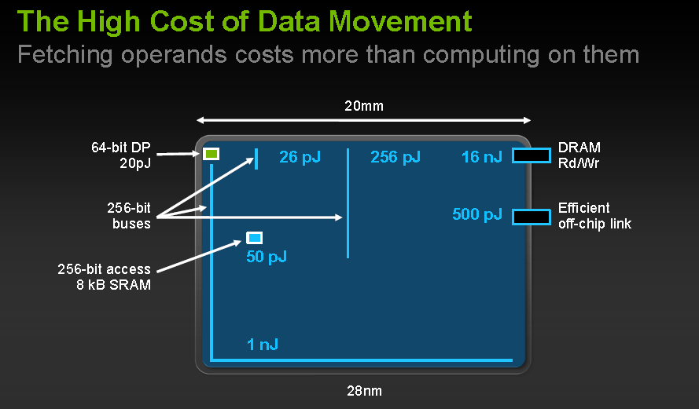
Challenge 2: Interconnect (contd.)
Source: W. J. Dally, Keynote at Supercomputing 2010
At the 28nm node, in nVIDIA’s logic chips,
Floating Point Operation = 20pJ, Integer Operation = 1pJ.
But operands to/from register file = 26pJ, Caches: L1/L2/L3 = 50pJ/256pJ/1nJ, DRAM = 16nJ

Slide 8
Challenge 3:
Transistor Quality
With scaling,
Flash: Transistors get much worse, Logic: Major transistor changes
Variability an issue
Can we move to next-generation technology that doesn’t degrade transistors?

Slide 9
How to get stacked single crystal silicon layers

Slide 10

Ion-cut (a.k.a Smart-CutTM)
→ Can give stacked defect-free single crystal Si layers atop Cu/low k
Hydrogen implant
of top layer
Flip top layer and
bond to bottom layer
Cleave using 400ºC
anneal or sideways
mechanical force. CMP CMP.
Oxide
Activated n Si
Oxide
H
Top layer
Activated n Si
Activated n Si
Activated n Si
H
Oxide
Oxide
Oxide
Bottom layer
Similar process used for manufacturing all SOI wafers today

Slide 11
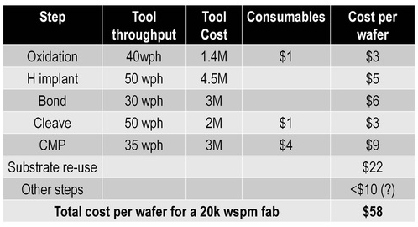
Cost of Ownership Analysis for Ion-Cut
Could be affordable for memory if free market scenario exists
SiGen and Twin Creeks Technologies using for cost-sensitive solar market

Slide 12
Monolithic 3D NAND Flash Memory
USP: Single-crystal silicon vs. poly Si for rest of industry

Slide 13
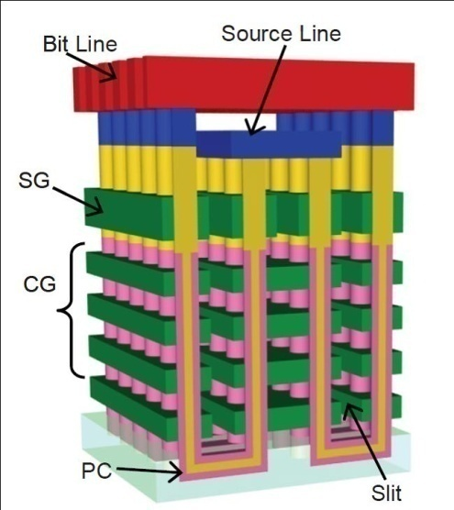
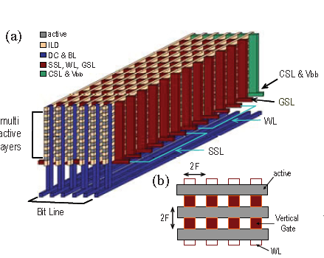
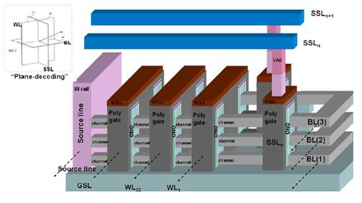
3D NAND flash approaches are poly Si based today…
Toshiba BiCS
Vertical, poly Si
Samsung VG-NAND
Horizontal, poly Si
Macronix junction-free-NAND
Horizontal, poly Si
Poly Si → low mobility, high variation, large sub-threshold slope → 2 bits/cell hard

Slide 14
Our Single-Crystal Silicon Memory Cell
CG
n+
ONO layer 1
ONO layer 2
n+
n+
SiO₂
CG
Double gate single-crystal Si cell
Fully-depleted device
Two charge trap layers per cell

Slide 15
Process Flow: Step 1
Fabricate peripheral circuits followed by oxide layer
Silicon Oxide
Peripheral circuits

Slide 16
Process Flow: Step 2
Layer transfer single crystal silicon using ion-cut
Silicon Oxide
n+ Silicon
Silicon Oxide
Silicon Oxide
Peripheral circuits

Slide 17
Process Flow: Step 3
Form multiple Si layers
Silicon Oxide 06
Silicon Oxide 06
Silicon Oxide 06
Silicon Oxide
Silicon Oxide
n+ Silicon
Silicon Oxide
Silicon Oxide
Peripheral circuits

Slide 18
Process Flow: Step 4
Use common litho and etch step to define multiple layers
Silicon Oxide 06
Silicon Oxide 06
Silicon Oxide 06
Silicon Oxide 06
Silicon Oxide 06
Silicon Oxide 06
Silicon Oxide 06
Silicon Oxide 06
Silicon Oxide
Peripheral circuits
Symbols
Shared litho step
n+ Silicon
Silicon oxide

Slide 19
Process Flow: Step 5
Deposit gate dielectric, electrode, CMP, pattern and etch
NAND string
Select gates
Silicon Oxide 06
Silicon Oxide 06
Silicon Oxide 06
Silicon Oxide 06
Silicon Oxide 06
Silicon Oxide 06
Silicon Oxide 06
Silicon Oxide
Peripheral circuits
Symbols
Shared litho step
n+ Silicon
Gate electrode 3724
Silicon oxide
Gate dielectric

Slide 20
Process Flow: Step 6
Oxide, CMP, form bit-lines, cell source regions
Wiring for select gates
Silicon oxide
Silicon Oxide 06
Silicon Oxide 06
Silicon Oxide 06
Silicon Oxide 06
WL
Silicon Oxide 06
Silicon Oxide 06
Silicon Oxide 06
Three Bit-Lines (BL) of n+ Si
Silicon Oxide
Peripheral circuits
Cell source regions
Gate dielectric
Silicon oxide
n+ Silicon
Gate electrode

Slide 21
MonolithIC 3D Flash vs. Conventional NAND vs. BiCS
Estimates from 2010 VLSI Symposium short course on 3D Memory.
140 sq. mm die | Conventional NAND 22nm node | BiCS 32 layers @ 45nm node | MonolithIC 3D Flash 8 layers @ 22nm node
Density | 64Gbit (3 bits/cell) | 128Gbit (1 bit/cell) | 256Gbit (2 bits/cell)
Aspect ratio |  | 60:1 → hard to manufacture | 16:1
MonolithIC 3D Flash
4x improvement in density at similar number of litho steps
Manufacturable aspect ratios
Benefit due to shared litho steps, single crystal silicon

Slide 22
Monolithic 3D DRAM, Resistive Memories
Shared litho architectures enabled by c-Si stacking

Slide 23
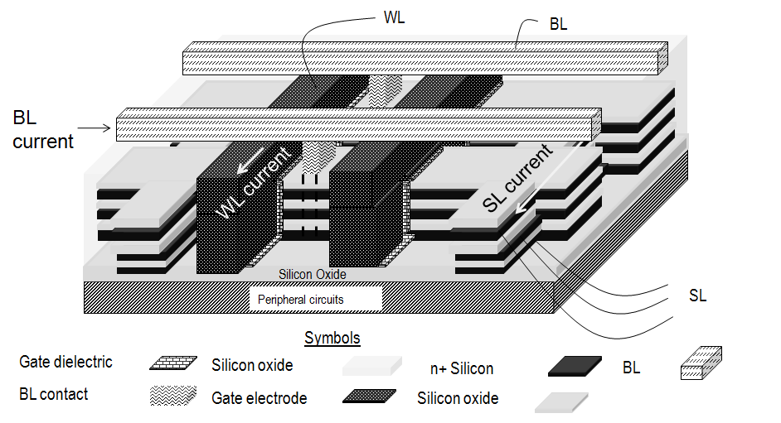
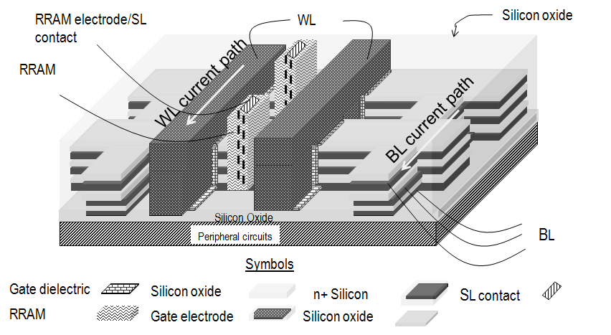
3D Shared Litho Architectures
Monolithic 3D DRAM
Monolithic 3D Resistive Memories
Floating body RAM → Without single crystal silicon, charge leakage
Resistive memories → Shared litho steps, monocrystalline transistor selectors

Slide 24
Monolithic 3D Logic
USP: Shorter wires. So, gates driving wires smaller.

Slide 25
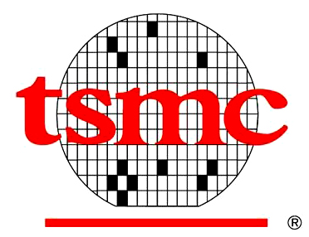
28nm CMOS Technology with TSVs
Symposium on VLSI Technology 2011
28nm
6um
Keep-Out
Zone
5um
Keep-Out
Zone
5um
TSV occupies 6um + 5um + 5um = 16um
On-chip Features = 28nm
Area Ratio = (16000nm/56nm)² ~ 100,000x
TSVs are fat!
Other companies offer similar large size TSVs
25

Slide 26
The Monolithic 3D Challenge
Needs Sub-400ºC Transistors for Cu/low k Compatibility
 | Sub-400ºC possible? | Method
Single Crystal Silicon | Yes | Ion-Cut
Shallow Trench Isolation | Yes | Radical Oxidation, HDP
High k/Metal Gate | Yes | ALD/CVD/PVD
Source-Drain Dopant activation | No | >750ºC anneal
Contacts | Yes | Nickel Silicide
Junction Activation: Key barrier

Slide 27
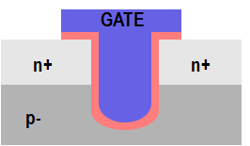
One path to solving the dopant activation problem:
Recessed Channel Transistors with Activation before Layer Transfer
Idea 1: Activate dopants before layer transfer
Layer transfer of un-patterned film. No alignment issues.
Oxide
n+ Si
p
p Si
p
p- Si wafer
n+
H
n+
p- Si wafer
Idea 2: Recessed channel transistors @ sub-400ºC
Idea 3: Thin-film Si → perfect alignment. TSVs minimum feature size.
n+
n+
Minimum feature size TSVs
All steps after layer transfer to Cu/low k @ < 400ºC!
p
p

Slide 28
Recessed channel transistors used in manufacturing today
→ easier adoption
GATE
GATE
GATE
n+
n+
n+
n+
p
p
RCAT recessed channel transistor:
Used in DRAM production
@ 90nm, 60nm, 50nm nodes
Longer channel length → low leakage, at same footprint
V-groove recessed channel transistor: Used in the TFT industry today
J. Kim, et al. Samsung, VLSI 2003
ITRS

Slide 29
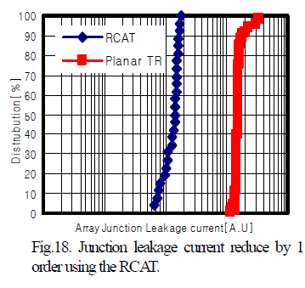
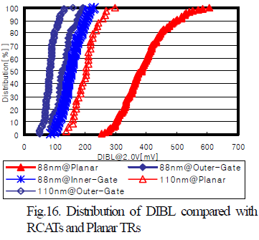
RCATs vs. Planar Transistors:
Experimental data from Samsung 88nm devices
From [J. Y. Kim, et al. (Samsung), VLSI Symposium, 2003]
RCATs → Less junction leakage
RCATs → Less DIBL i.e. short-channel effects

Slide 30
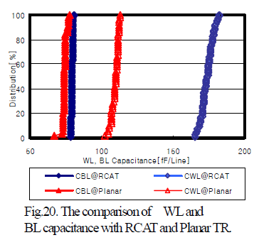
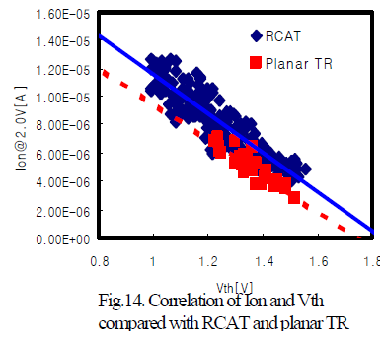
RCATs vs. Planar Transistors (contd.):
Experimental data from Samsung 88nm devices
From [J. Y. Kim, et al. (Samsung), VLSI Symposium, 2003]
RCATs → Similar drive current to standard MOSFETs
RCATs → Higher I/P capacitance

Slide 31
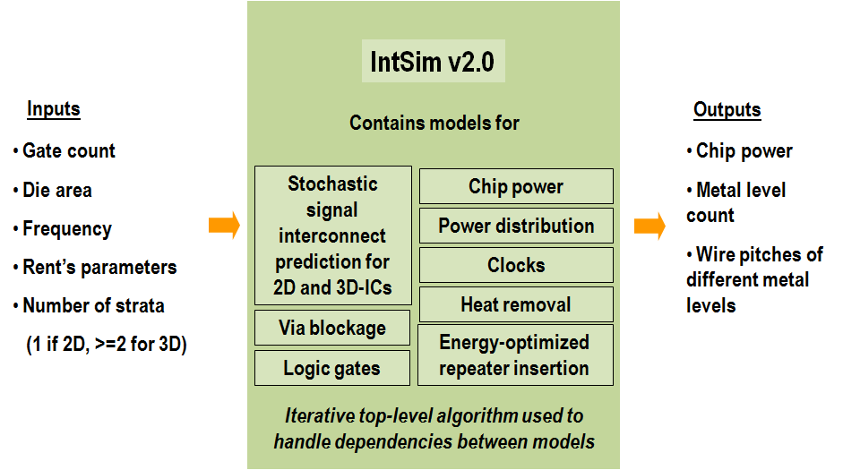
IntSim: The CAD tool used for our simulation study
[D. C. Sekar, J. D. Meindl, et al., ICCAD 2007]
Open-source tool, available for use at www.monolithic3d.com
IntSim v1.0: Built at Georgia Tech in Prof. James Meindl’s group
IntSim v2.0: Extended IntSim v1.0 to monolithic 3D using 3D wire length distribution models in the literature

Slide 32
IntSim-based analysis @ 22nm node
22nm node 600MHz logic core | 2D-IC | Fine-Grain 3D 2 Device Layers | Comments
Metal Levels | 10 | 10
Average Wire Length | 6um | 3.1um
Av. Gate Size | 6 W/L | 3 W/L | Since less wire cap. to drive
Optimal Die Size (active silicon area) | 50mm² | 24mm² | 3D-IC → Shorter wires → smaller gates → lower die area → wires even shorter 3D-IC footprint = 12mm²
Power | Logic = 0.21W | Logic = 0.1W | Due to smaller Gate Size
 | Reps. = 0.17W | Reps. = 0.04W | Due to shorter wires
 | Wires = 0.87W | Wires = 0.44W | Due to shorter wires
 | Clock = 0.33W | Clock = 0.19W | Due to less wire cap. to drive
 | Total = 1.6W | Total = 0.8W
3D with sub-50nm TSVs → 2x lower power, 2x lower active silicon area

Slide 33
Monolithic 3D is a major trend...
LOGIC
MEMORY
OPTO-ELECTRONICS
Monolithic 3D Integration with Ion-Cut Technology
3D-CMOS: Monolithic 3D Logic Technology
3D-FPGA: Monolithic 3D Programmable Logic
3D-Repair: Yield recovery for high-density chips
3D-DRAM: Monolithic 3D DRAM
3D-RRAM: Monolithic 3D RRAM
3D-Flash: Monolithic 3D Flash Memory
3D-Imagers: Monolithic 3D Image Sensor
3D-MicroDisplay: Monolithic 3D Display
3D-LED: Monolithic 3D LED
Can be applied to many market segments
MonolithIC 3D™ Inc. Patents Pending
33

Slide 34
Summary

Slide 35
To summarize..
Monolithic 3D attractive for logic, flash, DRAM and many other applications
Benefits:
Logic – Short wires, Smaller gates to drive wires. Less power and area
Memory – Shared litho steps, short wires
Risks:
Competing with 2D NAND roadmap, CAD Tools, transistor optimization, etc
Increasingly attractive due to lithography, interconnect trends

Slide 36
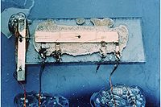

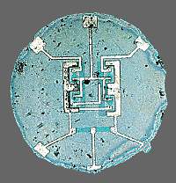
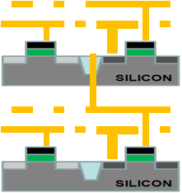
Will history repeat itself?
Will the monolithic idea become prevalent for 3D too?
(2D) INTEGRATED CIRCUIT
3D INTEGRATED CIRCUIT
Kilby version:
2D Interconnects not integrated, big sizes
3D-TSV:
3D Interconnects not integrated, big sizes
Noyce version (Monolithic 2D):
2D Interconnects integrated, small sizes
Monolithic 3D:
3D Interconnects integrated, small sizes

Slide 37
Acknowledgements
Brian Cronquist, Israel Beinglass, Ze’ev Wurman, Iulia Morariu,
Andrei Dalcu, Paul Lim, Parthiv Mohan – all with MonolithIC 3D Inc.

Slide 38
Thank you

Slide 39
Backup slides

Slide 40
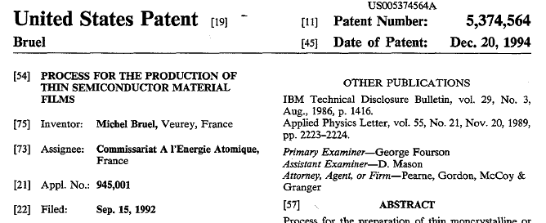
Ion-cut is great, but will it be affordable?
Aren’t ion-cut SOI wafers much costlier than bulk Si today?
Today: Single supplier → SOITEC. Owns basic patent on ion-cut.
Our industry sources + calculations → $60 ion-cut cost per $1500-$5000 wafer in a free market scenario (ion cut = implant, bond, anneal).
Free market scenario → After 2012 when SOITEC’s basic patent expires
SiGen and Twin Creeks Technologies using ion-cut for solar
Contents:
Hydrogen implant
Cleave with anneal
SOITEC basic patent expires 2012!!!

Slide 41
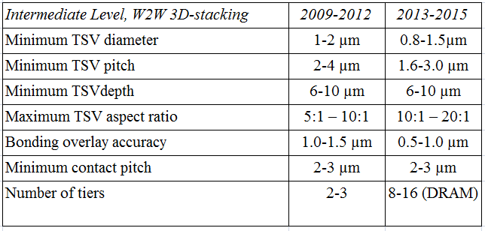
Industry Roadmap for 3D with TSV Technology
ITRS
2010
TSV size ~ 1um, on-chip wire size ~ 20nm → 50x diameter ratio, 2500x area ratio!!!
Cannot move many wires to the 3rd dimension
TSV: Good for stacking DRAM atop processors, but not as useful for on-chip wires

Slide 42
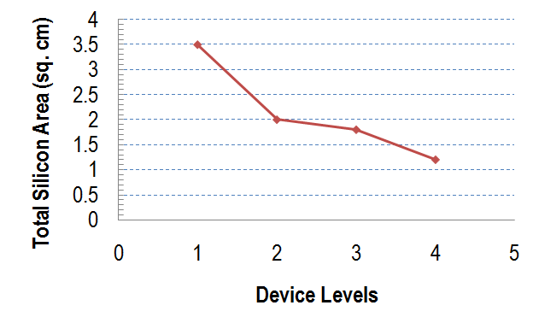
Benefits of Monolithic 3D for Logic
From J. Davis, J. Meindl, R. Reif, K. Saraswat, et al., Proceedings of the IEEE, 2001
Frequency = 450MHz, 180nm node, ASIC-like chip
Our own Rent’s rule-based analysis
@ the 22nm node
Frequency = 600MHz, 50% Logic 50% SRAM
 | 2D-IC @22nm | 2D-IC @ 15nm | 3D-IC 2 Device Layers @ 22nm
Power | 1.6W | 0.7W | 0.8W
Cost per die | 1 | 0.6 | 0.6
Shorter wires → Smaller gate drivers → Power and die size savings

Slide 43
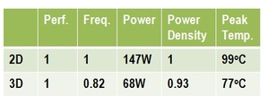

Studied by Intel and others:
Power savings of 3D could make heat removal achievable
Intel: Studied impact of building a Pentium 4 processor in 3D
Assumed fat TSVs that reduce wire lengths only in global metal levels → Global interconnects shorter in length → Can meet performance target at lower clock frequency → Lower power
Floorplanned blocks such that low power blocks on top of high power ones

Slide 44
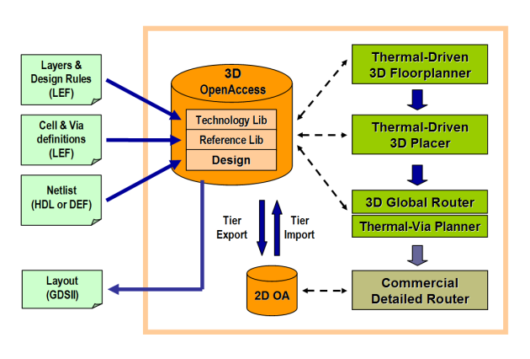
Thermal Aware CAD Tools
J. Cong, et al.
UCLA
Do floorplanning, place and route such that total wire length is minimized for a certain maximum temperature
Does not seem to impact performance much, but keeps temperature under control ☺

Slide 45
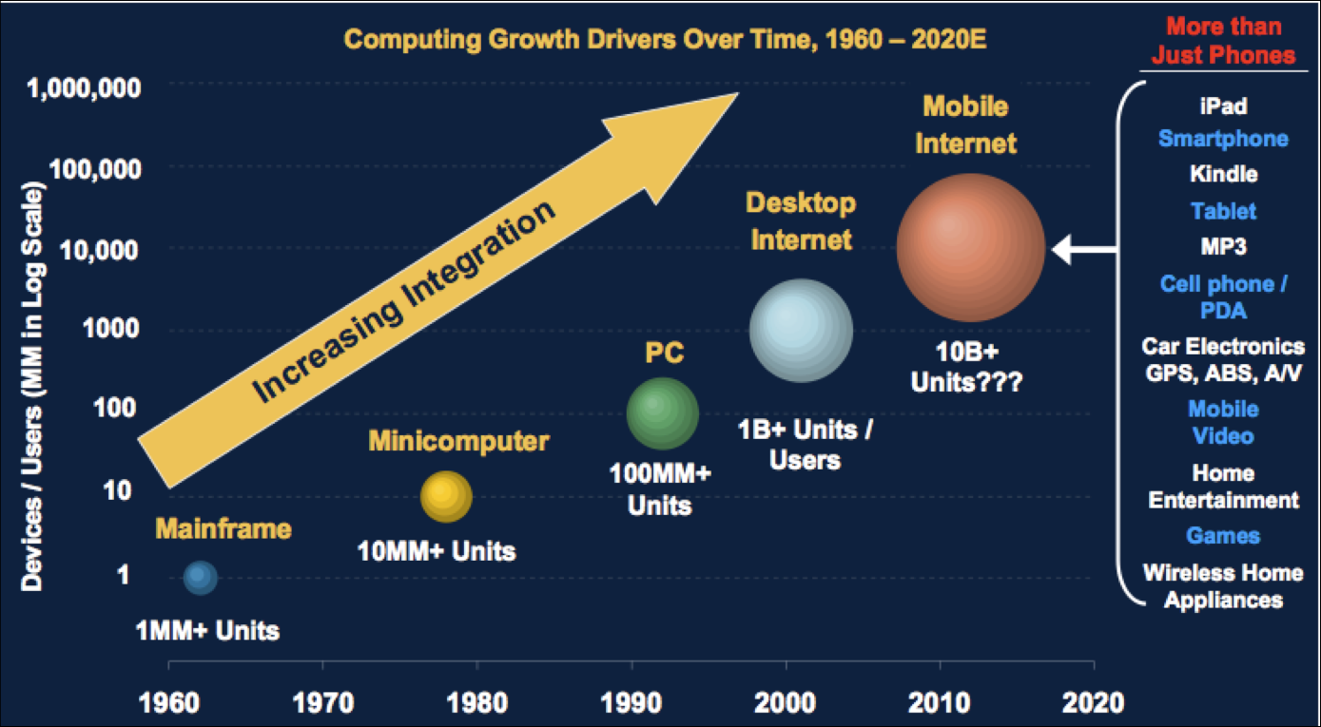
The Heat Removal Issue:
Low-Power Chips the Biggest Market for 3D

Slide 46

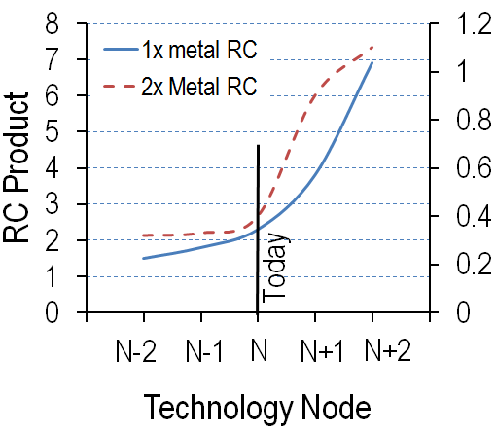
Challenge 2: Interconnect (contd.)
Wire RC trend in AMD chips
Sam Naffziger, AMD Corporate Fellow
“We are at the cusp of a dramatic increase in wire RC delays. Revolutionary solutions may be required.”
Source: S. Naffziger,
Keynote at the VLSI Symposium 2011

