Slide 1

The Monolithic 3D-IC
A Disruptor to the Semiconductor Industry

Slide 2
Interconnects Dominate with Scaling [Source: ITRS]
 | 90nm (2005) | 45nm (2010) | 22nm (2015) | 12nm (2020)
Transistor Delay | 1.6ps | 0.8ps | 0.4ps | 0.2ps
Delay of 1mm long Interconnect | 5x10²ps | 2x10³ ps | 1x10⁴ ps | 6x10⁴ ps
Ratio | 3x10² | 3x10³ | 4x10⁴ | 3x10⁵
Transistors keep improving
Surface scattering, grain boundary scattering and diffusion barrier degrade RC delay
Low k helps, but not enough to change trend
MonolithIC 3D™ Inc. Patents Pending
2

Slide 3
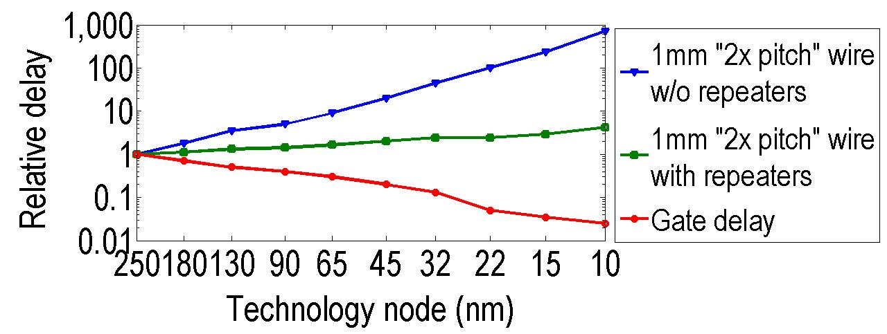
Interconnect delay a big issue with scaling
Source: ITRS
Transistors improve with scaling, interconnects do not
Even with repeaters, 1mm wire delay ~50x gate delay at 22nm node
MonolithIC 3D™ Inc. Patents Pending
3

Slide 4
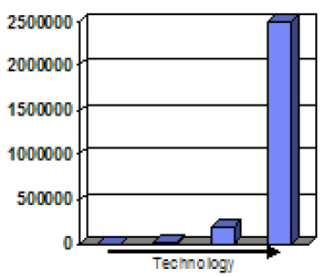
The repeater solution consumes power and area…
Source: IBM POWER processors
R. Puri, et al., SRC Interconnect Forum, 2006
Repeater count
130nm 90nm 65nm 45nm
Repeater count increases exponentially with scaling
At 45nm, repeaters >50% of total leakage power of chip [IBM].
Future chip power, area could be dominated by interconnect repeaters [IBM][P. Saxena, et al. (Intel), IEEE J. for CAD of Circuits, 2004]
MonolithIC 3D™ Inc. Patents Pending
4

Slide 5
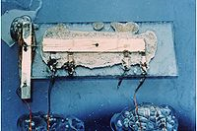
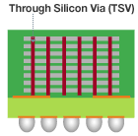
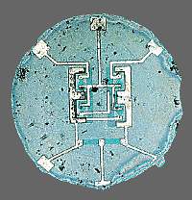
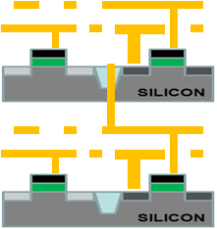
The Solution - 3D IC
1950s
Too many interconnects to manually solder → interconnect problem
Solution: The (2D) integrated circuit
Today
Interconnects dominate performance and power and diminish scaling advantages → interconnect problem
Solution: The 3D integrated circuit
Kilby version:
Connections not integrated
3D with TSV: TSV-3D IC
Connections not integrated
Noyce version (the monolithic idea):
Connections integrated
Monolithic 3D: Nu-3D IC
Connections integrated

Slide 6

Monolithic 10,000 x Vertical Connectivity vs. TSV
 | TSV | Monolithic
Layer Thickness | ~50μ | ~50nm
Via Diameter | ~5μ | ~50nm
Via Pitch | ~10μ | ~100nm
Wafer (Die) to Wafer Alignment | ~1μ | Alignment => Will keep scaling
TSV size typically ~5um:
Limited by alignment accuracy and silicon thickness
Processed Top Wafer
Align and bond
Processed Bottom Wafer

Slide 7
The Monolithic 3D Challenge
A process on top of copper interconnect should not exceed 400ºC
    How to bring mono-crystallized silicon on top at less than 400ºC
    How to fabricate advanced transistors below 400ºC
Misalignment of pre-processed wafer to wafer bonding step is ~1μ
    How to achieve 100nm or better connection pitch
    How to fabricate thin enough layer for inter-layer vias of ~50nm
MonolithIC 3D™ Inc. Patents Pending
7

Slide 8
Path 1 - RCAT
A process on top of copper interconnect should not exceed 400ºC
    How to bring mono-crystallized silicon on top at less than 400ºC
    How to fabricate advanced transistors below 400ºC
MonolithIC 3D™ Inc. Patents Pending
8

Slide 9

Steps 1&2: Donor Layer Processing
step 1 - Implant and activate unpatterned N+ and P- layer regions in standard donor wafer at high temp. (~900ºC) before layer transfer. Oxidize top surface (CVD)
SiO2 Oxide layer (~100nm) for oxide –to-oxide bonding with device wafer: planarize with CMP or plasma.
P
-
N+
P-
step 2 - Implant H+ to form cleave plane for the ion cut
P
-
N+
H+ Implant Cleave Line in N+ or below
P-
-
MonolithIC 3D™ Inc. Patents Pending
9
Notes:
9
9

Slide 10
step 3 - Bond and Cleave: Flip Donor Wafer and Bond to Processed Device Wafer
Cleave along
H+ implant line using 400ºC anneal or sideways mechanical force.
Polish with CMP.
-
Silicon
N+
<200nm)
SiO2 bond layers on base and donor wafers (alignment not an issue with blanket wafers)
P-
Processed Base IC
MonolithIC 3D™ Inc. Patents Pending
10
Notes:
10
10

Slide 11
step 4 - Etch and Form Isolation and RCAT Gate
Litho patterning with features aligned to bottom layer.
Etch shallow trench isolation (STI) and gate structures
Deposit SiO² in STI
Grow gate with ALD, etc. at low temp
(<350º C oxide or high-K metal gate)
Gate
Oxide
Isolation
Gate
+N
Ox
Ox
Advantage: Thinned donor wafer is transparent to litho, enabling direct alignment to device wafer alignment marks: no indirect alignment.
P-
Processed Base IC
MonolithIC 3D™ Inc. Patents Pending
11
Notes:
11
11

Slide 12

step 5 – Etch Contacts/Vias to Contact the RCAT
Complete transistors, interconnect wires on ‘donor’ wafer layers
Etch and fill connecting contacts and vias from top layer aligned to bottom layer
+N
P-
Processed Base IC
MonolithIC 3D™ Inc. Patents Pending
12
Notes:
12
12

Slide 13
Path 2 – Leveraging Gate Last + Innovative Alignment
Misalignment of pre-processed wafer to wafer bonding step is ~1μ
    How to achieve 100nm or better connection pitch
    How to fabricate thin enough layer for inter-layer vias of ~50nm
MonolithIC 3D™ Inc. Patents Pending
13

Slide 14
A Gate-Last Process for Cleave and Layer Transfer
NMOS
PMOS
Poly
Oxide
Donor wafer
Fully constructed transistors attached to each other; no blanket films.
proprietary methods align top layer atop bottom layer
Device wafer
Notes:
14

Slide 15
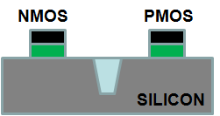
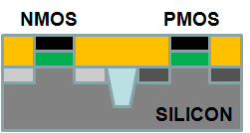
A Gate-Last Process for Cleave and Layer Transfer
Step 1 (std): On donor wafer, fabricate standard dummy gates with oxide, poly-Si
Poly
Oxide
Step 2 (std): Std Gate-Last
Self-aligned S/D implants
Self-aligned SiGe S/D
High-temp anneal
Salicide/contact etch stop
or faceted S/D
Deposit and polish ILD
S/D Implant
ILD
CMP to top of dummy gates
Notes:
15

Slide 16
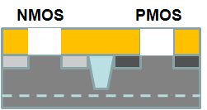
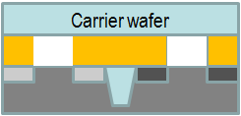
A Gate-Last Process for Cleave and Layer Transfer
Step 3.
Implant H for cleaving
H+ Implant Cleave Line
Step 4.
Bond to temporary carrier wafer
(adhesive or oxide-to-oxide)
Cleave along cut line
CMP to STI
Carrier
STI
CMP to STI
Notes:
16

Slide 17
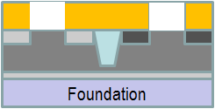
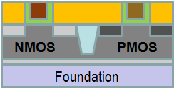
A Gate-Last Process for Cleave and Layer Transfer
Step 5.
Low-temp oxide deposition
Bond to bottom layer
Remove carrier
Carrier
Oxide-oxide bond
Remove (etch) dummy gates, replace with HKMG
Step 6. On transferred layer:
Etch dummy gates
Deposit gate dielectric and electrode
CMP
Etch tier-to-tier vias thru STI
Fabricate BEOL interconnect
Notes:
17

Slide 18
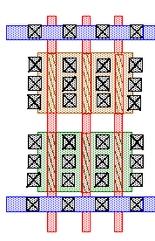
Novel Alignment Scheme using Repeating Layouts
Oxide
Landing pad
Through-layer connection
Bottom layer
layout
Top layer
layout
Even if misalignment occurs during bonding → repeating layouts allow correct connections.
Above representation simplistic (high area penalty).
Notes:
18

Slide 19
A More Sophisticated Alignment Scheme
Oxide
Landing pad
Through-layer connection
Bottom layer
layout
Top layer
layout
Notes:
19

Slide 20
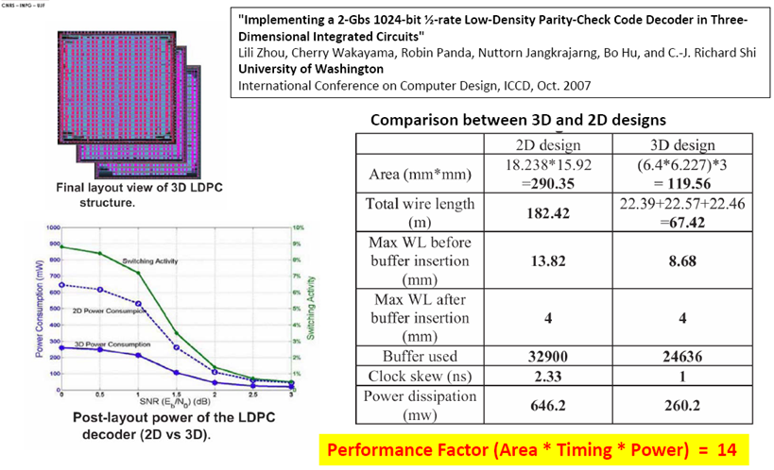
Technical Literature:
[L. Zhou, R. Shi, et al, Proc. ICCD 2007]
Did layout of 2D and 3D-ICs, and showed more than 10x benefit
MonolithIC 3D™ Inc. Patents Pending
20
Notes:
20
20

Slide 21
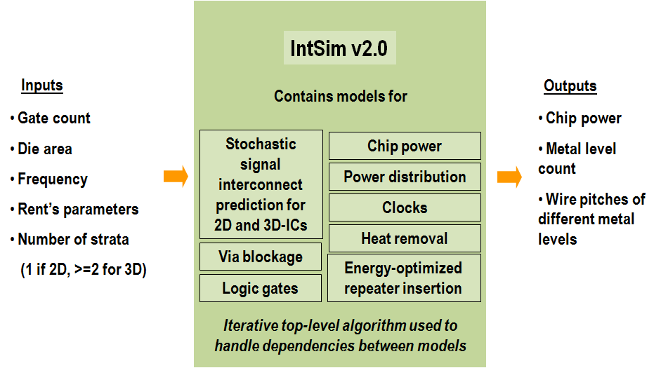
IntSim: The CAD tool used for our simulation study
[D. C. Sekar, J. D. Meindl, et al., ICCAD 2007]
Open-source tool, available for use at www.monolithic3d.com
IntSim v1.0: Built at Georgia Tech (by Deepak Sekar, now @ MonolithIC 3D)
IntSim v2.0: Extended IntSim v1.0 to monolithic 3D using 3D wire length models in the literature
MonolithIC 3D Inc. , Patents Pending
21

Slide 22
Compare 2D and 3D-IC versions of the same logic core with IntSim
22nm node 600MHz logic core | 2D-IC | 3D-IC 2 Device Layers | Comments
Metal Levels | 10 | 10
Average Wire Length | 6um | 3.1um
Av. Gate Size | 6 W/L | 3 W/L | Since less wire cap. to drive
Die Size (active silicon area) | 50mm² | 24mm² | 3D-IC → Shorter wires → smaller gates → lower die area → wires even shorter 3D-IC footprint = 12mm²
Power | Logic = 0.21W | Logic = 0.1W | Due to smaller Gate Size
 | Reps. = 0.17W | Reps. = 0.04W | Due to shorter wires
 | Wires = 0.87W | Wires = 0.44W | Due to shorter wires
 | Clock = 0.33W | Clock = 0.19W | Due to less wire cap. to drive
 | Total = 1.6W | Total = 0.8W
MonolithIC 3D™ Inc. Patents Pending
22

Slide 23
Scaling with 3D or conventional 0.7x scaling?
Analysis with IntSim v2.0 Same logic core scaled | 2D-IC @22nm | 2D-IC @ 15nm | 3D-IC 2 Layers @ 22nm
Frequency | 600MHz | 600MHz | 600MHz
Metal Levels | 10 | 12 | 10
Footprint | 50mm² | 25mm² | 12mm²
Total Silicon Area (a.k.a “Die size”) | 50mm² | 25mm² | 24mm²
Average Wire Length | 6um | 4.2um | 3.1um
Av. Gate Size | 6 W/L | 4 W/L | 3 W/L
Power | 1.6W | 0.7W | 0.8W
3D can give you similar benefits vis-à-vis a generation of scaling for a logic
Without the need for costly lithography upgrades!!!
Let’s understand this better…

Slide 24
To summarize,
600MHz Die with 50% logic , 50% SRAM | 2D-IC @22nm | 2D-IC @ 15nm | 3D-IC 2 Device Layers @ 22nm
Power | 1.6W | 0.7W | 0.8W
Cost per die | 1 | 0.6 | 0.6
Capital-expenditure for upgrade |  | $4B if all tools changed | H+ Implanter +Wafer bonder
Monolithic 3D scaling gives
Performance, power and cost benefits of feature-size scaling
But without the large cap-ex, litho risk and production ramp times
MonolithIC 3D Inc. Confidential, Patents Pending
24

Slide 25
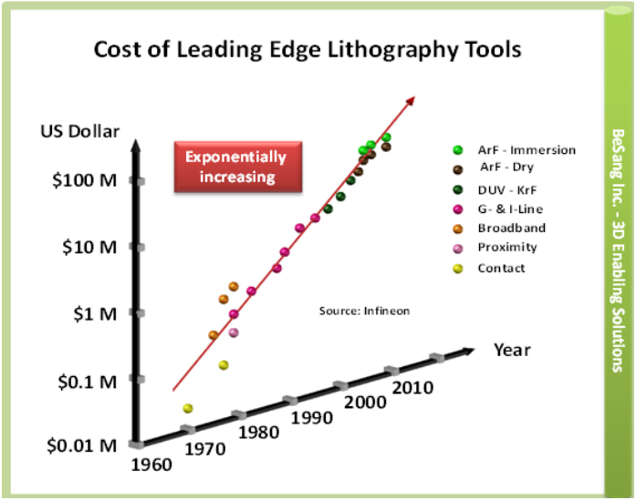
Escalating Cost of Litho to Dominate Fab and Device Cost
MonolithIC 3D™ Inc. Patents Pending
25

Slide 26
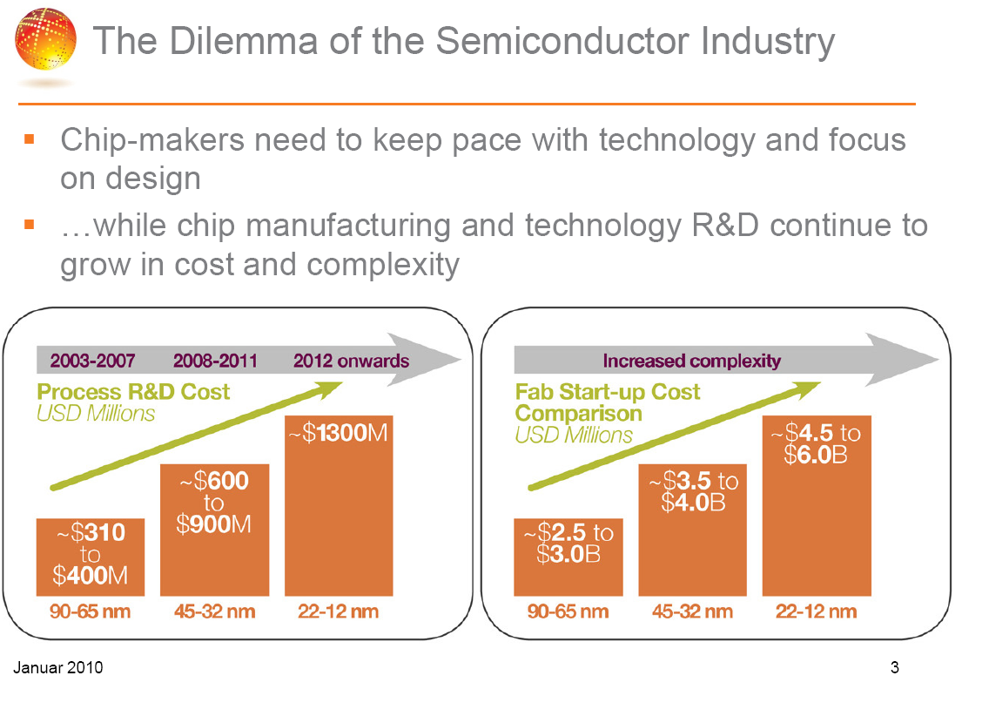
Courtesy: GlobalFoundries
Notes:
26

Slide 27
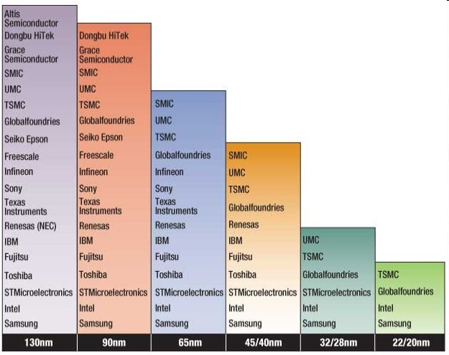
Severe Reduction in Number of Fabs
(Source: IHS iSuppli)

Slide 28


The Next Generation Dilemma:
Going Up or Going Down?
x0.7 Scaling
Monolithic 3D
Scale Down 0.7x
Scale Up 2D →3D
Cost: Capital > $4B
R&D Cost > $1B
Benefits: Logic Die Size → 0.5x
Power → 0.5x
for Speed → No Change
Cost: Capital < $100M
R&D Cost < $100M
Benefits: Logic Die Size → 0.5x
Power → 0.5x
for Speed → No Change
Notes:
28

Slide 29
Summary
Monolithic 3D is possible and practical
Monolithic 3D provides the equivalence of one process node for each folding
  Older Fabs can re-invent themselves and compete with leading edge
  Leading edge fabs could add significant value
Monolithic 3D provides an attractive path for memory scaling
Monolithic 3D is an attractive path…
MonolithIC 3D™ Inc. Patents Pending
29

Slide 30
Monolithic 3D Provides an Attractive Path to…
3D-CMOS: Monolithic 3D Logic Technology
3D-FPGA: Monolithic 3D Programmable Logic
3D-GateArray: Monolithic 3D Gate Array
3D-Repair: Yield recovery for high-density chips
3D-DRAM: Monolithic 3D DRAM
3D-RRAM: Monolithic 3D RRAM
3D-Flash: Monolithic 3D Flash Memory
3D-Imagers: Monolithic 3D Image Sensor
3D-MicroDisplay: Monolithic 3D Display
LOGIC
Monolithic 3D Integration with Ion-Cut Technology
Can be applied to many market segments
MEMORY
OPTO-ELECTRONICS

