Slide 1

THE MONOLITHIC 3D-IC:
Logic + eDRAM on top

Slide 2
How get single crystal silicon layers at less than 400ºC
(Required for stacking atop copper/low k)

Slide 3
How are all SOI wafers manufactured today?
Cleave using 400ºC
anneal or sideways
mechanical force. CMP.
Hydrogen implant
of top layer
Flip top layer and
bond to bottom layer
Oxide
Activated n Si
Oxide
H
Top layer
Activated n Si
Activated n Si
Top layer
Activated n Si
H
Oxide
Oxide
Oxide
Silicon
Silicon
Silicon
Bottom layer
Using Ion-Cut (a.k.a. Smart-Cut) technology

Slide 4
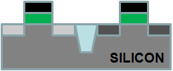
Ion-cut (a.k.a Smart-CutTM)
→ Can also give stacked defect-free single crystal Si layers atop Cu/low k
Cleave using 400ºC
anneal or sideways
mechanical force. CMP.
Hydrogen implant
of top layer
Flip top layer and
bond to bottom layer
Oxide
Activated n Si
Oxide
H
Top layer
Activated n Si
Activated n Si
Activated n Si
H
Oxide
Oxide
Oxide
Bottom layer

Slide 5
Ion-cut vs. other types of stacked Si
 | Poly Si with RTA | Ion-cut Si
Defect density | High | Perfect single crystal Si.
Mobility | 100cm²/Vs | 650cm²/Vs
Variability | High | Low
Sub-threshold slope and Leakage | High | Low
Temperature stacked bottom layer exposed to typically | 700-800ºC for crystallization | <400ºC
Cost | Low | See next slide

Slide 6
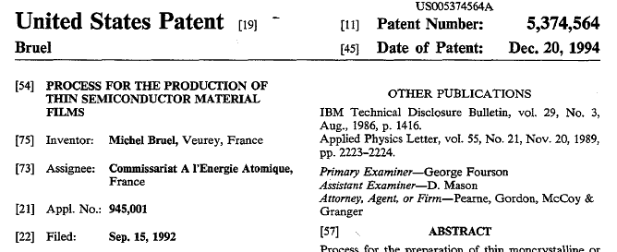
Ion-cut is great, but will it be affordable?
Aren’t ion-cut SOI wafers much costlier than bulk Si today?
Today: Single supplier → SOITEC. Owns basic patent on ion-cut.
Our industry sources + calculations → $50 ion-cut cost per $1500-$5000 wafer in a free market scenario (ion cut = implant, bond, anneal).
Free market scenario → After 2012 when SOITEC’s basic patent expires
SiGen and Twin Creeks Technologies using ion-cut for solar
Contents:
Hydrogen implant
Cleave with anneal
SOITEC basic patent expires 2012!!!

Slide 7
Monolithic 3D Logic
Shorter wires. So, gates driving wires are smaller.

Slide 8
TSV vs. Monolithic 3D
10,000x higher connectivity
TSV
 | TSV | Monolithic
Layer Thickness | ∼50μ | ~50nm
Via Diameter | ~5μ | ~50nm
Via Pitch | ~10μ | ~100nm
Wafer (Die) to Wafer Alignment | ~1μ | ~1nm
TSV size typically >>1um: Limited by alignment accuracy, silicon thickness
Monolithic offers 10,000x higher connectivity than TSV
Processed Top Wafer
Align and bond
Processed Bottom Wafer

Slide 9
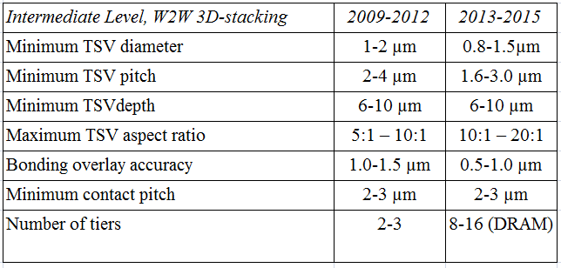
Industry Roadmap for 3D with TSV Technology
ITRS
2010
TSV size ~ 1um, on-chip wire size ~ 20nm → 50x diameter ratio, 2500x area ratio!!!
Cannot move many wires to the 3rd dimension

Slide 10
Monolithic 3D: The Other Option
Needs Sub-400ºC Transistors
Transistor part | Process | Temperature
Crystalline Si for 3D layer | Bonding, layer-transfer | Sub-400ºC
Gate oxide | ALD high k | Sub-400ºC
Metal gate | ALD | Sub-400ºC
Junctions | Implant, RTA for activation | >400ºC
Junction Activation: Key barrier to getting sub-400ºC transistors
In next few slides, will show 3 solutions to this problem…

Slide 11
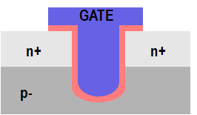
One path to solving the dopant activation problem:
Recessed Channel Transistors with Activation before Layer Transfer
Idea 1: Do high temp. steps (eg. Activate) before layer transfer
Layer transfer
Oxide
n+ Si
p
p Si
p
p- Si wafer
n+
H
n+
p- Si wafer
Idea 2: Use low-T processes like etch and deposition to define recessed channel transistors, the standard transistor type used in all DRAMs today. STI not shown for simplicity.
Idea 3: Silicon layer very thin (<100nm), so transparent, can align perfectly to features on bottom wafer
Note:
All steps after Next Layer is attached to Previous Layer are
@ < 400ºC!
n+
n+
p
p

Slide 12
Recessed channel transistors used in manufacturing today
→ easier adoption
GATE
GATE
GATE
n+
n+
n+
n+
p
p
RCAT recessed channel transistor:
Used in DRAM production
@ 90nm, 60nm, 50nm nodes
Longer channel length → low leakage, at same footprint
V-groove recessed channel transistor: Used in the TFT industry today
J. Kim, et al. Samsung, VLSI 2003
ITRS

Slide 13
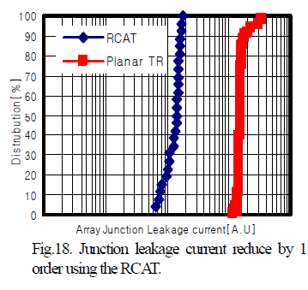
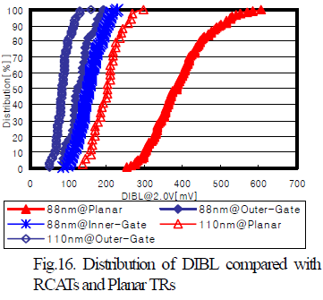
RCATs vs. Planar Transistors:
Experimental data from Samsung 88nm devices
From [J. Y. Kim, et al. (Samsung), VLSI Symposium, 2003]
RCATs → Less junction leakage
RCATs → Less DIBL i.e. short-channel effects

Slide 14
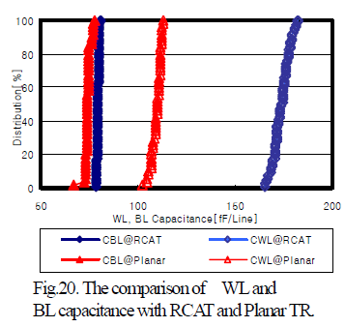
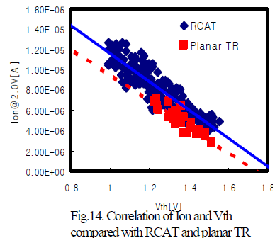
RCATs vs. Planar Transistors (contd.):
Experimental data from Samsung 88nm devices
From [J. Y. Kim, et al. (Samsung), VLSI Symposium, 2003]
RCATs → Similar drive current to standard MOSFETs → Mobility improvement (lower doping) compensates for longer L_{eff}
RCATs → Higher I/P capacitance

Slide 15


Step 1. Donor Layer Processing
Step 1 - Implant and activate unpatterned N+ and P- layer regions in standard donor wafer at high temp. (~900ºC) before layer transfer. Oxidize (or CVD oxide) top surface.
SiO₂ Oxide layer (~100nm) for oxide -to-oxide bonding with device wafer.
P-
N+
P-
Step 2 - Implant H+ to form cleave plane for the ion cut
P-
N+
H+ Implant Cleave Line in N+ or below
P-
MonolithIC 3D™ Inc. Patents Pending
15
Notes:
15
15

Slide 16
Step 3 - Bond and Cleave: Flip Donor Wafer and Bond to Processed Device Wafer
Cleave along
H+ implant line using 400ºC anneal or sideways mechanical force.
Polish with CMP.
-
Silicon
N+
<200nm
P-
SiO₂ bond layers on base and donor wafers (alignment not an issue with blanket wafers)
Processed Base IC
MonolithIC 3D™ Inc. Patents Pending
16
Notes:
16
16

Slide 17
Step 4 - Etch and Form Isolation and RCAT Gate
Litho patterning with features aligned to bottom layer
Etch shallow trench isolation (STI) and gate structures
Deposit SiO₂ in STI
Grow gate with ALD, etc. at low temp
(<350º C oxide or high-K metal gate)
Gate
Oxide
Isolation
Gate
+N
Ox
Ox
Advantage: Thinned donor wafer is transparent to litho, enabling direct alignment to device wafer alignment marks: no indirect alignment.
P-
Processed Base IC
MonolithIC 3D™ Inc. Patents Pending
17
Notes:
17
17

Slide 18

Step 5 – Etch Contacts/Vias to Contact the RCAT
Complete transistors, interconnect wires on ‘donor’ wafer layers
Etch and fill connecting contacts and vias from top layer aligned to bottom layer
+N
P-
Processed Base IC
Processed Base IC
MonolithIC 3D™ Inc. Patents Pending
18
Notes:
18
18

Slide 19
Compare 2D and 3D-IC versions of the same logic core with IntSim
22nm node 600MHz logic core | 2D-IC | 3D-IC 2 Device Layers | Comments
Metal Levels | 10 | 10
Average Wire Length | 6um | 3.1um
Av. Gate Size | 6 W/L | 3 W/L | Since less wire cap. to drive
Die Size (active silicon area) | 50mm² | 24mm² | 3D-IC → Shorter wires → smaller gates → lower die area → wires even shorter 3D-IC footprint = 12mm²
Power | Logic = 0.21W | Logic = 0.1W | Due to smaller Gate Size
 | Reps. = 0.17W | Reps. = 0.04W | Due to shorter wires
 | Wires = 0.87W | Wires = 0.44W | Due to shorter wires
 | Clock = 0.33W | Clock = 0.19W | Due to less wire cap. to drive
 | Total = 1.6W | Total = 0.8W
MonolithIC 3D™ Inc. Patents Pending
19

Slide 20
SoC Device Architecture
Pull out the memory to the second layer
  50% of SoC is embedded memory, 50% of the logic area is due to gate sizing buffers and repeaters.
    => Base layer 25%, just the logic
    => 2nd layer eDRAM with stack capacitor
  25% of the area of eDRAM (1T) needs to replace 50% of the equivalent SRAM
    1T vs. ½ of 6T ~ 1:3, could be used for:
      Use older node for the eDRAM, with optional additional port for independent refresh
    Additional advantage for dedicated layer of eDRAM
      Optimized process
      Only 3 metal layers, no die area wasted on loigic 10 metal layers
      Repetitive memory structure – easy for litho and fab

Slide 21
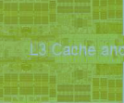
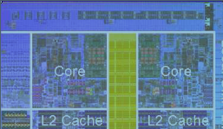
2D SoC to Monolithic 3D
(eDRAM on top of Logic)
2D SoC
14mm
Logic + Memory
Footprint = 196mm²
14mm
3D SoC
Memory
7mm
Footprint = 49mm²
Logic
7mm

Slide 22
Monolithic 3D SoC Side View
Stack Capacitors (for eDRAM)
RCAT transistors
(eDRAM + Decoders)
Logic circuits
Base wafer with Logic circuits

Slide 23
eDRAM
Use RCAT for bit cell and decoders
Vdd
WL
Bit Line
eDRAM with independent port for refresh
Bit Line
Vdd
WL
WL-Refresh

Slide 24
eDRAM vs SRAM on top
Smaller area and shorter lines should result in competitive performance
Independent port for refresh should allow reduced voltage and therefore comparable power

Slide 25
Summary
First use of MonolithIC 3D technology for SoC could be pulling out the embedded memory to a 2nd layer
2nd Layer embedded memory could use RCAT + Stack Capacitor
EDA may need to be adjusted but existing EDA could be used by modifying the memory library and other software shortcuts
Estimated benefits:
  ~1/3 Device cost (first layer size is ~1/4 and second layer is low cost using older process node, repetitive layout, and only 3 metal layers)
  ½ power
  Comparable or better performance

