Slide 1
Monolithic 3D Integrated Circuits
Deepak C. Sekar, Brian Cronquist, Israel Beinglass and Zvi Or-Bach
Presentation at Intel’s Photonics Technology Lab, 15th July 2011

Slide 2
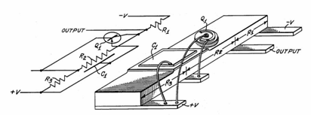
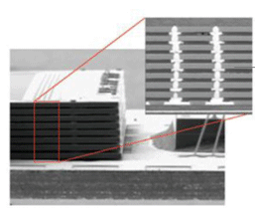
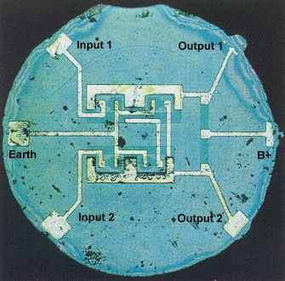
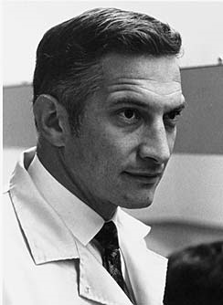
Before we start, a Historical Perspective...
First 2D-IC, Jack Kilby, 1958
Connections not integrated, low density
First 3D-ICs, with TSV Technology
Connections not integrated, low density
First Monolithic 2D-IC, Bob Noyce, 1961
Integrated connections, high density
Monolithic 3D-ICs (our company)
Integrated connections, high density

Slide 3
This talk: How can we get practical Monolithic 3D-ICs? Implications for Optical Integration with Logic Technologies?

Slide 4
Outline
Background
Paths to Monolithic 3D
Implications of Monolithic 3D
Conclusions

Slide 5
Outline
Background
Paths to Monolithic 3D
Implications of Monolithic 3D
Conclusions

Slide 6
Introduction
Transistors improve with scaling, interconnects do not
Even with repeaters, 1mm wire delay ~50x gate delay at 22nm node

Slide 7
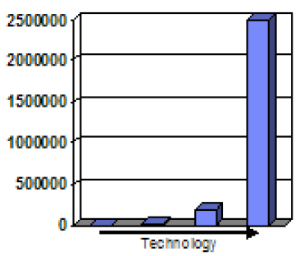
The repeater solution consumes power and area…
Source: IBM POWER processors
R. Puri, et al., SRC Interconnect Forum, 2006
Repeater count
130nm 90nm 65nm 45nm
Repeater count increases exponentially
At 45nm, repeaters >50% of total leakage power of chip [IBM].
Future chip power, area could be dominated by interconnect repeaters
[P. Saxena, et al. (Intel), IEEE J. for CAD of Circuits and Systems, 2004]

Slide 8
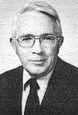
We have a serious interconnect problem
What’s the solution?
Arrange components in the form of a 3D cube → short wires
James Early, ISSCC 1960

Slide 9
3D with Through-Silicon Via (TSV) Technology
TSV size typically >1um: Limited by alignment accuracy and silicon thickness
Processed Top Wafer
Align and bond
Processed Bottom Wafer

Slide 10
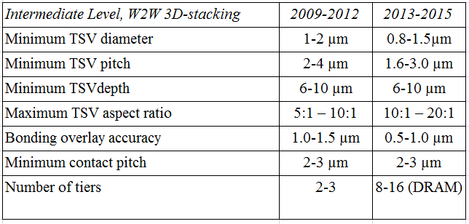
Industry Roadmap for 3D with TSV Technology
ITRS
2010
TSV size ~ 1um, on-chip wire size ~ 20nm → 50x diameter ratio, 2500x area ratio!!!
Cannot move many wires to the 3rd dimension
TSV: Good for stacking DRAM atop processors, but doesn’t help on-chip wires much

Slide 11
Can we get Monolithic 3D?
Requires sub-50nm vertical and horizontal connections
Next section of this talk…

Slide 12
Outline
Background
Paths to Monolithic 3D
Implications of Monolithic 3D
Conclusions

Slide 13
Getting sub-50nm vertical connections
Sub-100nm c-Si, can look through and align
Build transistors with c-Si films above copper/low k
→ Avoids alignment issues of bonding pre-fabricated wafers
Need <400-450ºC for transistor fabrication → no damage to copper/low k

Slide 14
Layer Transfer Technology (or “Smart-Cut”) → Defect-free c-Si films formed @ <400ºC
Hydrogen implant
of top layer
Flip top layer and
bond to bottom layer
Cleave using 400ºC
anneal or sideways
mechanical force. CMP.
Oxide
p Si
Top layer
p Si
Oxide
H
p Si
p Si
H
Oxide
Oxide
Oxide
Oxide
Oxide
Bottom layer
Same process used for manufacturing all SOI wafers today

Slide 15
Sub-400ºC Transistors
Transistor part | Process | Temperature
Crystalline Si for 3D layer | Bonding, layer-transfer | Sub-400ºC
Gate oxide | ALD high k | Sub-400ºC
Metal gate | ALD | Sub-400ºC
Junctions | Implant, RTA for activation | >400ºC
Junction Activation: Key barrier to getting sub-400ºC transistors
In next few slides, will show 3 solutions to this problem… under development.
For more details, check out www.monolithic3d.com

Slide 16
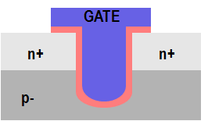
One path to solving the dopant activation problem: Recessed Channel Transistors with Activation before Layer Transfer
Idea 1: Do high temp. steps (eg. Activate) before layer transfer
Layer transfer
Oxide
n+ Si
p
p Si
p
p- Si wafer
n+
H
n+
p- Si wafer
Idea 2: Use low-temp. processes like etch and deposition to define (novel) recessed channel transistors. STI.
Idea 3: Silicon layer very thin (<100nm), so transparent, can align perfectly to features on bottom wafer
Note:
All steps after Next Layer attached to Previous Layer are @ < 400ºC!
n+
n+
p
p

Slide 17
Recessed channel transistors used in manufacturing today → easier adoption
GATE
GATE
GATE
n+
n+
n+
n+
p
p
RCAT recessed channel transistor:
Used in DRAM production
@ 90nm, 60nm, 50nm nodes
Longer channel length → low leakage, at same footprint
V-groove recessed channel transistor: Used in the TFT industry today
J. Kim, et al. Samsung, VLSI 2003
ITRS

Slide 18
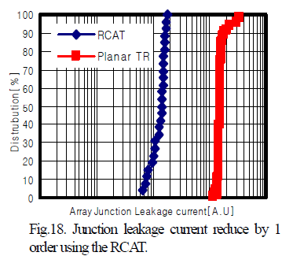
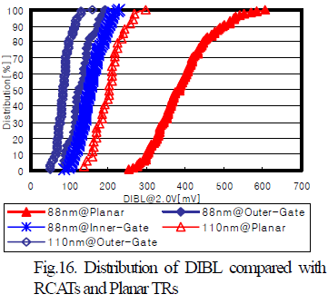
RCATs vs. Planar Transistors: Experimental data from 88nm DRAM chips
From [J. Y. Kim, et al. (Samsung), VLSI Symposium, 2003]
RCATs → Less junction leakage
RCATs → Less DIBL i.e. short-channel effects

Slide 19
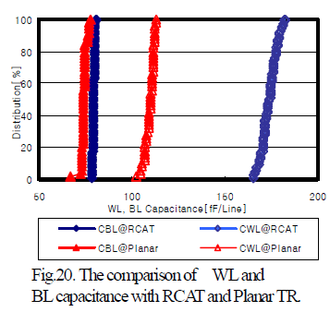
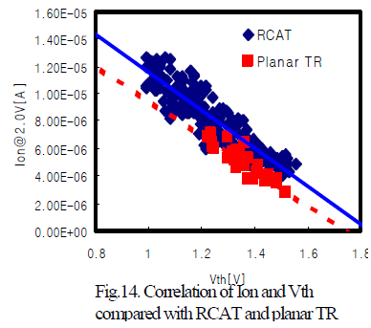
RCATs vs. Planar Transistors (contd.): Experimental data from 88nm DRAM chips
From [J. Y. Kim, et al. (Samsung), VLSI Symposium, 2003]
RCATs → Similar drive current to standard MOSFETs → Mobility improvement (lower doping) compensates for longer L_{eff}
RCATs → Higher I/P capacitance

Slide 20
Another path to solving the dopant activation problem: Dopant Segregated Schottky Transistors with Layer Transfer
Form NiSi @ 400ºC
Implant Arsenic at surface
Drive-in anneal @ 400-500ºC
Gate
Gate
Gate
Gate
n+ Si
NiSi
NiSi
NiSi
p Si
p Si
p Si
Arsenic not soluble in Ni, moves to interface.
Cannot diffuse in p Si since temperature (400-500ºC) low.
Explored by Globalfoundries, TSMC, Toshiba, IBM, possibly Intel, etc
→ their application = low resistance contacts to Finfet and FD-SOI devices
Our application = 400-450ºC 3D stacked transistors with layer transfer

Slide 21
Yet another path to solving the dopant activation problem
Standard replacement-gate transistors
Bond pre-fabricated wafers with
some tricks to get thin Silicon
Repeating layouts
like in a gate array
To tackle misalignment
while bonding
+
For more details of this technique, visit our website www.monolithic 3d.com

Slide 22
Outline
Background
Paths to Monolithic 3D
Implications of Monolithic 3D
Conclusions

Slide 23
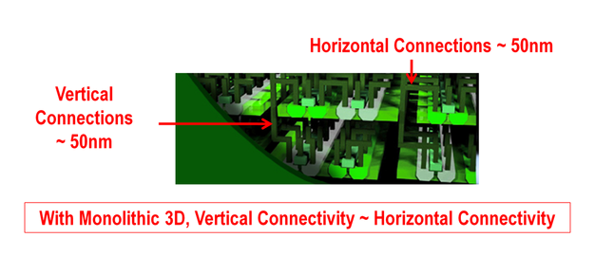
How does Monolithic 3D impact chip performance, power, die size?
Monolithic 3D → Circuits built in three dimensions
Therefore, Shorter wires with less capacitance. So, gates that drive wires smaller.
Die size and power reduce for a certain performance, due to these reasons. Chips today severely wire-limited, so anything that reduces wire problems → big benefits

Slide 24
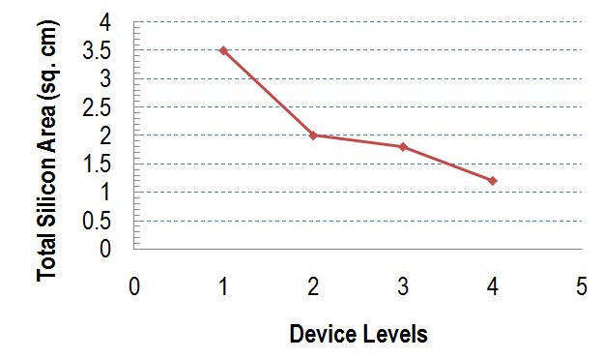
Technical Literature: [J. Davis, J. Meindl, K. Saraswat, R. Reif, et al., Proc. IEEE, 2001]
Simulation study:
Frequency = 450MHz, 180nm node
ASIC-like chip
Tremendous benefits when vertical connectivity ~ horizontal connectivity. 3x reduction in total silicon area + 12x reduction in footprint
vs. a 2D implementation, even @ 180nm node
Notes:
24

Slide 25
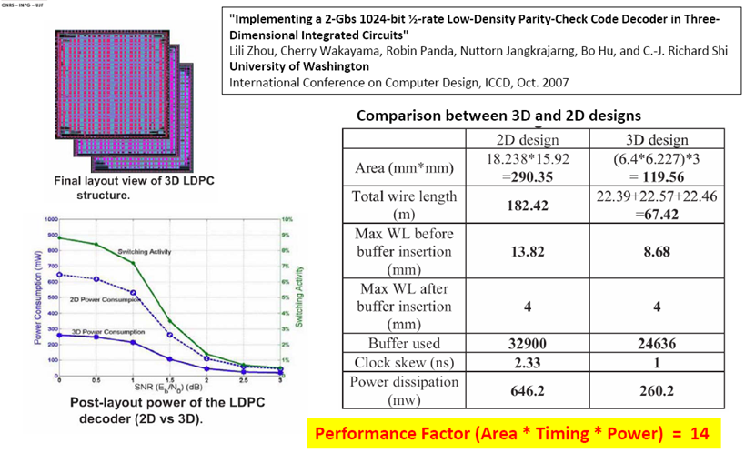
Technical Literature: [L. Zhou, R. Shi, et al, Proc. ICCD 2007]
Did layout of 2D and 3D-ICs, and showed more than 10x benefit
Notes:
25

Slide 26
Technical Literature: Synopsys @ RTI 3D Workshop, Dec. 2010
Notes:
26

Slide 27
Other technical literature
Many papers
→ Study 3D-TSV technology where via sizes 1um and on-chip wires <50nm
→ not much benefit in that case, since few wires move to the 3rd dimension
We did our own study to estimate performance/power/die size benefits of monolithic 3D:
- Latest process technology (22nm node)
- Uses well-referenced simulation framework (more details in next slide)

Slide 28
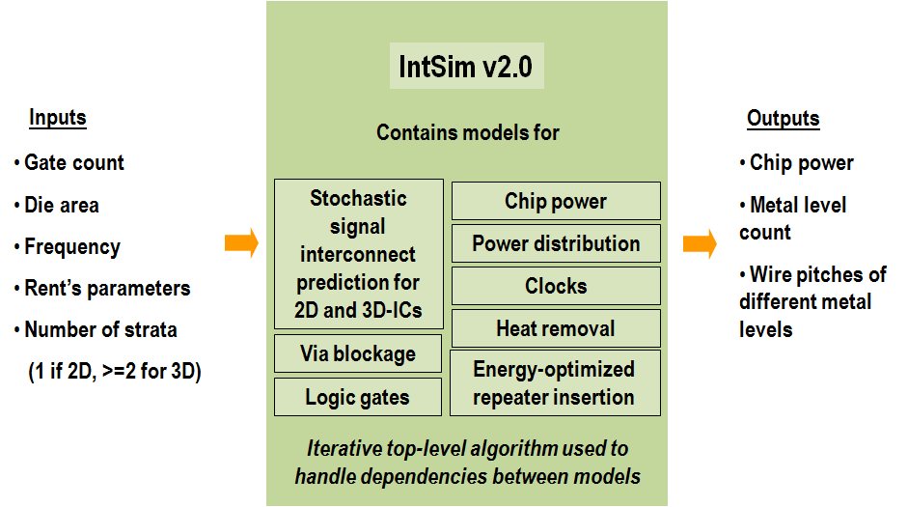
IntSim: The CAD tool used for our simulation study [D. C. Sekar, J. D. Meindl, et al., ICCAD 2007]
Open-source tool, available for use at www.monolithic3d.com
IntSim v1.0: Built at Georgia Tech in Prof. James Meindl’s group (by Deepak Sekar, now @ MonolithIC 3D)
IntSim v2.0: Extended IntSim v1.0 to monolithic 3D using 3D wire length distribution models in the literature

Slide 29
Demo
IntSim v2.0
App
Utility of IntSim v2.0:
Pre-silicon optimization and estimation of frequency, power, die size, supply voltage, threshold voltage and multilevel interconnect pitches
Study scaling trends and estimate benefits of different technology and design modifications
Undergraduate and graduate courses in universities for intuitive understanding of how a VLSI chip works

Slide 30
Compare 2D and 3D-IC versions of the same logic core with IntSim
22nm node 600MHz logic core | 2D-IC | 3D-IC 2 Device Layers | Comments
Metal Levels | 10 | 10
Average Wire Length | 6um | 3.1um
Av. Gate Size | 6 W/L | 3 W/L | Since less wire cap. to drive
Die Size (active silicon area) | 50mm² | 24mm² | 3D-IC → Shorter wires → smaller gates → lower die area → wires even shorter 3D-IC footprint = 12mm²
Power | Logic = 0.21W | Logic = 0.1W | Due to smaller Gate Size
 | Reps. = 0.17W | Reps. = 0.04W | Due to shorter wires
 | Wires = 0.87W | Wires = 0.44W | Due to shorter wires
 | Clock = 0.33W | Clock = 0.19W | Due to less wire cap. to drive
 | Total = 1.6W | Total = 0.8W
3D with 2 device layers → 2x power reduction, ~2x active silicon area reduction vs. 2D

Slide 31
Scaling with 3D or conventional 0.7x scaling?
Analysis with IntSim v2.0 Same logic core scaled | 2D-IC @22nm | 2D-IC @ 15nm | 3D-IC 2 Device Layers @ 22nm
Frequency | 600MHz | 600MHz | 600MHz
Metal Levels | 10 | 12 | 10
Footprint | 50mm² | 25mm² | 12mm²
Total Silicon Area (a.k.a “Die size”) | 50mm² | 25mm² | 24mm²
Average Wire Length | 6um | 4.2um | 3.1um
Av. Gate Size | 6 W/L | 4 W/L | 3 W/L
Power | 1.6W | 0.7W | 0.8W
One 3D folding can give you similar benefits vis-à-vis a generation of scaling for logic!
Without the need for costly lithography upgrades!!!
Let’s understand this better…

Slide 32
Theory: 2D Scaling vs. 3D Scaling
 | 2D Scaling (0.7x Dennard scaling) |  | Monolithic 3D Scaling (2 device layers)
 | Ideal | Today, V_{dd} scales slower
Chip Footprint | 2x reduction |  | 2x-4x reduction (see slide 18)
 | 0.7x reduction |  | 0.7x-2x reduction
Long wire capacitance | 0.7x reduction |  | 0.7x-2x reduction
Long wire resistance | >0.7x increase |  | 0.7x-2x reduction
Gate Capacitance | 0.7x reduction |  | Same
Driver (Gate) Resistance (Vdd/Idsat) | Same | Increases | Same
Overall benefits seen with IntSim have basis in theory
2D scaling scores: Gate capacitance
3D scaling scores: Wire resistance, driver resistance, wire capacitance

Slide 33
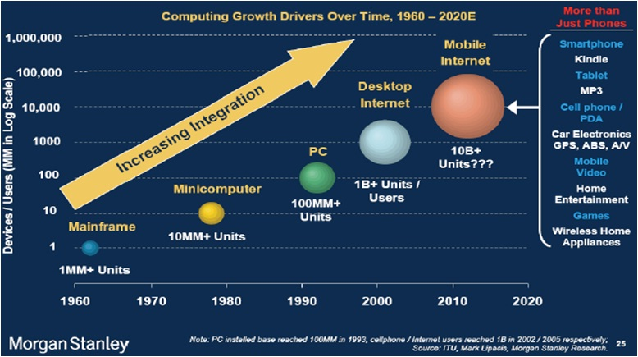
3D-ICs: The Heat Removal Question
Sub-1W smartphones, cellphones and tablets the wave of the future.
Heat removal not a key issue there → can 3D stack. Also, shorter wires → net power less.
Notes:
33

Slide 34
If future logic transistors are sub-400ºC processed, easy integration with silicon photonics
Sub-400ºC Logic
Optical I/O, etc
Substrate

Slide 35
Outline
Background
Paths to Monolithic 3D
Implications of Monolithic 3D
Conclusions

Slide 36
Conclusions
Monolithic 3D Technology possible and practical:
- Recessed Channel Transistors
- Dopant segregated Schottky transistors
- Standard transistors + repeating layouts
3D scaling
→ Benefits similar to 2D scaling, but without costly litho upgrades
→ Easy integration of silicon photonics with logic technologies

