Slide 1


Monolithic 3D –
The Most Effective Path for Future IC Scaling
MonolithIC 3D™ Inc. Patents Pending
1

Slide 2
Agenda:
Semiconductor Industry is reaching an inflection point
Monolithic 3D IC – The next generation technology driver
  Monolithic 3D – Game Change, using existing transistor process !
Heat removal
The MonolithIC 3D Advantages
Summary

Slide 3
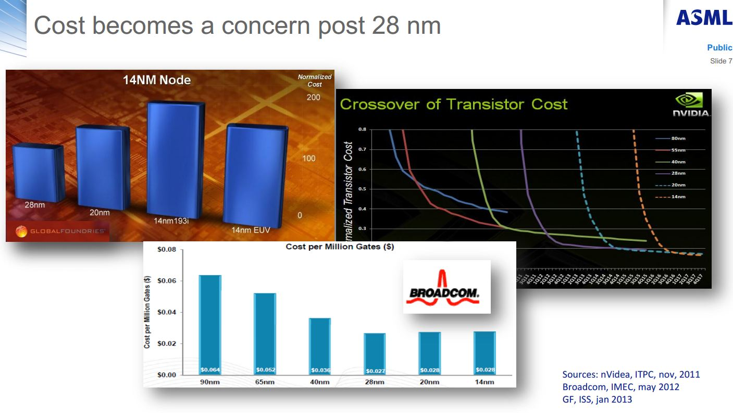
Martin van den Brink -EVP & CTO, ASML
ISSCC 2013 & SemiconWest 2013

Slide 4
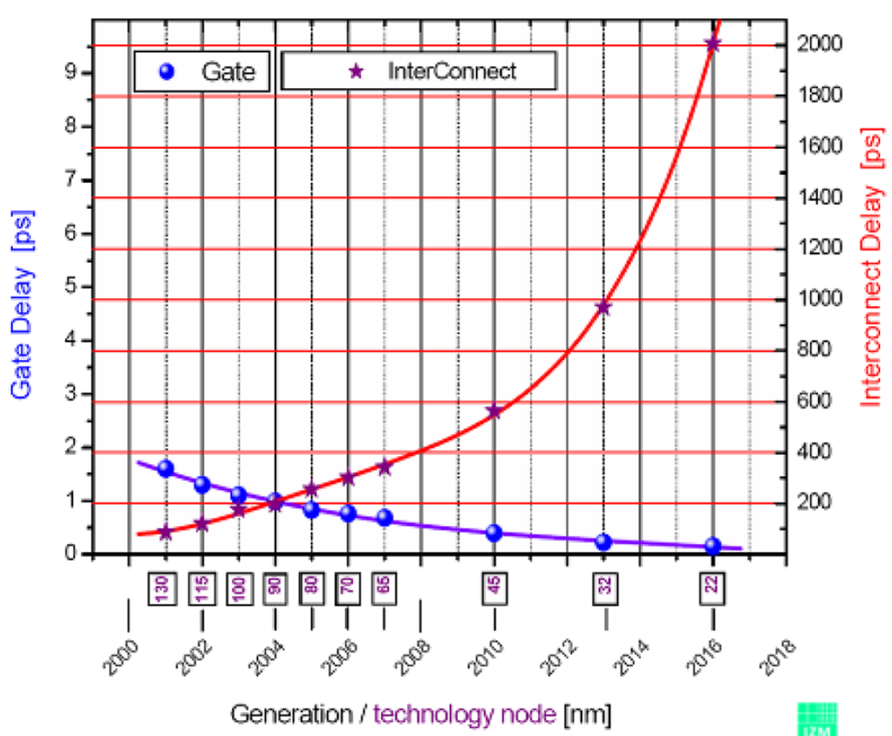
The Current 2D-IC is Facing Escalating Challenges
On-chip interconnect is
  Dominating device power consumption, performance and cost
B. Wu, A. Kumar, Applied Materials

Slide 5
3D and EDA need to make up for Moore’s Law, says Qualcomm*
“Qualcomm is looking to monolithic 3D and smart circuit architectures to make up for the loss of traditional 2D process scaling as wafer costs for advanced nodes continue to increase. .. Now, although we are still scaling down it’s not cost-economic anymore”
“Interconnect RC is inching up as we go to deeper technology. That is a major problem because designs are becoming interconnect-dominated. Something has to be done about interconnect. What needs to be done is monolithic three-dimensional ICs.”
“TSV...are not really solving the interconnect issue I’m talking about.
So we are looking at true monolithic 3D. You have normal vias between different stacks.”
* Karim Arabi Qualcomm VP of engineering, DAC 2014 Key Note
<http://www.techdesignforums.com/blog/2014/06/05/karim-arabi-monolithic-3dic-dac-2014/>

Slide 6
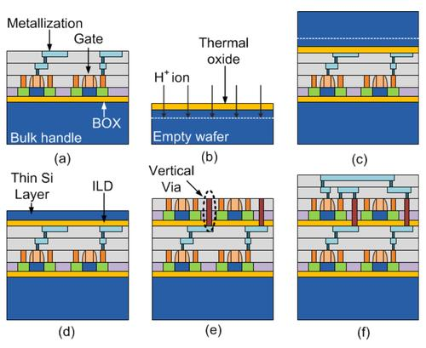
Monolithic 3D Qualcomm SoCs by 2016*
*EE Times 3/31/2015 <http://www.eetimes.com/document.asp?doc_id=1326174&piddl_msgid=338050#msg_338050>
“3DV, enables die size to be shrunk in half, while simultaneously increasing yields,“
Qualcomm's motivation, according to Arabi, is market share in the 8 billion smartphones that he predicts will be produced from 2014 to 2018
In the fabrication process of front-to-back (F2B) 3DVs (a) the bottom tier is created the same way as 2D-ICs. (b,c,d) To add another layer, first a thin layer of silicon is deposited on top of the bottom tier. (e) This front-end-of-line (FEOL) process of the top tier permits the addition of normal vertical vias and top-tier contacts. (f) Finally back-end-of-line (BEOL) processing creates the top-tier. (Source:Qualcomm)

Slide 7
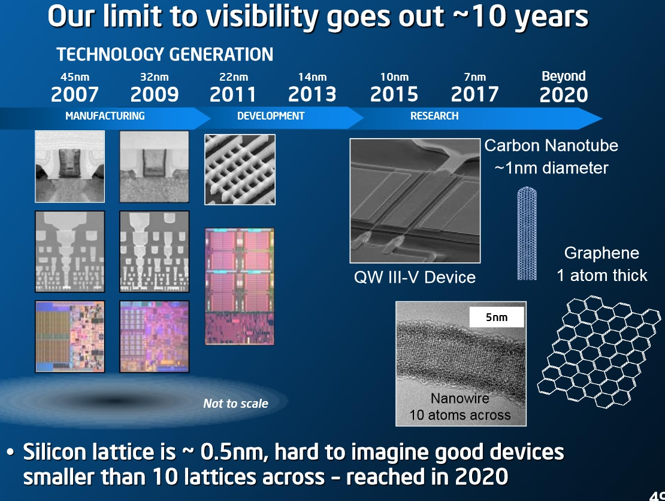
Even Intel Agrees – 7nm is the Limit for Silicon
ISSCC 2015

Slide 8
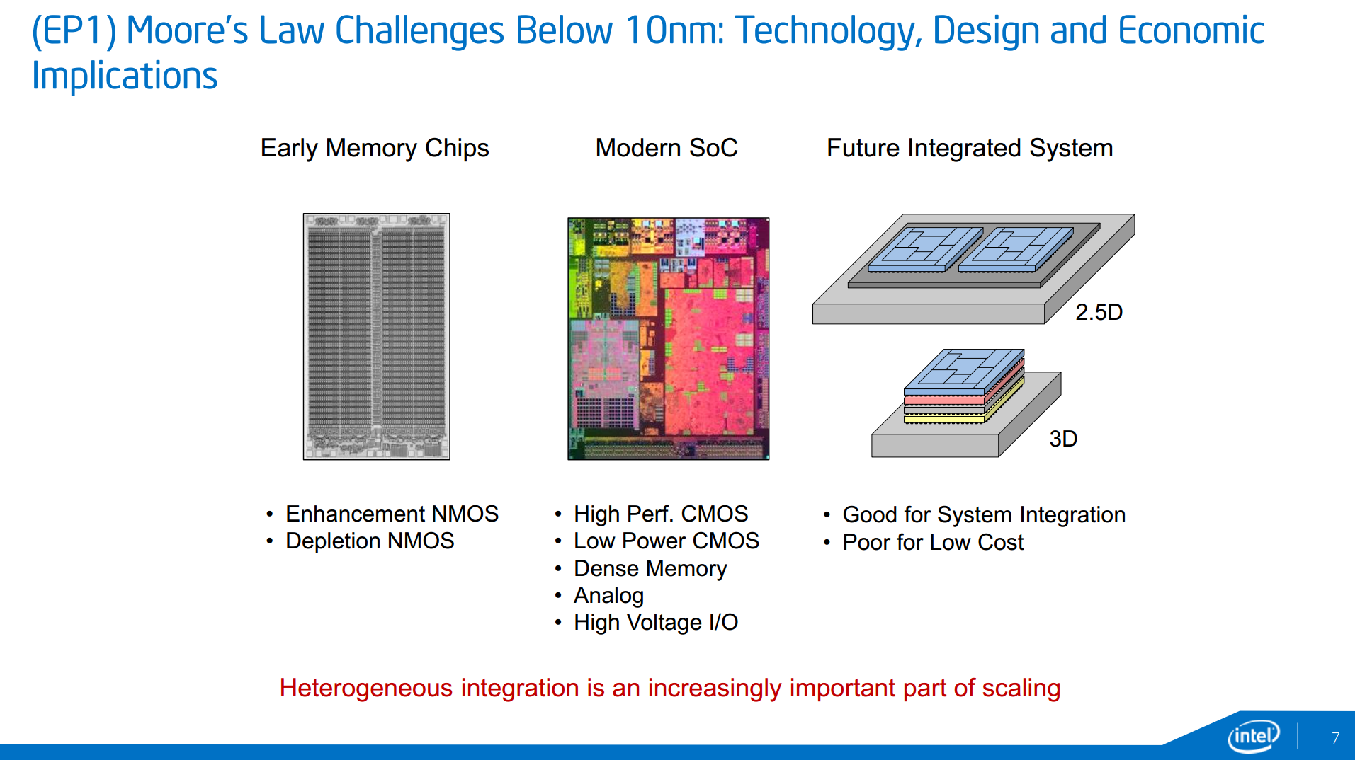

Slide 9
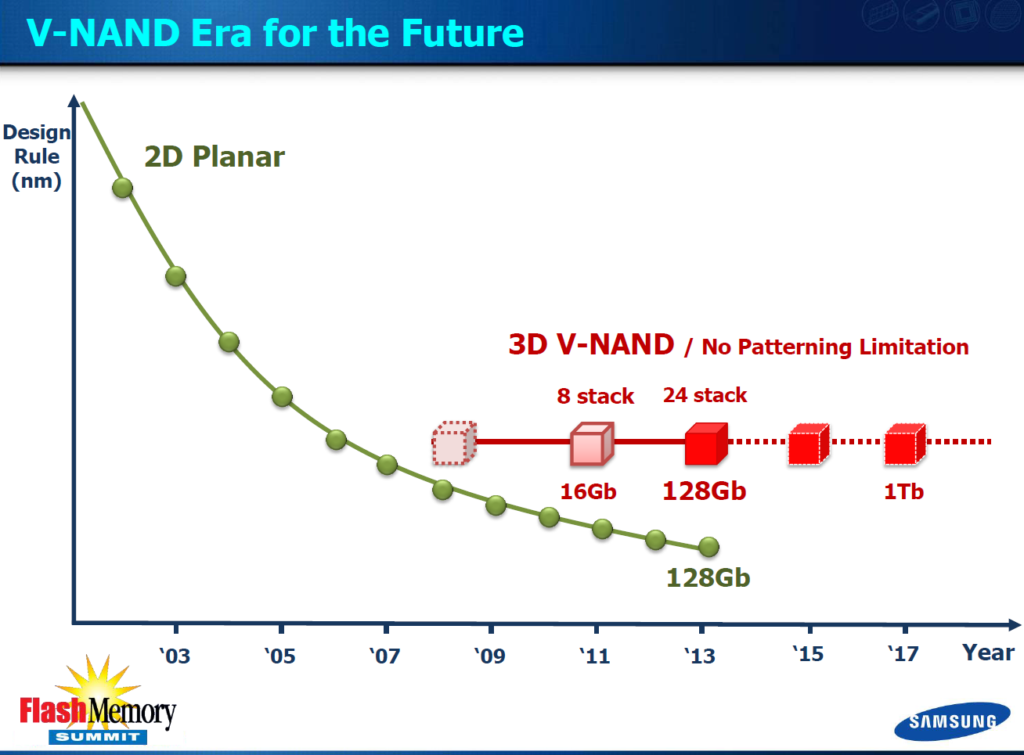

Slide 10
Conclusions:
Dimensional Scaling (“Moore’s Law”) is already exhibiting diminishing returns
The road map beyond 2017 (7nm) is unclear
While the research community is working on many interesting new technologies (see below), none of them seem mature enough to replace silicon for 2019
    - Carbon nanotube - Indium gallium arsenide - 2D (MoS₂, etc.) transistors
    - Graphene - Spintronics
    - Nanowire - Molecular computing
    - Photonics - Quantum computing
3D IC is considered, by all, as the near-term solution, Monolithic 3D IC is well positioned to be so, as it uses the existing infrastructure!
  It is safe to state that Monolithic 3D is the only alternative that could be ready for high volume in 2019 !!

Slide 11
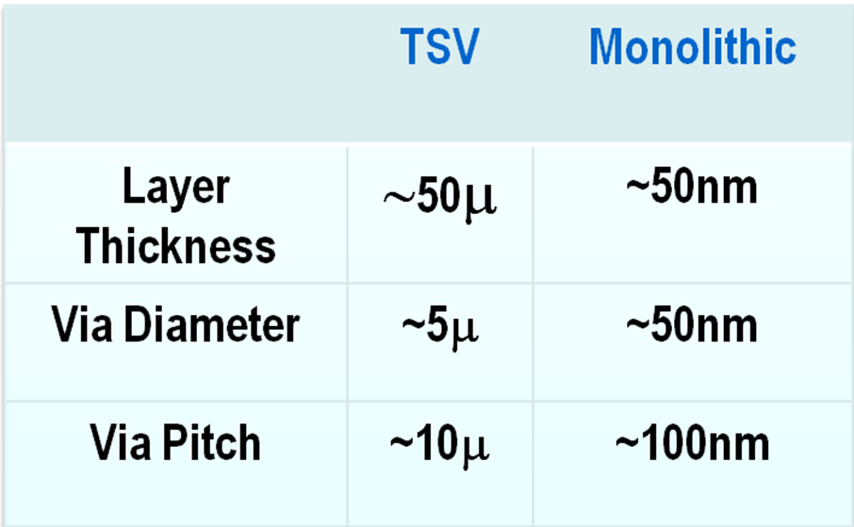
MONOLITHIC
10,000x the Vertical Connectivity of TSV
11

Slide 12
The Monolithic 3D Challenge
Why is it not already in wide use?
Processing on top of copper interconnects should not make the copper interconnect exceed 400ºC
    How to bring mono-crystallized silicon on top at less than 400ºC
    How to fabricate state-of-the-art transistors on top of copper interconnect and keep the interconnect below at less than 400ºC
Misalignment of pre-processed wafer to wafer bonding step used to be ~1µm
    How to achieve 100nm or better connection pitch
    How to fabricate thin enough layer for inter-layer vias of ~50nm
12

Slide 13
MonolithIC 3D – Innovative Flows
RCAT (2009) – Process the high temperature on generic structures prior to ‘smart-cut’, and finish with cold processes – Etch & Depositions
Gate Replacement (2010) (=Gate Last, HKMG) - Process the high temperature on repeating structures prior to ‘smart-cut’, and finish with ‘gate replacement’, cold processes – Etch & Depositions
Laser Annealing (2012) – Use short laser pulse to locally heat and anneal the top layer while protecting the interconnection layers below from the top heat
Game Change, using existing transistor process !
Modified ELTRAN (2015) – Use ELTRAN for low cost, No defects, Existing transistor flow
Precise Bonder (2014) – Use new precise bonders, offering low cost flow with minimal R&D

Slide 14
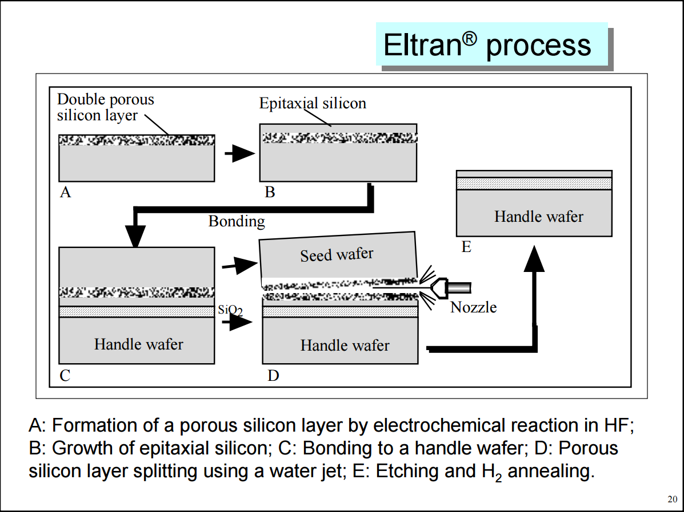
ELTRAN® - Epitaxial Layer TRANsfer
Originated, developed and produced at Canon Inc.
‘

Slide 15
M3D Leveraging the ELTRAN Idea
Both donor and carrier wafer could be pre-processed
  Donor wafer:
  Carrier wafer:
No impact on processed layer or on device processing
Donor and Carrier could be easily recycled – reused
Minimal incremental cost per layer (porous + epi <$20)
epi. layer
porous ‘cut’ layer
Base wafer - reused
oxide layer
porous ‘cut’ layer
Base wafer - reused

Slide 16
Use standard flow to process “Stratum 3”
- using ELTRAN donor wafer (through silicidation)
Stratum 3
NMOS
Poly
Oxide
PMOS
STI
epi
~700 µm Donor Wafer
porous layer
Silicon
MonolithIC 3D™ Inc. Patents Pending
16

Slide 17
Bond to a ELTRAN carrier-wafer
~700µm Carrier Wafer
porous layer
oxide to oxide bond
STI
~700µm Donor Wafer
Silicon
17

Slide 18
‘Cut’ Donor Wafer off
~700µm Carrier Wafer
Transferred ~100nm Layer
- Stratum 3
STI
Silicon
~700µm Donor Wafer
Silicon
18

Slide 19
Etch Off the Porous Silicon and Smooth
Silicon
~100nm
STI
Oxide
porous layer
~700µm
Carrier Wafer
19

Slide 20
Use standard flow to process “Stratum 2”
Note: High Temperature is OK
High Performance Transistors
Oxide
Stratum 2
Silicon
~100nm Layer
Need to set
vertical isolation
STI
Stratum 3
Porous ‘cut’ layer
~700µm
Carrier Wafer
20

Slide 21
Add at least one interconnect layer
For some applications such as
Image Sensor, this could be it !
Stratum-2 copper interconnection layers
Stratum 2
~100nm
Transferred Layer
Stratum 3
~700µm
Carrier Wafer
21

Slide 22
Transfer onto Final carrier
~700µm
Carrier Wafer
porous ‘cut layer
Transferred
Layer (Stratum 2 +Stratum 3)
Oxide-oxide bond
Final Carrier
MonolithIC 3D Inc. Patents Pending
22

Slide 23
Remove carrier-wafer
Transferred
Layer (Stratum 2 +Stratum 3)
Oxide-oxide bond
Final Carrier
MonolithIC 3D Inc. Patents Pending
23

Slide 24
Add Stratum-3 Interconnections
Transferred
Layer (Stratum 2 +Stratum 3)
Oxide-oxide bond
Final Carrier
MonolithIC 3D Inc. Patents Pending
24

Slide 25
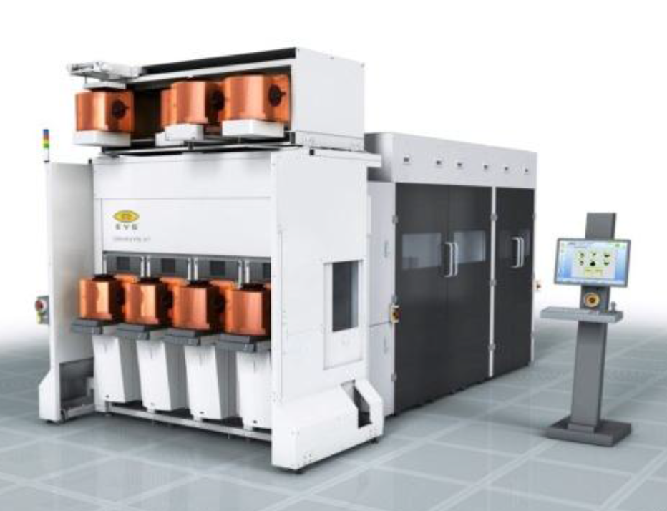
Precise Bonder – Multi-Strata M3D
Utilizing the existing front-end process !!!
  <200 nm (3σ)
Achieving 10,000x vertical connectivity as the upper strata will be thinner than 100 nm
  Mix – Sequential/Parallel M3D
  Low manufacturing costs

Slide 27
Transfer onto Pre-Processed Wafer
~700µm
Carrier Wafer
Transferred
Layer (Stratum 2 +Stratum 3)
Oxide-oxide bond
Base Wafer
NMOS
PMOS
MonolithIC 3D Inc. Patents Pending
27

Slide 28
Remove Carrier Wafer
Transferred
Layer (Stratum 2 +Stratum 3)
Oxide-oxide bond
Base Wafer
NMOS
PMOS
MonolithIC 3D Inc. Patents Pending
28

Slide 29
Connect to Stratum 1
Transferred
Layer (Stratum 2 +Stratum 3)
Oxide-oxide bond
Base Wafer
NMOS
PMOS
MonolithIC 3D Inc. Patents Pending
29

Slide 30
Add Metal Layers
Transferred
Layer (Stratum 2 +Stratum 3)
Oxide-oxide bond
Base Wafer
NMOS
PMOS
MonolithIC 3D Inc. Patents Pending
30

Slide 31
Monolithic 3D using ELTRAN & Precise Bonder
Utilizes existing transistor process
Could help upgrade any fab (leading or trailing)
Very competitive cost structure
Better power, performance, price than a node of scaling at a fraction of the costs !!!
Allows functionality that could not be attained by 2D devices

Slide 32
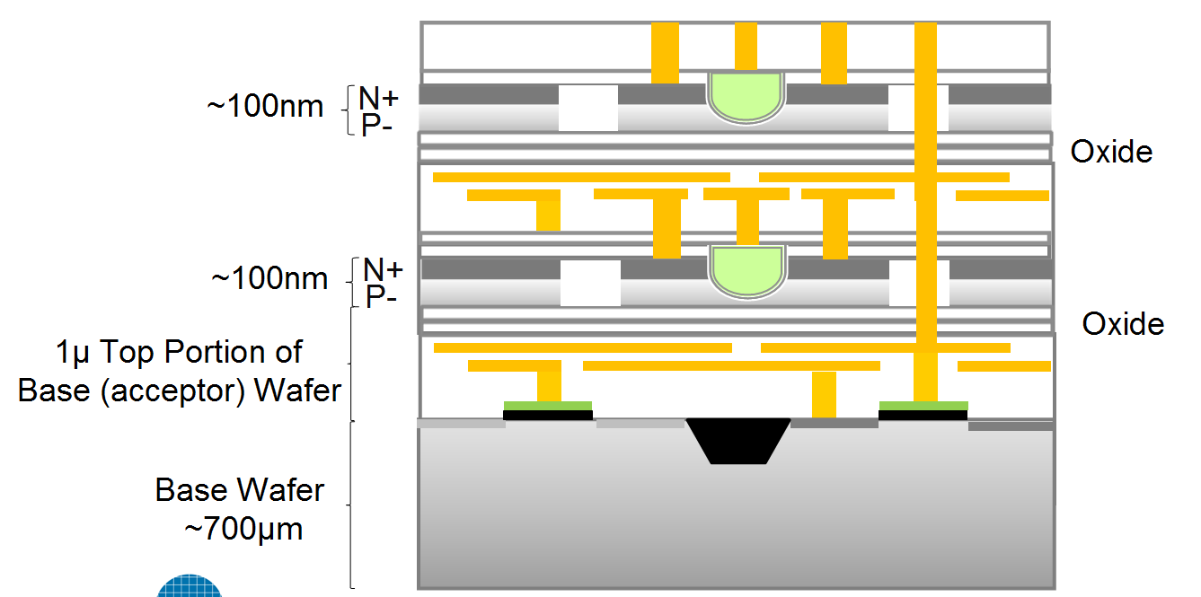
The Operational Thermal Challenge
Poor Heat Conduction
~1 W/mK
Good Heat Conduction
~100 W/mK
Upper tier transistors are fully surrounded by oxide and have no thermal path to remove operational heat

Slide 33
The Solution
Use Power Delivery (Vdd, Vss) Network (“PDN”) also for heat removal
Add heat spreader to smooth out hot spots
Add thermally conducting yet electrically non-conducting contacts to problem areas such as transmission gates

Slide 34
Cooling Three-Dimensional Integrated Circuits using
Power Delivery Networks (PDNs)
IEDM 2012 Paper
Hai Wei, Tony Wu, Deepak Sekar*, Brian Cronquist*, Roger Fabian Pease, Subhasish Mitra
Stanford University, Monolithic 3D Inc.*
34

Slide 35
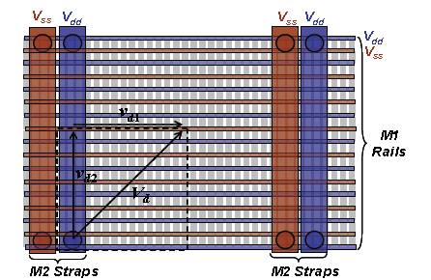





Monolithic 3D Heat Removal Architecture (Achievable with Monolithic 3D vertical interconnect density)
p_{x}
Signal wire
p_{y}
Heat sink
Global power grid shared among multiple device layers, local power grid for each device layer
Local V_{DD} grid architecture shown above
Optimize all cells in library to have low thermal resistance to V_{DD}/V_{SS} lines (local heat sink)
Without Power Grid
With Power Grid
Patented and Patent Pending Technology

Slide 36
The Monolithic 3D Advantage
  1. Reduction die size and power – doubling transistor count - Extending Moore’s law
  Monolithic 3D is far more than just an alternative to 0.7x scaling !!!
  2. Significant advantages from using the same fab, design tools
  3. Heterogeneous Integration
  4. Multiple layers Processed Simultaneously - Huge cost reduction (Nx)
  Logic redundancy => 100x integration made possible
  3D FPGA prototype, 2D volume
  7. Enables Modular Design
  8. Naturally upper layers are SOI
  9. Local Interconnect above and below transistor layer
  10. Re-Buffering global interconnect by upper strata
  11. Others
  A. Image sensor with pixel electronics
  B. Micro-display

Slide 37
Summary
We have reached an inflection point
Multiple practical paths to monolithic 3D exist
Heat removal of monolithic 3D could be designed in
Breaking News – The process barriers are now removed
=> Monolithic 3D – The Most Effective Path for Future IC Scaling

