Slide 1


THE MONOLITHIC 3D-IC
A DISRUPTOR TO THE SEMICONDUCTOR INDUSTRY
MonolithIC 3D™ Inc. Patents Pending
1

Slide 2
Agenda:
Monolithic 3D – the emerging path for the next generation technology driver
The thermal challenge and solution - for the fabrication of monolithic 3D IC
The thermal challenge and solution - for the operation of monolithic 3D IC

Slide 3
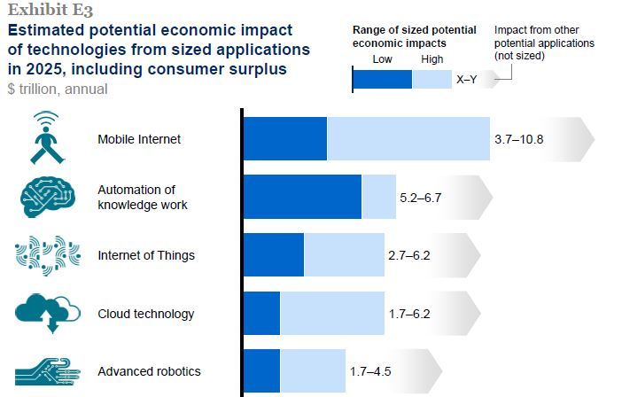
$15-34 trillion, annual =>~$5T Semi /year
Source: McKinsey Global Institute Analysis 2013

Slide 4
Cisco sees $19 Trillion opportunity in IoT
“CES LIVE: Cisco's Chambers Says Internet of Everything, $19 Trillion Opportunity, Is Next Big Thing” 1/7/14
<ttp://www.forbes.com/sites/connieguglielmo/2014/01/07/ces-live-cisco-ceo-chambers-to-deliver-keynote/>
$19 trillion: that’s the opportunity he says for the Internet of Everything in the private and public sector combined. Breakout is $14.4 trillion in private sector and $4.6 trillion in public sector of new revenue generation or new savings. That’s a conservative number he says for public sector.
“This will be bigger than anything done in high tech in a decade.”
“As many as 50 billion devices will be connected to the Internet by 2020, creating a $14.4 trillion business opportunity” said Rob Lloyd, president of sales and development at Cisco, <http://www.eetimes.com/electronics-news/4409928/Cisco-sees--14-trillion-opportunity-in-Internet-of-Things>

Slide 5
Semiconductor Industry is Facing an
Inflection Point
Dimensional Scaling has reached Diminishing Returns

Slide 6
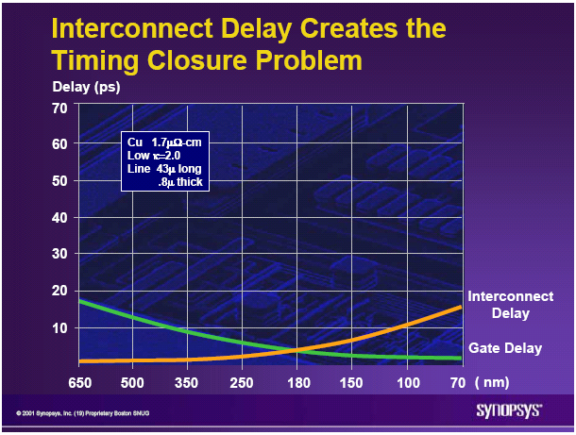
The Current 2D-IC is Facing Escalating Challenges - I
On-chip interconnect is
  Dominating device power consumption
  Dominating device performance
  Penalizing device size and cost

Slide 7
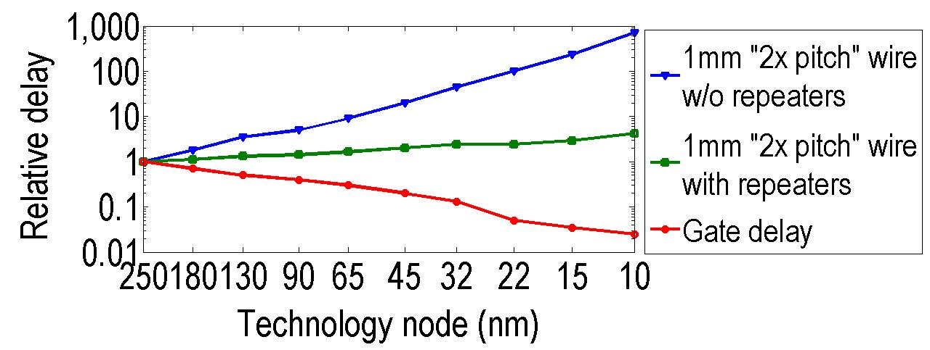
Interconnect Delay
A Big Issue with Scaling
Source: ITRS
Transistors improve with scaling, interconnects do not
Even with repeaters, 1mm wire delay ~50x gate delay at 22nm node
MonolithIC 3D™ Inc. Patents Pending
7

Slide 8
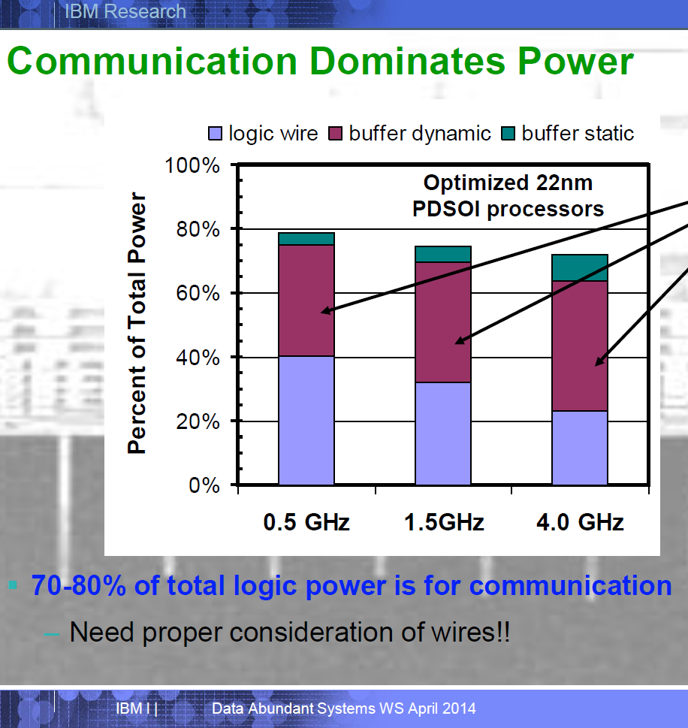
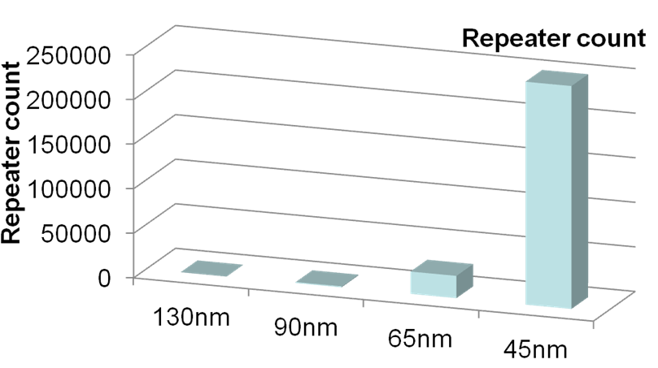
Connectivity Consumes 70-80% of Total Power @ 22nm
Repeaters Consume Exponentially More Power and Area
At 22nm, on-chip connectivity consumes 70-80% of total power
Repeater count increases exponentially
At 45nm, repeaters are > 50% of total leakage
MonolithIC 3D™ Inc. Patents Pending
Source: IBM POWER processors
R. Puri, et al., SRC Interconnect Forum, 2006

Slide 9
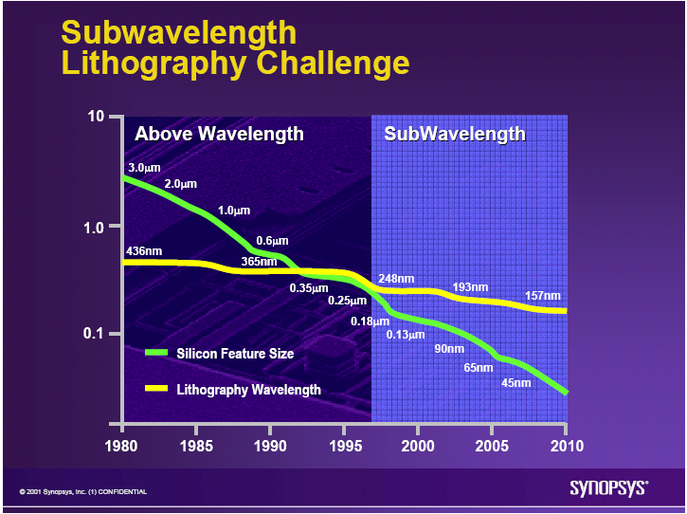
The Current 2D-IC is Facing Escalating Challenges - II
Lithography is
  Dominating Fab cost
  Dominating device cost and diminishing scaling’s benefits
  Dominating device yield
  Dominating IC development costs

Slide 10
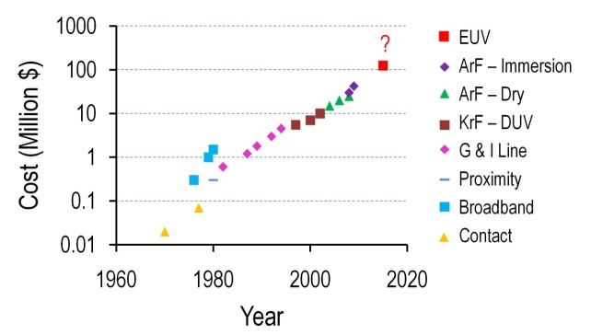
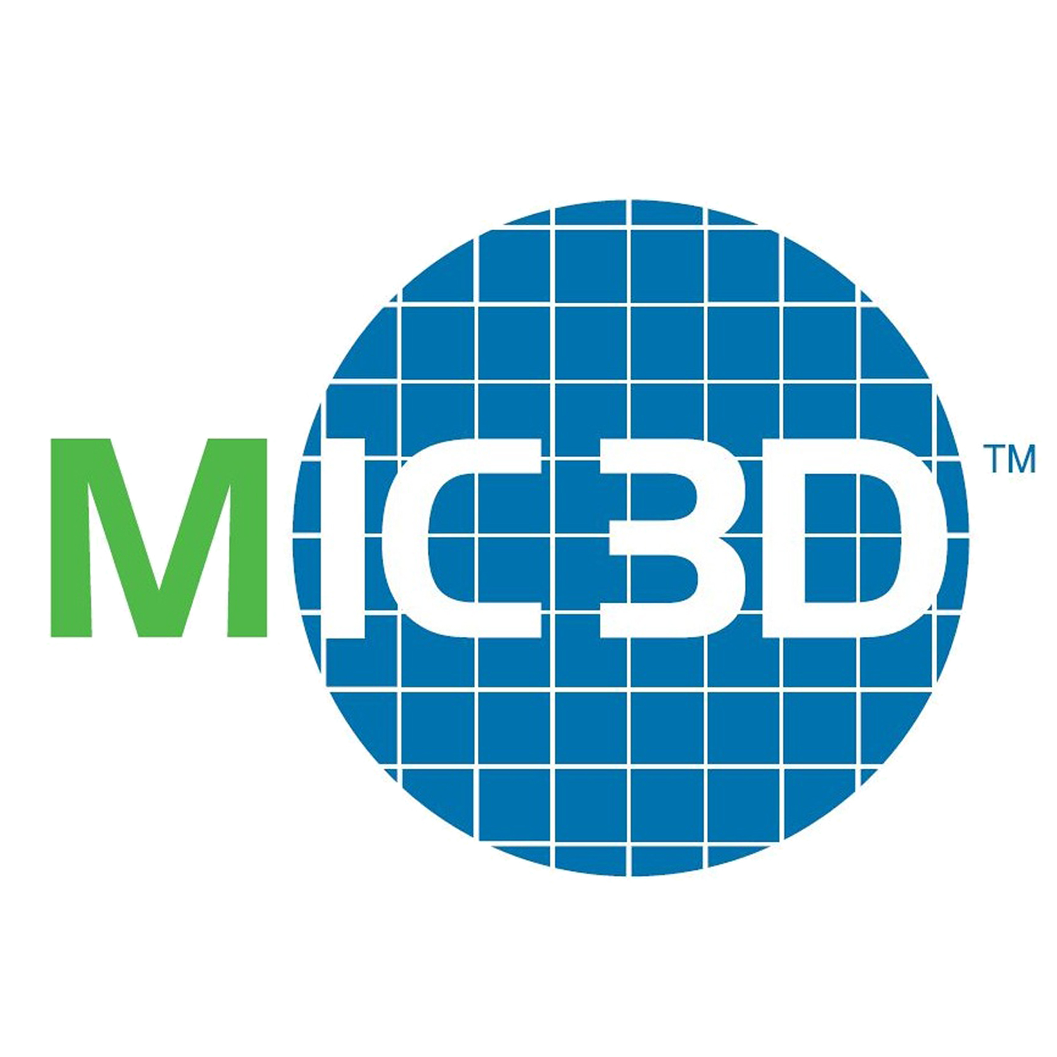
A Challenge: Lithography
Quad-patterning next year → costly. EUV delayed, costly.
Can we get benefits of scaling without relying on lithography?
MonolithIC 3D™ Inc. Patents Pending
10

Slide 11
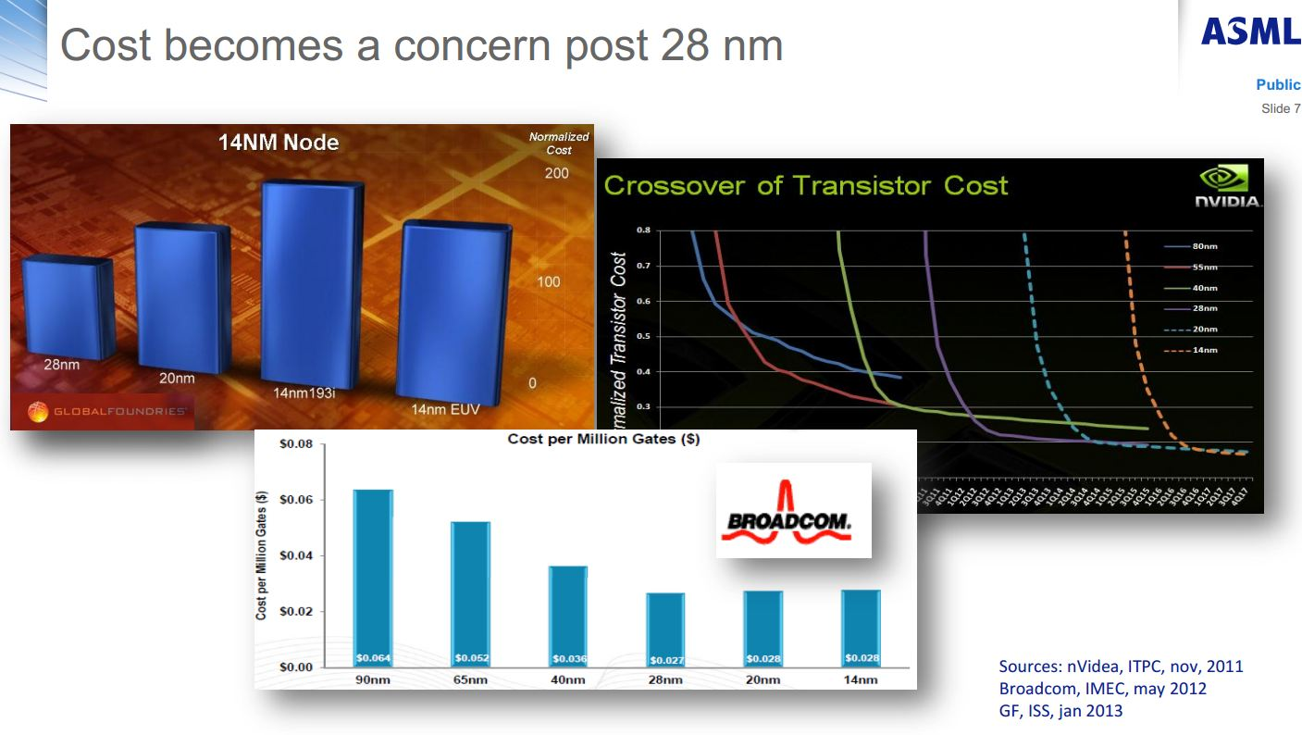
Martin van den Brink -EVP & CTO, ASML
ISSCC 2013 & SemiconWest 2013

Slide 12
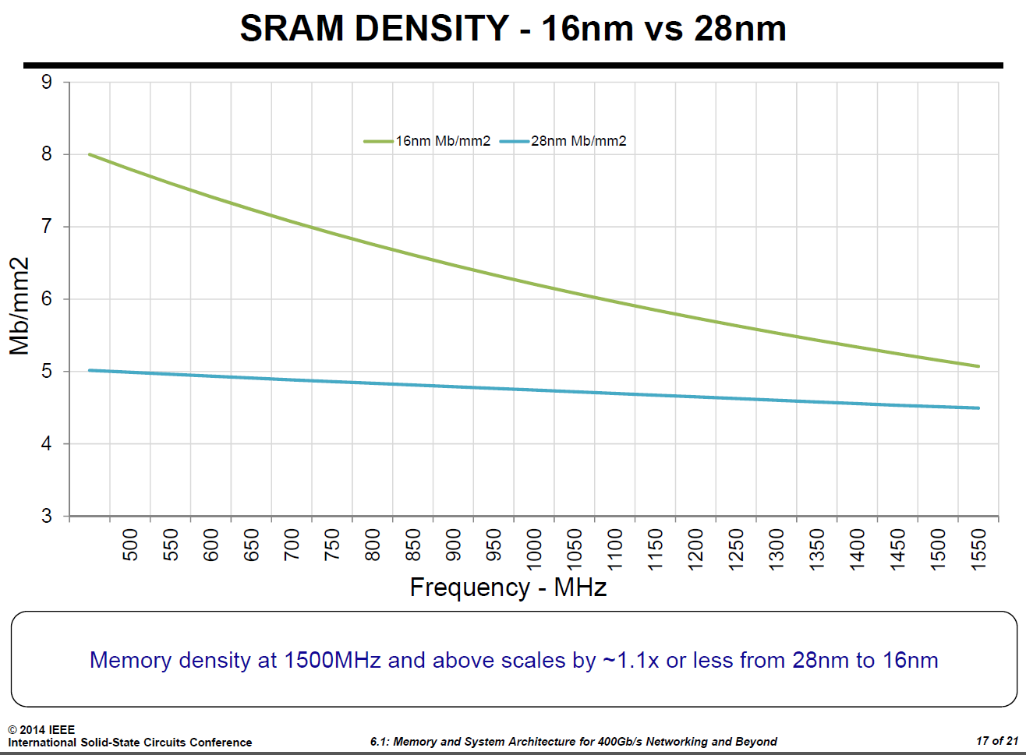
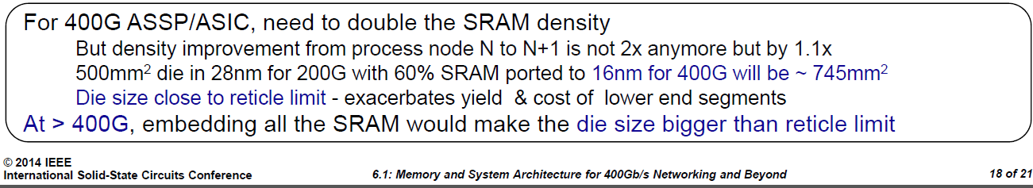
Embedded SRAM isn’t Scaling Beyond 28nm (1.1x instead off 4x)
eSRAM > 60% of Die Area => End of Dimension Scaling !
Dinesh Maheshwari, CTO, Memory Products Division at Cypress Semiconductors, ISSCC2014

Slide 13
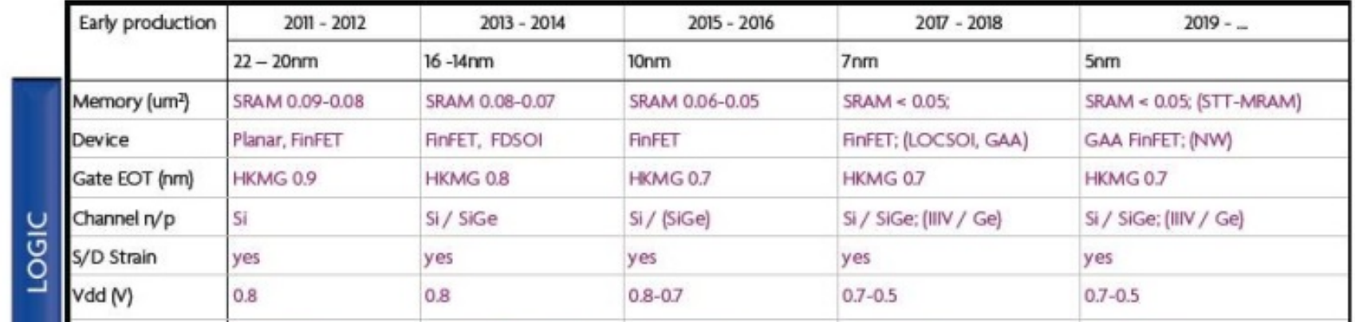
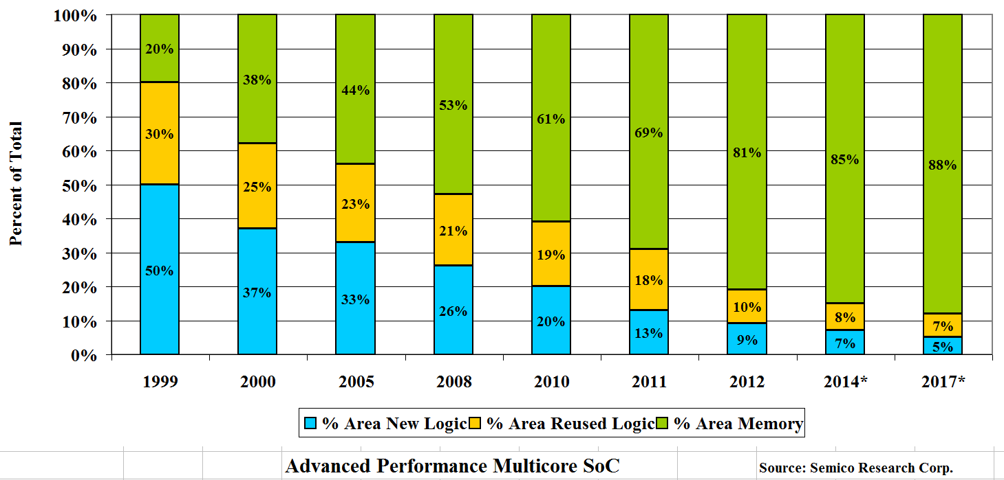
Embedded SRAM isn’t Scaling Beyond 28nm
eSRAM > 60% of Die Area => End of Dimensional Scaling !
*
*imec’s 2013 International Technology Forum,

Slide 14
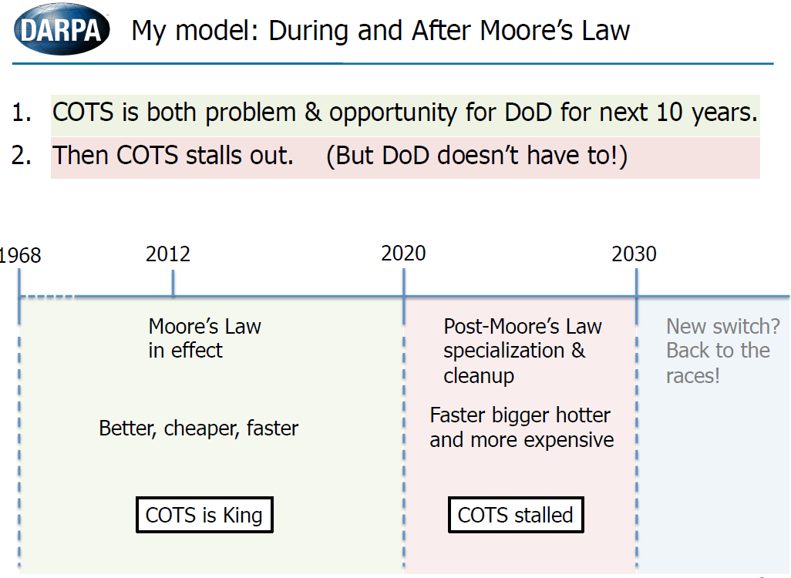
Moore's Law Dead by 2022*
Bob Colwell, Director MTO, DARPA
*http://www.eetimes.com/document.asp?doc_id=1319330
*CRA/CCC & ACM SIGDA, Pittsburgh, March 2013

Slide 15
Conclusions:
Dimensional Scaling (“Moore’s Law”) is already exhibiting diminishing returns
The road map beyond 2017 (7nm) is unclear
While the research community is working on many interesting new technologies (see below), none of them seem mature enough to replace silicon for 2019
    - Carbon nanotube - Indium gallium arsenide
    - Graphene - Spintronics
    - Nanowire - Molecular computing
    - Photonics - Quantum computing
3D IC is considered, by all, as the near term solution, and Monolithic 3D IC is well positioned to be so, as it uses the existing infrastructure!
  It is safe to state that Monolithic 3D is the only alternative that could be ready for high volume in 2019 !!

Slide 16
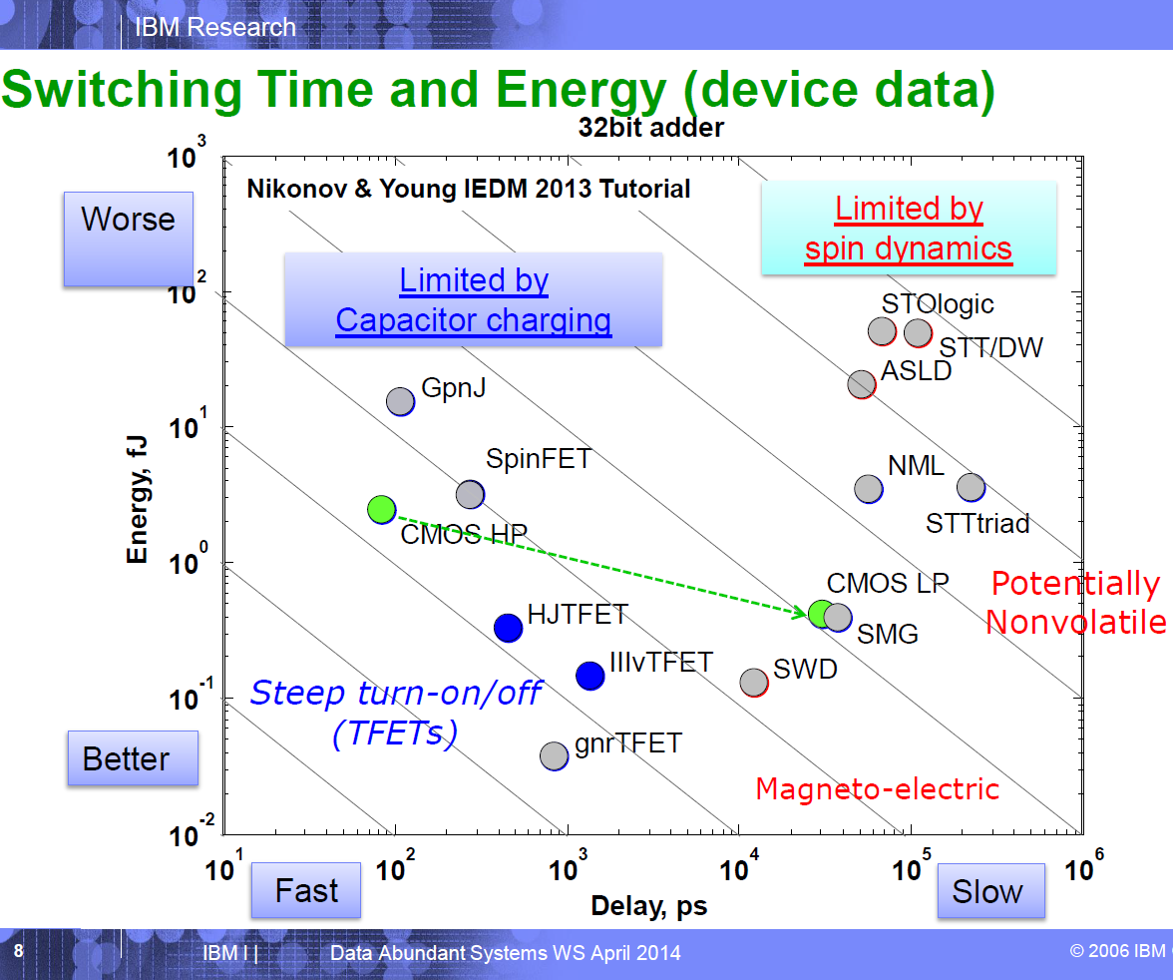
CMOS is the Best Device Option

Slide 18
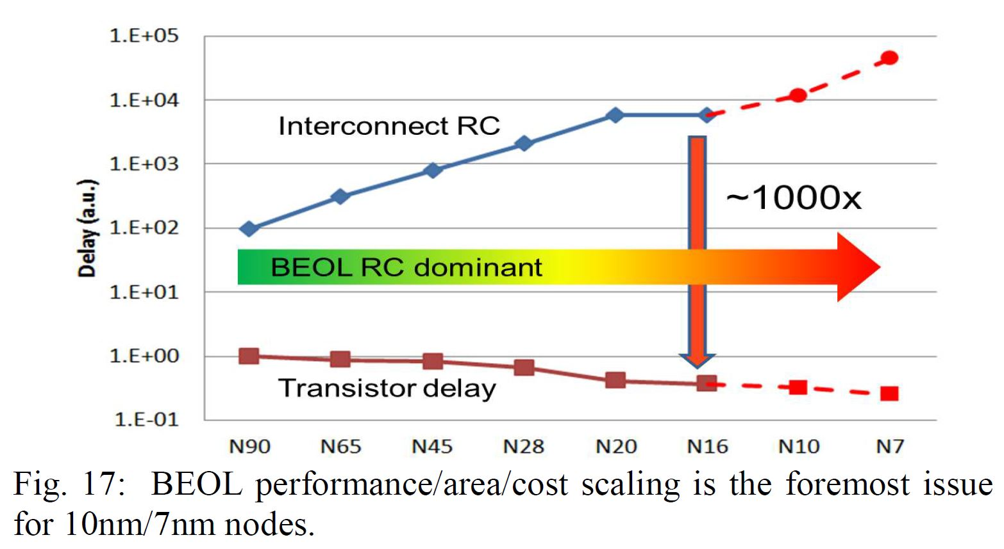
“CEA-Leti Signs Agreement with Qualcomm to Assess Sequential (monolithic)3D Technology”
Business Wire December 08, 2013
“Monolithic 3D (M3D) is an emerging integration technology poised to reduce the gap significantly between transistors and interconnect delays to extend the semiconductor roadmap way beyond the 2D scaling trajectory predicted by Moore’s Law.”
Geoffrey Yeap,
VP of Technology at Qualcomm,
Invited paper, IEDM 2013

Slide 19
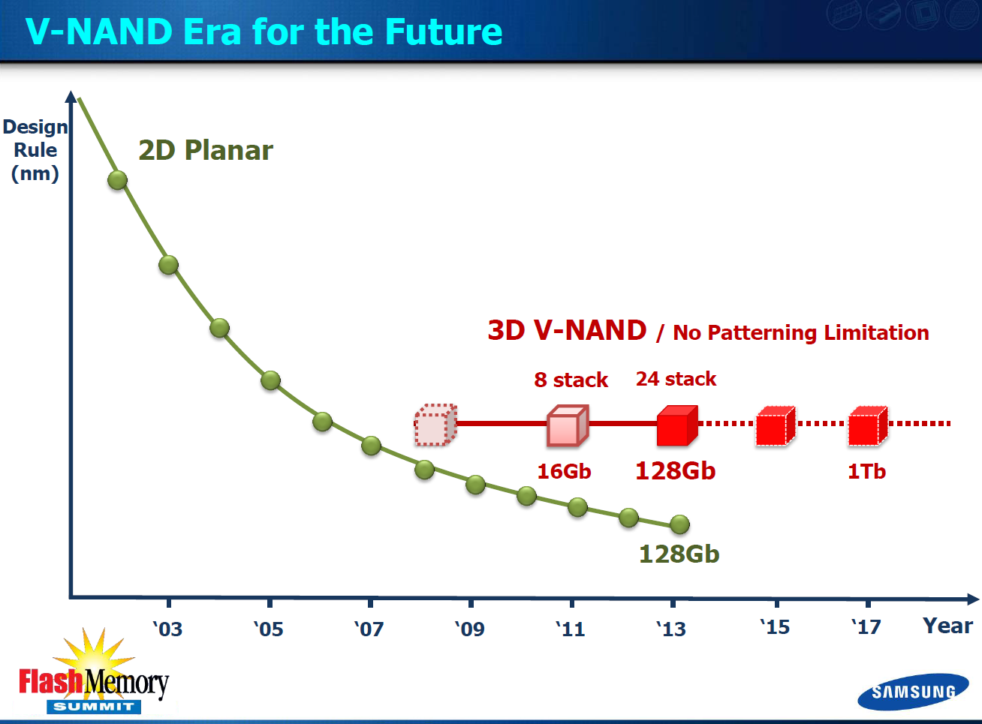

Slide 20
Two Types of 3D Technology
3D-TSV
Transistors made on separate wafer @ high temperature, then thin + align + bond
Monolithic 3D
Transistors made monolithically atop wiring (@ sub-400ºC for logic)
10um-
50um
100 nm
TSV pitch > 1um*
TSV pitch ~ 50-100nm
* [Reference: P. Franzon: Tutorial at IEEE 3D-IC Conference 2011]
20
Notes:
20

Slide 21
MONOLITHIC
10,000x the Vertical Connectivity of TSV
Enables: | TSV | Monolithic
Layer Thickness | ∼50μ | ~50nm
Via Diameter | ~5μ | ~50nm
Via Pitch | ~10μ | ~100nm
Wafer (Die) to Wafer Alignment | ~1μ | ~1nm
Overall Scale | microns | nano-meters

Slide 22
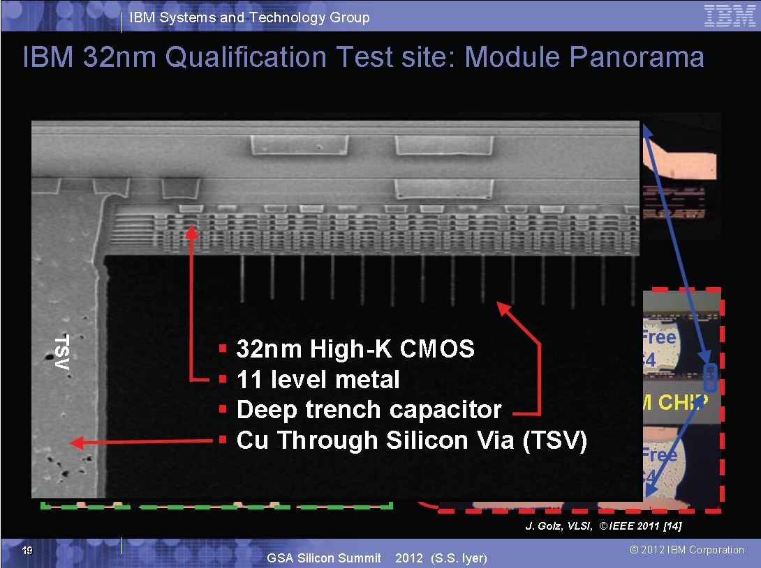
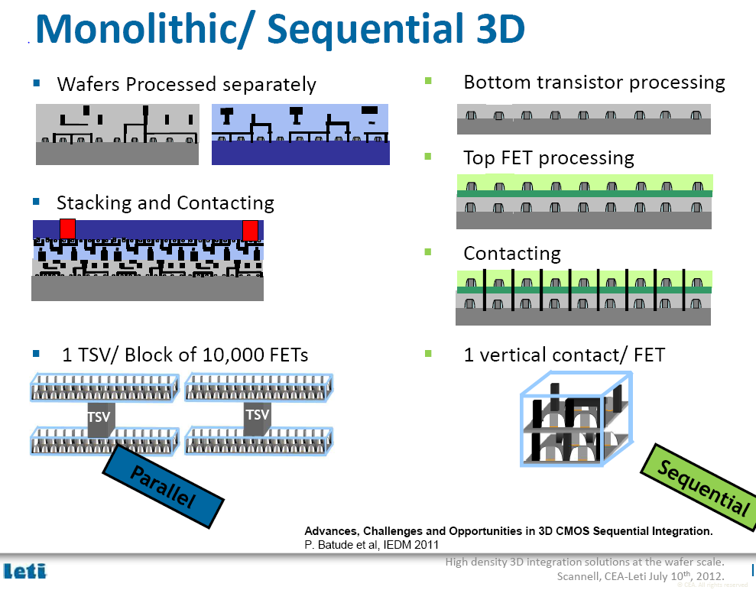

Slide 23
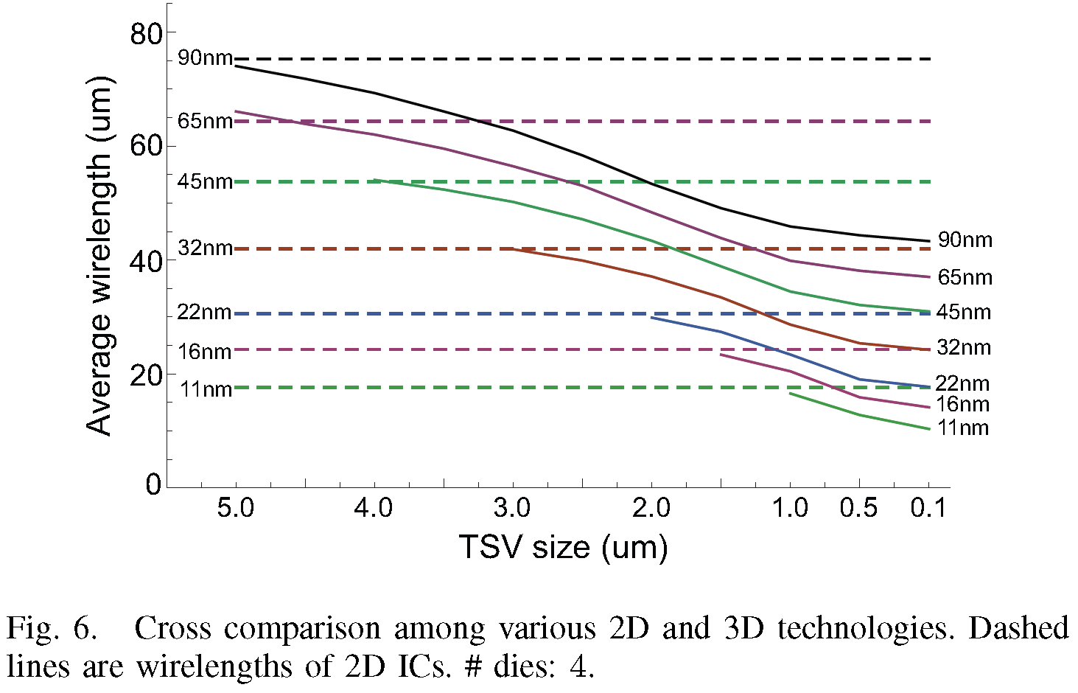
3D ICs in older process (65nm) is better than 2D ICs built with a newer process (32nm)
*IEEE IITC11 Kim

Slide 25
Agenda:
Monolithic 3D – the emerging path for the next generation technology driver
The thermal challenge and solution - for the fabrication of monolithic 3D IC
The thermal challenge and solution - for the operation of monolithic 3D IC

Slide 26
The Monolithic 3D Challenge
Why is it not already in wide use?
Processing on top of copper interconnects should not make the copper interconnect exceed 400ºC
    How to bring mono-crystallized silicon on top at less than 400ºC
    How to fabricate state-of-the-art transistors on top of copper interconnect and keep the interconnect below at less than 400ºC
Misalignment of pre-processed wafer to wafer bonding step is ~1um
    How to achieve 100nm or better connection pitch
    How to fabricate thin enough layer for inter-layer vias of ~50nm
MonolithIC 3D™ Inc. Patents Pending
26

Slide 27
MonolithIC 3D – Breakthrough
3 Classes of Solutions (3 Generations of Innovation)
RCAT (2009) – Process the high temperature on generic structures prior to ‘smart-cut’, and finish with cold processes – Etch & Depositions
Gate Replacement (2010) (=Gate Last, HKMG) - Process the high temperature on repeating structures prior to ‘smart-cut’, and finish with ‘gate replacement’, cold processes – Etch & Depositions
Laser Annealing (2012) – Use short laser pulse to locally heat and anneal the top layer while protecting the interconnection layers below from the top heat

Slide 28
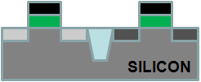
Layer Transfer (“Ion-Cut”/“Smart-Cut”)
→ The Technology Behind SOI
Cleave using 400ºC
anneal or sideways
mechanical force. CMP.
Hydrogen implant
of top layer
Flip top layer and
bond to bottom layer
Oxide
p- Si
Top layer
Oxide
H
p- Si
H
p- Si
p- Si
Oxide
Oxide
Oxide
Oxide
Oxide
Bottom layer
Similar process (bulk-to-bulk) used for manufacturing all SOI wafers today

Slide 29
MonolithIC 3D - 3 Classes of Solutions
RCAT – Process the high temperature on generic structure prior to ‘smart-cut’, and finish with cold processes – Etch & Depositions
Gate Replacement (=Gate Last, HKMG) - Process the high temperature on repeating structure prior to ‘smart-cut’, and finish with ‘gate replacement’, cold processes – Etch & Depositions
Laser Annealing – Use short laser pulse to locally heat and anneal the top layer while protecting the interconnection layers below from the top heat

Slide 30

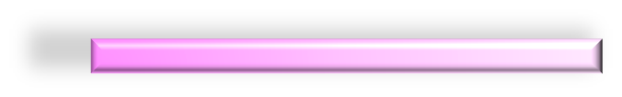

Step 1. Donor Layer Processing
Step 1 - Implant and activate unpatterned N+ and P- layer regions in standard donor wafer at high temp. (~900ºC) before layer transfer. Oxidize (or CVD oxide) top surface.
SiO₂ Oxide layer (~100nm) for oxide -to-oxide bonding with device wafer.
P-
N+
P-
Step 2 - Implant H+ to form cleave plane for the ion cut
P-
H+ Implant Cleave Line in N+ or below
N+
P-
MonolithIC 3D™ Inc. Patents Pending
30
Notes:
30
30

Slide 31
Step 3 - Bond and Cleave: Flip Donor Wafer and Bond to Processed Device Wafer
Cleave along
H+ implant line using 400ºC anneal or sideways mechanical force.
Polish with CMP.
-
Silicon
N+
<200nm)
P-
SiO₂ bond layers on base and donor wafers (alignment not an issue with blanket wafers)
Processed Base IC
MonolithIC 3D™ Inc. Patents Pending
31
Notes:
31
31

Slide 32
Step 4 - Etch and Form Isolation and RCAT Gate
Litho patterning with features aligned to bottom layer
Etch shallow trench isolation (STI) and gate structures
Deposit SiO₂ in STI
Grow gate with ALD, etc. at low temp
(<350º C oxide or high-K metal gate)
Gate
Oxide
Isolation
Gate
+N
Ox
Ox
Advantage: Thinned donor wafer is transparent to litho, enabling direct alignment to device wafer alignment marks: no indirect alignment. (common for TSV 3DIC)
P-
Processed Base IC
MonolithIC 3D™ Inc. Patents Pending
32
Notes:
32
32

Slide 33

Step 5 – Etch Contacts/Vias to Contact the RCAT
Complete transistors, interconnect wires on ‘donor’ wafer layers
Etch and fill connecting contacts and vias from top layer aligned to bottom layer
+N
P-
Processed Base IC
Processed Base IC
MonolithIC 3D™ Inc. Patents Pending
33
Notes:
33
33

Slide 34
MonolithIC 3D - 3 Classes of Solutions
RCAT – Process the high temperature on generic structure prior to ‘smart-cut’, and finish with cold processes – Etch & Depositions
Gate Replacement (=Gate Last, HKMG) - Process the high temperature on repeating structure prior to ‘smart-cut’, and finish with ‘gate replacement’, cold processes – Etch & Depositions
Laser Annealing – Use short laser pulse to locally heat and anneal the top layer while protecting the interconnection layers below from the top heat

Slide 35
Path 2 – Leveraging Gate Last + Innovative Alignment
Misalignment of pre-processed wafer to wafer bonding step is ~1um
    How to achieve 100nm or better connection pitch
    How to fabricate thin enough layer for inter-layer vias of ~50nm
1μ Misalignment
MonolithIC 3D™ Inc. Patents Pending
35

Slide 36
A Gate-Last Process for Cleave and Layer Transfer
NMOS
PMOS
Poly
Oxide
Donor wafer
Fully constructed transistors attached to each other; no blanket films
proprietary methods align top layer atop bottom layer
Device wafer
MonolithIC 3D™ Inc. Patents Pending
36
Notes:
36
36

Slide 37
A Gate-Last Process for Cleave and Layer Transfer
Step 3.
Implant H for cleaving
Step 4.
Bond to temporary carrier wafer (adhesive or oxide-to-oxide)
Cleave along cut line
CMP to STI
NMOS
PMOS
Carrier
STI
H+ Implant Cleave Line
CMP to STI
MonolithIC 3D™ Inc. Patents Pending
37
Notes:
37
37

Slide 38
A Gate-Last Process for Cleave and Layer Transfer
Carrier
Step 5.
Low-temp oxide deposition
Bond to bottom layer
Remove carrier
Oxide-oxide bond
NMOS
PMOS
Foundation
MonolithIC 3D™ Inc. Patents Pending
38
Notes:
38
38

Slide 39
A Gate-Last Process for Cleave and Layer Transfer
Remove (etch) dummy gates, replace with HKMG
Step 6. On transferred layer:
Etch dummy gates
Deposit gate dielectric and electrode
CMP
Etch tier-to-tier vias thru STI
Fabricate BEOL interconnect
NMOS
PMOS
NMOS
PMOS
MonolithIC 3D™ Inc. Patents Pending
39

Slide 40
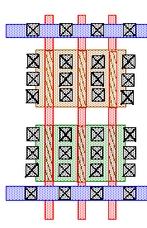
Novel Alignment Scheme using Repeating Layouts
Oxide
Landing pad
Through-layer connection
Bottom layer
layout
Top layer
layout
Even if misalignment occurs during bonding →
repeating layouts allow correct connections
Above representation simplistic (high area penalty)
MonolithIC 3D™ Inc. Patents Pending
40
Notes:
40
40

Slide 41
A More Sophisticated Alignment Scheme
Oxide
Landing pad
Through-layer connection
Bottom layer
layout
Top layer
layout
MonolithIC 3D™ Inc. Patents Pending
41
Notes:
41
41

Slide 42
MonolithIC 3D - 3 Classes of Solutions
RCAT – Process the high temperature on generic structures prior to ‘smart-cut’, and finish with cold processes – Etch & Depositions
Gate Replacement (=Gate Last, HKMG) - Process the high temperature on repeating structures prior to ‘smart-cut’, and finish with ‘gate replacement’, cold processes – Etch & Depositions
Laser Annealing – Use short laser pulse to locally heat and anneal the top layer while protecting the interconnection layers below from the top heat

Slide 43
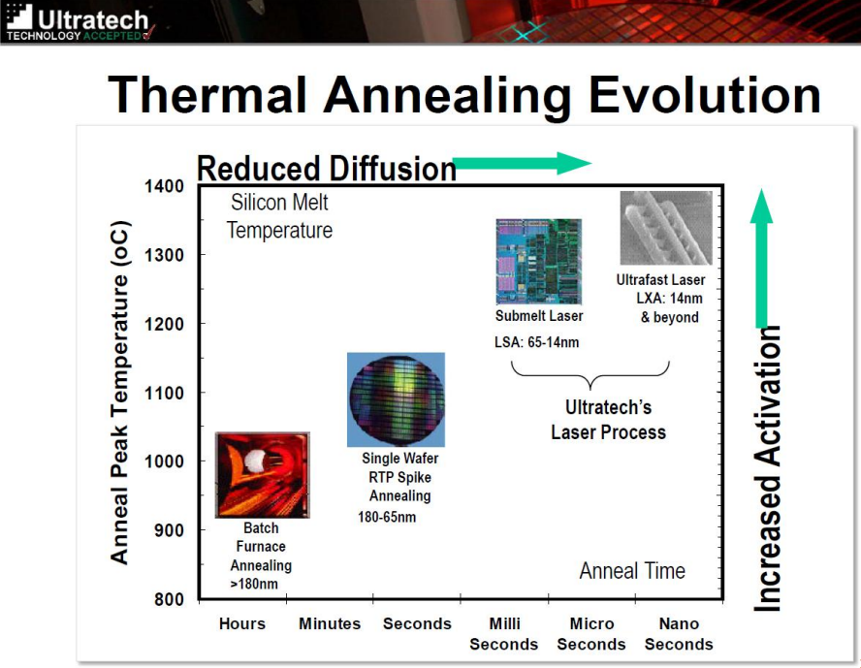
Annealing Trend with Scaling

Slide 44
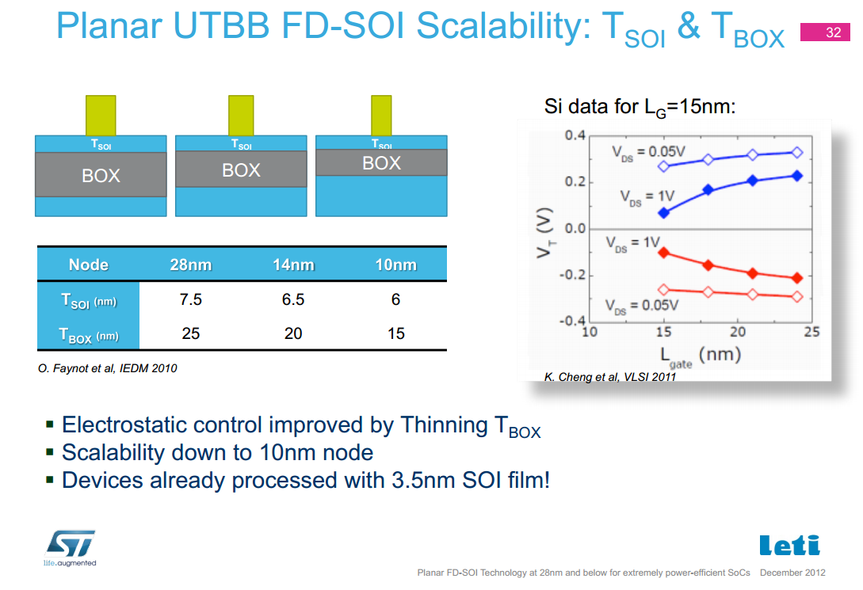

Slide 45
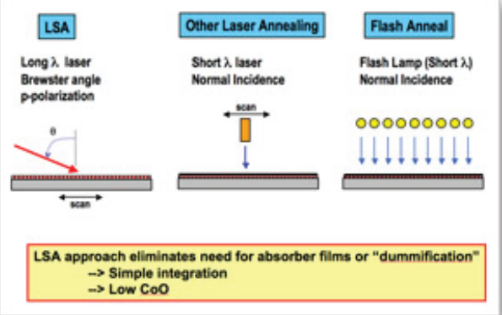
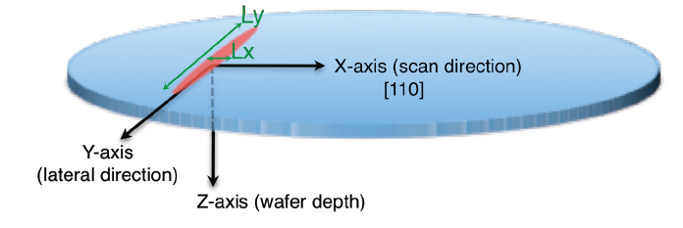
LSA 100A – Short Pulse, Small Spot
Dwell time ~ 275µs

Slide 46
Two Major Semiconductor Trends help make Monolithic 3D Practical NOW
As we have pushed dimensional scaling:
  The volume of the transistor has scaled
    Bulk um-sized transistors FDSOI & FinFet nm transistors
  Processing times have trended lower
    Shallower & sharper junctions, tighter pitches, etc.
=> Much less to heat and for much shorter time

Slide 47
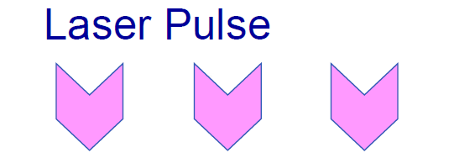
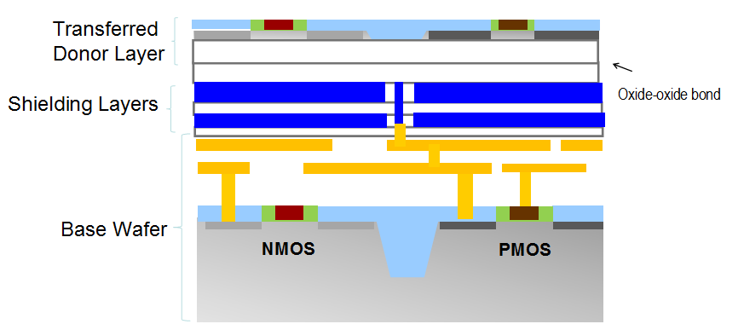
The Top Layer has a High Temperature >1000°C)
without Heating the Bottom Layers (<400°C) !!!
}
>1000°C
}
<400°C

Slide 48
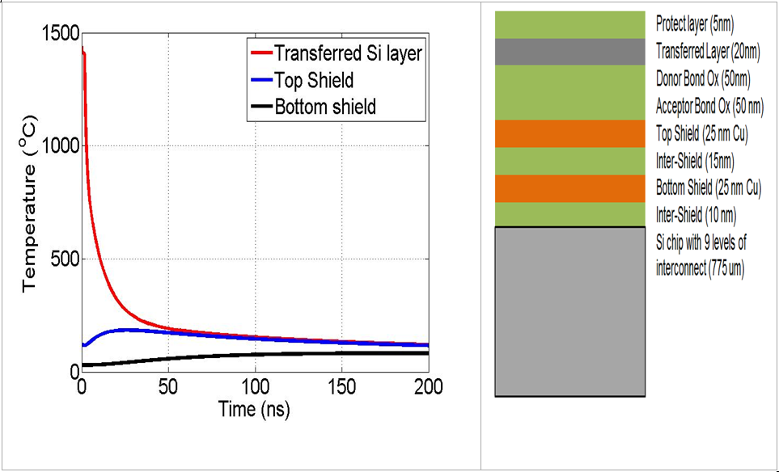
Process Window Set to Avoid Damage
Temperature variation at the 20 nm thick Si source/drain region in the upper active layer during laser annealing.
Note that the shield layers are very effective in preventing any large thermal excursions in the lower layers

Slide 49
Agenda:
Monolithic 3D – the emerging path for the next generation technology driver
The thermal challenge and solution - for the fabrication of monolithic 3D IC
The thermal challenge and solution - for the operation of monolithic 3D IC

Slide 50
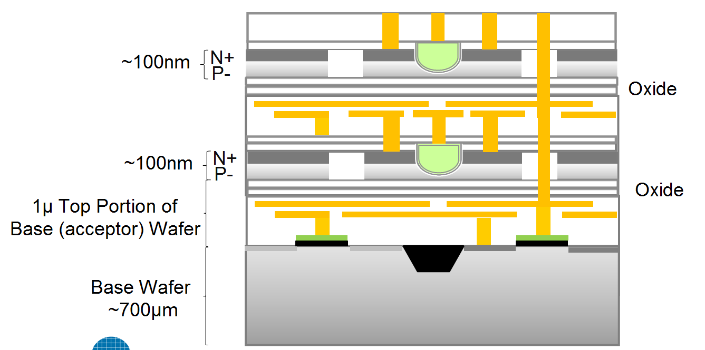
The Operational Thermal Challenge
Upper tier transistors are fully surrounded by oxide and have no thermal path to remove operational heat away
Poor Heat Conduction
~1 W/mK
Good Heat Conduction
~100 W/mK

Slide 51
The Solution
Use Power Delivery (Vdd, Vss) Network (“PDN”) also for heat removal
Add heat spreader to smooth out hot spots
Add thermally conducting yet electrically non-conducting contacts to problem areas such as transmission gates

Slide 52
Cooling Three-Dimensional Integrated Circuits using
Power Delivery Networks (PDNs)
IEDM 2012 Paper
Hai Wei, Tony Wu, Deepak Sekar⁺, Brian Cronquist*, Roger Fabian Pease, Subhasish Mitra
Stanford University, Rambus⁺, Monolithic 3D Inc.*
52

Slide 53
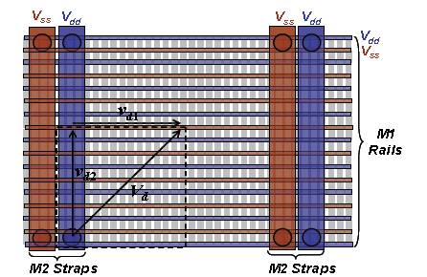





Monolithic 3D Heat Removal Architecture (Achievable with Monolithic 3D vertical interconnect density)
p_{x}
Signal wire
p_{y}
Heat sink
Global power grid shared among multiple device layers, local power grid for each device layer
Local V_{DD} grid architecture shown above
Optimize all cells in library to have low thermal resistance to V_{DD}/V_{SS} lines (local heat sink)
Without Power Grid
With Power Grid
Patented and Patent Pending Technology

Slide 54
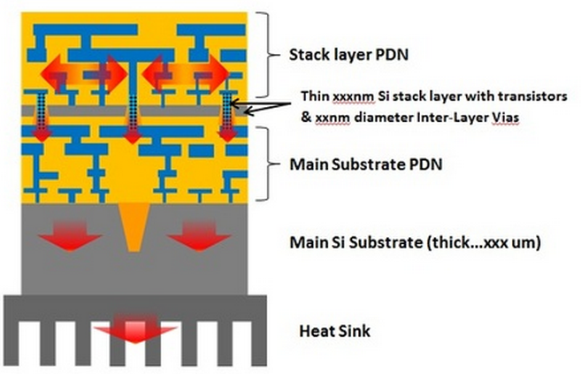
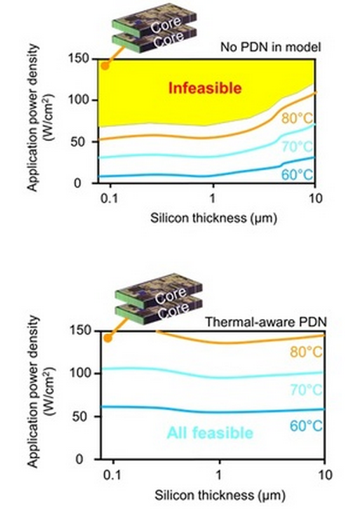
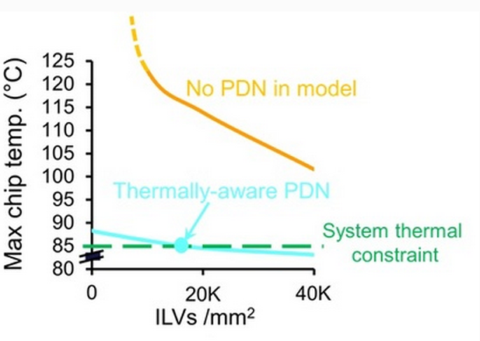
Power Delivery (Vdd, Vss) Network Provide effective Heat Removal Path

Slide 55
Heat Spreader
Heat spreader requirements
  Low heat resistance to 2nd tier silicon but electrically isolated
  Very good heat conduction
Other uses for heat spreader
  Deliver power – “ground plane”
  EMI isolation of 2nd tier from 1st tier
  Protect existing metal from the laser annealing process

Slide 56
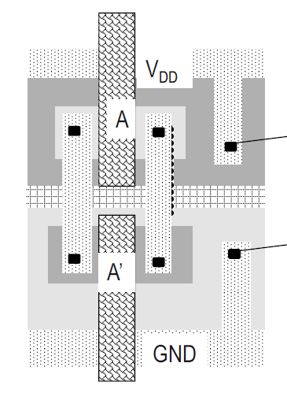
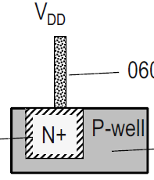
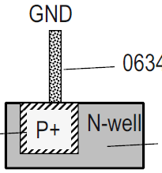
Heat Conducting Electrically Isolative Contacts
For transistor with no connection to the power network
Reverse bias diode

Slide 57
Summary
Monolithic 3D is now practical and well positioned to keep Moore’s Law alive for many years
Multiple paths to process mono-crystal transistors over copper interconnect
Effective options to remove heat from upper tier transistors within monolithic 3D IC

Slide 58
Back Ups

Slide 59
Monolithic 3D Provides an
Attractive Path to…
LOGIC
MEMORY
OPTO-ELECTRONICS
Monolithic 3D Integration with Ion-Cut Technology
3D-CMOS: Monolithic 3D Logic Technology
3D-FPGA: Monolithic 3D Programmable Logic
3D-GateArray: Monolithic 3D Gate Array
3D-Repair: Yield recovery for high-density chips
3D-DRAM: Monolithic 3D DRAM
3D-RRAM: Monolithic 3D RRAM
3D-Flash: Monolithic 3D Flash Memory
3D-Imagers: Monolithic 3D Image Sensor
3D-MicroDisplay: Monolithic 3D Display
3D-LED: Monolithic 3D LED
Can be applied to many market segments

Slide 60
The Monolithic 3D Advantage
  II. Reduction die size and power – doubling transistor count - Extending Moore’s law
  Monolithic 3D is far more than just an alternative to 0.7x scaling !!!
  III. Significant advantages from using the same fab, design tools
  IV. Heterogeneous Integration
  V. Multiple layers Processed Simultaneously - Huge cost reduction (Nx)
  VI. Logic redundancy => 100x integration made possible
  VII. Enables Modular Design
  VIII. Naturally upper layers are SOI
  IX. Local Interconnect above and below transistor layer
  X. Re-Buffering global interconnect by upper strata
  XI. Others
  A. Image sensor with pixel electronics
  B. Micro-display

Slide 61
Reduction of Die Size & Power – Doubling Transistor Count Extending Moore’s law
Reduction of Die Size & Power
IntSim v2.0 free open source >600 downloads

Slide 62
IV. Heterogeneous Integration
Logic, Memories, I/O on different strata
  Optimized process and transistors for the function
  Optimizes the number of metal layers
  Optimizes the litho. (spacers, older node)
Low power, high speed (sequential, combinatorial)
Different crystals – E/O

Slide 63
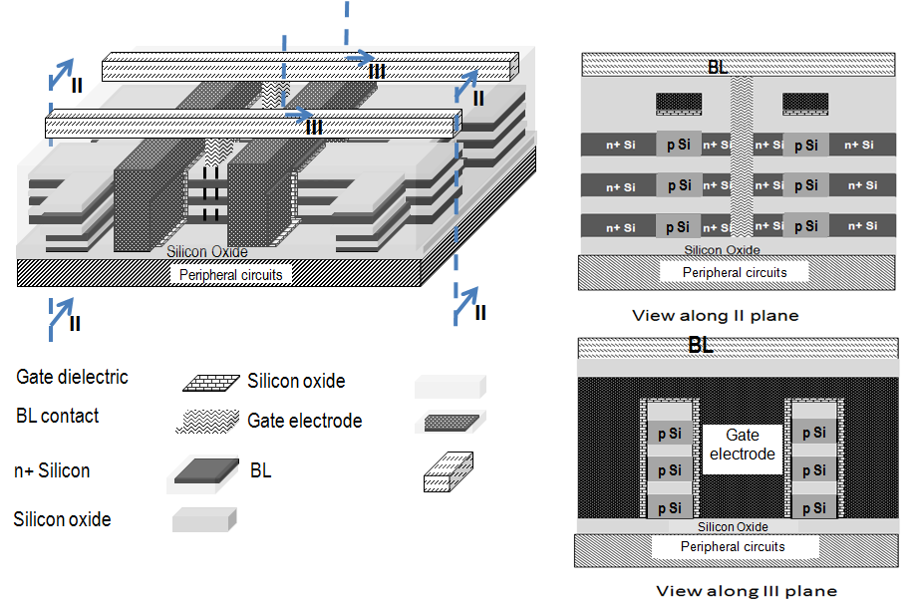
3D DRAM 3.3x Cost Advantage vs. 2D DRAM
 | Conventional stacked capacitor DRAM | Monolithic 3D DRAM with 4 memory layers
Cell size | 6F² | Since non self-aligned, 7.2F²
Density | x | 3.3x
Number of litho steps | 26 (with 3 stacked cap. masks) | ~26 extra masks for memory layers, but no stacked cap. masks)
MonolithIC 3D™ Inc. Patents Pending

Slide 64
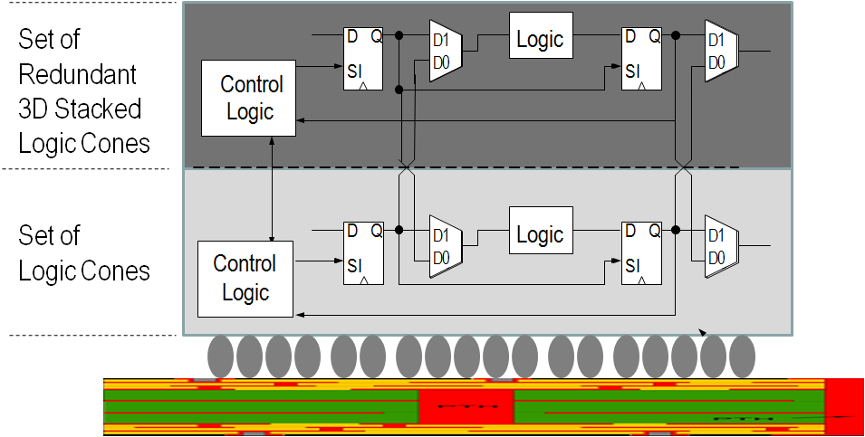
Innovation Enabling ‘Wafer Scale Integration’
– 99.99% Yield with 3D Redundancy
Gene Amdahl -“Wafer scale integration will only work with 99.99% yield, which won’t happen for 100 years” (Source: Wikipedia)
Swap at logic cone granularity
Negligible design and power penalty
Redundant 1μ above, no performance penalty
Server-Farm in a Box
Watson in a Smart Phone
…
MonolithIC 3D™ Inc. Patents Pending

Slide 65
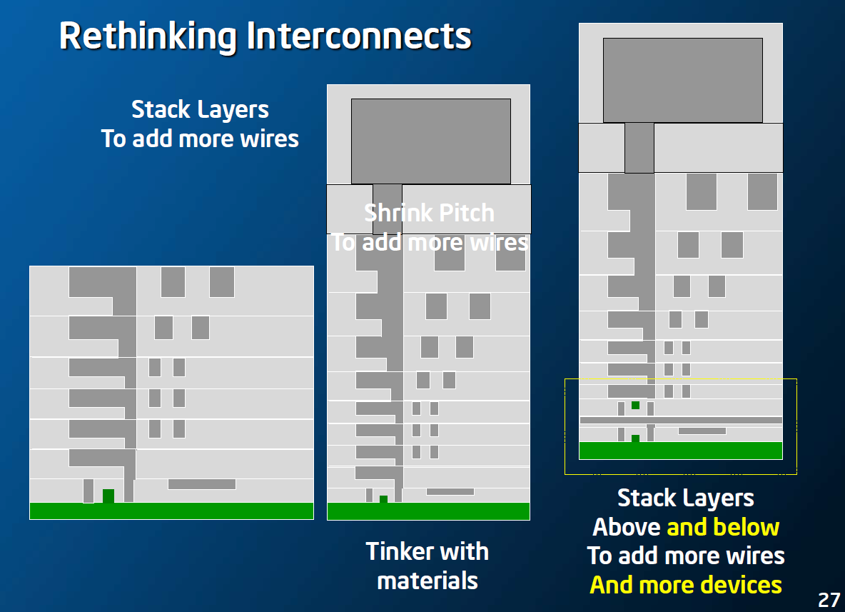
IX. Local Interconnect - Above and Below Transistor Layer
Intel March, 2013
Increased complexity requires increased connectivity. Adding more metal layer increases the challenge of connecting upper layers to the transistor layer below.

Slide 66
XI. Others
A. Image Sensor with Pixel Electronics
With rich vertical connectivity, every pixel of an image sensor could have its own pixel electronics underneath
MonolithIC 3D™ Inc. Patents Pending

