Slide 1
Low Power Design, Past and Future
Bob Brodersen (UCB),
Anantha Chandrakasan (MIT) and
Dejan Markovic (UCLA)

Slide 2
Acknowledgements
Rahul Rithe (MIT)
Mehul Tikekar (MIT)
Chengcheng Wang (UCLA)
Fang-Li Yuan (UCLA)

Slide 3
Technologies evolved to obtain improved Energy Efficiency
1940-1945 Relays
1945-1955 Vacuum Tubes
1955-1970 Bipolar - ECL, TTL, I²L
1970-1975 PMOS and NMOS Enhancement mode
1975-1980 NMOS Depletion mode
1975-2005 CMOS with Feature size, Voltage and Frequency Scaling
(The Golden Age)

Slide 4
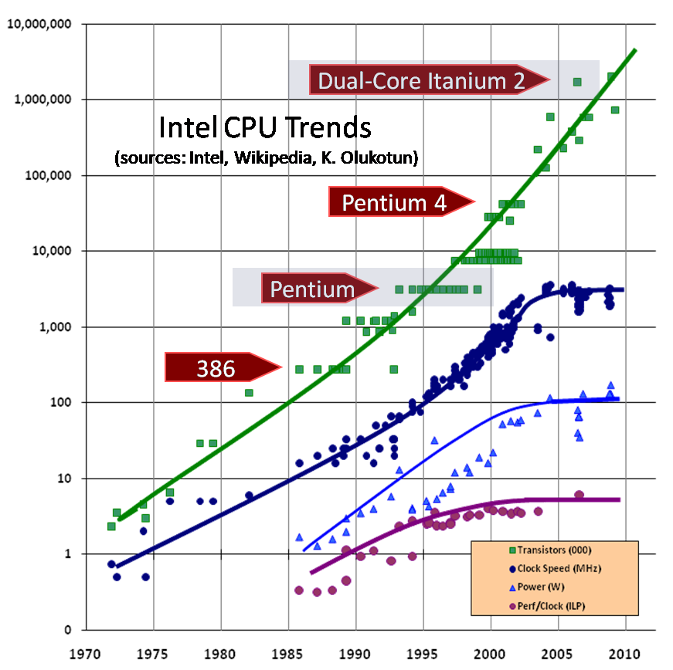
The End of (Energy) Scaling is Here
Number of transistors increase and will continue to increase with CMOS technology and 3D integration
But….
For energy efficiency of logic it is the voltage and frequency that is critical and they aren’t scaling

Slide 5
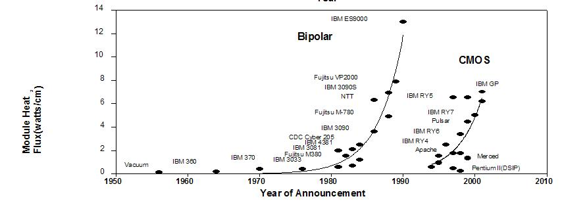
Now what??
Do we need a fundamentally new device like in the past? Carbon nanotube, Spin transistor?

Slide 6
Now what??
Do we need a fundamentally new device like in the past? Carbon nanotube, Spin transistor?
It really isn’t necessary!
Other considerations are becoming more important than the logic device
There are other ways to stay on a “Moore’s Law” for energy efficiency

Slide 7
Definitions…
Operation = OP = algorithmically interesting operation (i.e. multiply, add, memory access)
MOPS = Millions of OP’s per Second
N_{op} = Number of parallel OP’s in each clock cycle

Slide 8
Energy and Power Efficiency
MOPS/mW = OP/nJ
Power efficiency metric = Energy efficiency metric
Energy Efficiency = Number of useful operations Energy required
= # of Operations = OP/nJ
NanoJoule
= OP/Sec = MOPS = Power Efficiency
NanoJoule/Sec mW

Slide 9
Design Techniques to reduce energy/power
System – Protocols, sleep modes, communication vs. computation
Algorithms – Minimize computational complexity and maximize parallelism
Architectures – Tradeoff flexibility against energy/power efficiency
Circuits – Optimization at the transistor level

Slide 10
Design Techniques to reduce energy/power
System – Protocols, sleep modes, communication vs. computation
Algorithms – Minimize computational complexity and maximize parallelism
Architectures – Tradeoff flexibility against energy/power efficiency
Circuits – Optimization at the transistor level

Slide 11
Future Circuit Improvements (other than memory)
Functional over wide supply range for use with dynamic voltage scaling and optimized fixed supplies
Power down and sleep switches to facilitate dark silicon
Tradeoff speed and density for leakage reduction
Optimized circuits to support near V_{t} and below V_{t} operation with low clock rates
However, these improvements will only be effective if developed along with new architectures

Slide 12
The memory problem (a circuit and device issue)
DRAM’s are incredibly inefficient (40 nm, 1V)
6 OP/nJ (OP = 16 bit access)
A 16 bit adder (40 nm at .5 V)
60,000 OP/nJ (OP= 16 bit add)
1000 times lower efficiency than logic!
SRAM’s are better
8 T cell .5 V - 330 OP/nJ (M. Sinangil et. al. JSSC 2009)
10T cell .5V - 590 OP/nJ (S. Clerc et. al. 2012 ICICDT)
Example of using more transistors to improve energy efficiency (more will be coming)

Slide 13
Design Techniques to reduce energy/power
System – Protocols, sleep modes, communication vs. computation
Algorithms – Minimize computational complexity and maximize parallelism
Architectures – Tradeoff flexibility against energy/power efficiency
Circuits – Optimization at the transistor level

Slide 14
Year 1997-2000 ISSCC Chips (.18μ-.25μ)
Chip #
Year
Paper
Description
Chip #
Year
Paper
Description
1
1997
10.3
μP - S/390
11
1998
18.1
DSP -Graphics
2
2000
5.2
μP – PPC (SOI)
12
1998
18.2
DSP - Multimedia
DSP’s
3
1999
5.2
μP - G5
13
2000
14.6
DSP –
Multimedia
4
2000
5.6
μP - G6
14
2002
22.1
DSP –
Mpeg Decoder
Microprocessors
5
2000
5.1
μP - Alpha
15
1998
18.3
DSP - Multimedia
6
1998
15.4
μP - P6
16
2001
21.2
Encryption Processor
7
1998
18.4
μP - Alpha
17
2000
14.5
Hearing Aid Processor
Dedicated
8
1999
5.6
μP – PPC
18
2000
4.7
FIR for Disk Read Head
9
1998
18.6
DSP -
StrongArm
19
1998
2.1
MPEG Encoder
DSP’s
10
2000
4.2
DSP – Comm
20
2002
7.2
802.11a Baseband

Slide 15
What is the key architectural feature which gives the best energy efficiency (15 years ago)?
We’ll look at one from each category…
WLAN
;;
Microprocessors
General
Purpose DSP
Dedicated
NEC
DSP
PPC

Slide 16
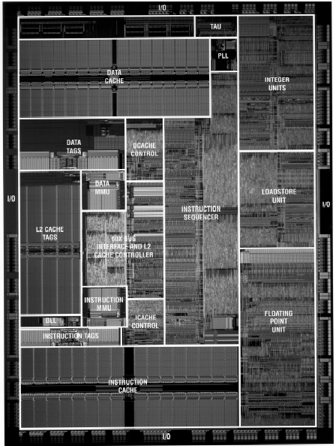
Uniprocessor (PPC): MOPS/mW=.13
The only circuitry which
supports “useful operations”
All the rest is overhead
to support the time multiplexing
Number of operations each clock cycle = N_{op} = 2
f_{clock} = 450 MHz (2 way)
= 900 MOPS
Power = 7 Watts

Slide 17
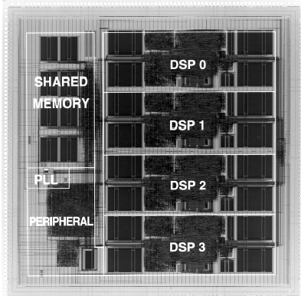
Programmable DSP: MOPS/mW=7
Same granularity (a
datapath), more parallelism
4 Parallel processors
(4 ops each)
N_{op} = 16
50 MHz clock
=> 800 MOPS
Power = 110 mW.

Slide 18
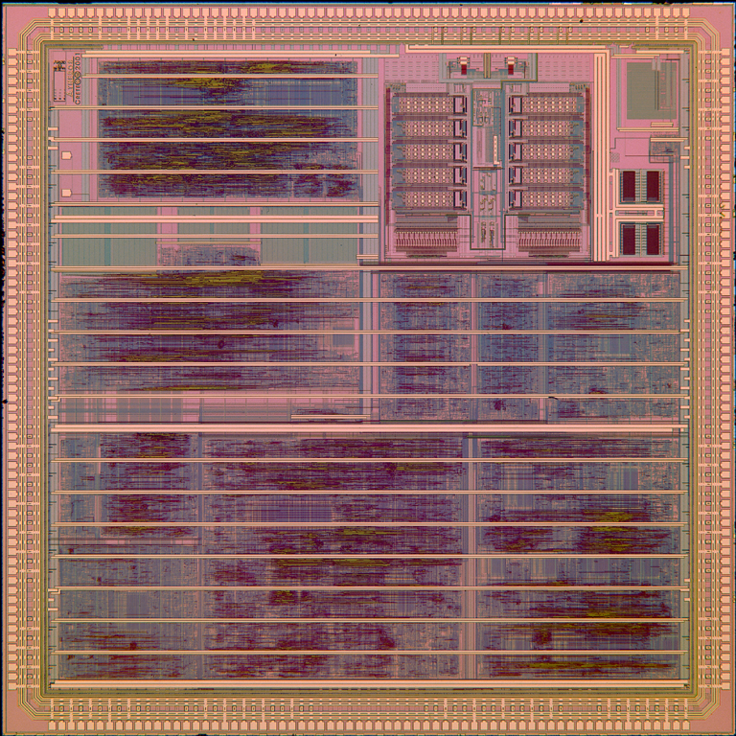
802.11a Dedicated Design - WLAN : MOPS/mW=200
Fully parallel mapping of an 802.11a implementation.
No time multiplexing.
N_{op} = 500
Clock rate = 80 MHz => 40,000 MOPS
Power = 200 mW
Viterbi
Decoder
ADC/DAC
MAC Core
FSM
AGC
DMA
Time/Freq
Synch
FFT
PCI

Slide 19
Now lets update the plot and look at more recent chips
(x.x) 2013 ISSCC Paper
SVD (90nm)
SDR Processor
Video Decoder (9.5)
Recognition Processor (9.8)
(9.6)
Computational
Photography
Application Processor (9.4)
Mobile Processors
(Atom, Snapdragon, Exynos, OMAP)
DSP Processor (7.5 – 2011)
24 Core Processor (3.6)
100,000 X
Fujitsu 4 Core FR550
Intel Sandy Bridge
Microprocessors
Programmable DSP
Dedicated

Slide 20
Lets again look at 3 of them
(x.x) 2013 ISSCC Paper
SVD (90nm)
SDR Processor
Video Decoder (9.5)
Recognition Processor (9.8)
(9.6)
Computational
Photography
Application Processor (9.4)
Mobile Processors
(Atom, Snapdragon, Exynos, OMAP)
DSP Processor (7.5 – 2011)
24 Core Processor (3.6)
Fujitsu 4 Core FR550
Intel Sandy Bridge
Microprocessors
Programmable DSP
Dedicated

Slide 21
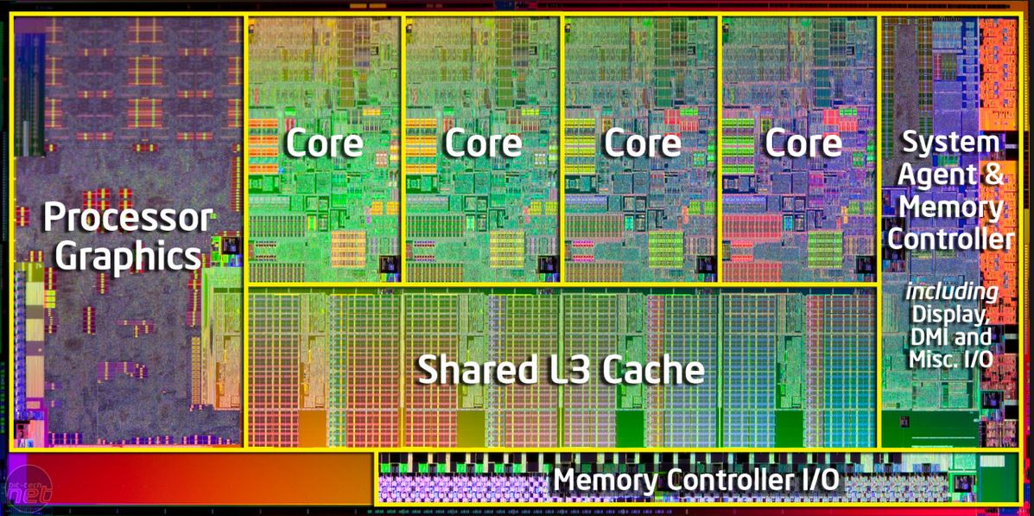
Microprocessor (Intel Sandy Bridge): MOPS/mW=.86
Number of operations each clock cycle = N_{op} = 27 f_{clock} = 3 GHz Performance = 81 GOPS
Power = 95 Watts

Slide 22
Mobile Processors: MOPS/mW = 200
Mobile Processors (Tegra, Atom, Snapdragon, Exynos, OMAP)
A combination of programmable dedicated and general purpose multicores
1/3 of power in internal busses
Dark silicon strategy – transistors that aren’t used

Slide 23
802.11a Dedicated Design – Computational Photography : MOPS/mW=55,000
Parallel, programmable implementation of computational photography functions
N_{op} = 5000
Clock rate = 25 MHz => 125,000 MOPS
V_{dd} = .5 V, Power = 2.3 mW
At Vdd = .9 V,
MOPS/mW =28,000
Rahul Rithe et. al. ISSCC 2013

Slide 24
Is all Parallelism Equal?
If you parallelize using an inefficient architecture it still will be inefficient.
Lets look at desktop computer multi-cores.
Do they really improve energy efficiency?
Can software be written for these architectures?

Slide 25
From a white paper from a VERY large semiconductor company
By incorporating multiple cores, each core is able to run at a lower frequency, dividing among them the power normally given to a single core. The result is a big performance increase over a single-core processor
This fundamental relationship between power and frequency can be effectively used to multiply the number of cores from two to four, and then eight and more, to deliver continuous increases in performance without increasing power usage.
Lets look at this…

Slide 26
Not much improvement with with a multi-core architecture and 15 years of technology scaling
Intel Pentium MMX (1998) 250nm
1.8 GOPS at 19 Watt, 2 V. and a 450 MHz clock
.1MOPS/mW
Intel Sandy Bridge Quad Core (2013) 32 nm
81 GOPS at 95 Watts, 1 V. and a 3 GHz clock
.9 MOPS/mW Only a ratio of 9 in MOPS/mW

Slide 27
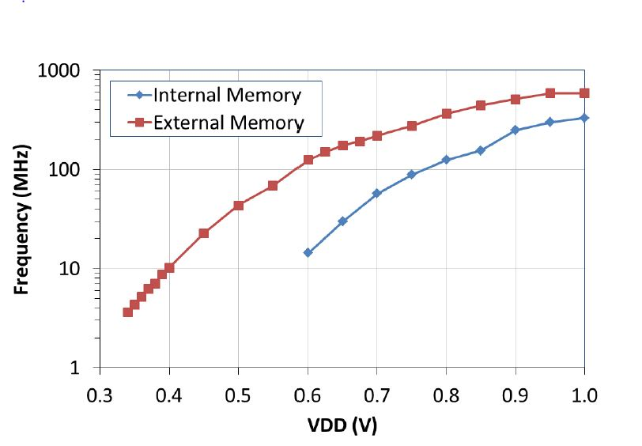
Duplicating inefficient Von Neumann architectures isn’t the solution
Power of a Multi-core chip = N_{cores}* CV² * f
10X reduction in power requires 170 cores for the same performance
To get 10X performance increase requires 1700 Cores!
Supply: 1V ->.34 V
Clock: 600 MHz->3.5 MHz
Mobile DSP, G. Gammie et. al. ISSCC 2011 7.5)

Slide 28
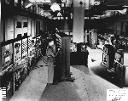
What is the basic problem?
The Von Neumann architecture was developed when
Hardware was expensive
Cost, size and power were not an issue
Time sharing the hardware was absolutely necessary – more transistors make this unnecessary and undesirable
Requires higher clock rates
Memory to store intermediate results and instructions

Slide 29
Another problem is software
"With multicore, it's like we are throwing this Hail Mary pass down the field and now we have to run down there as fast as we can to see if we can catch it." Dave Patterson – UC Berkeley (ISSCC Panel)
"The industry is in a little bit of a panic about how to program multi-core processors, especially heterogeneous ones. To make effective use of multi-core hardware today you need a PhD in computer science.” Chuck Moore - AMD

Slide 30
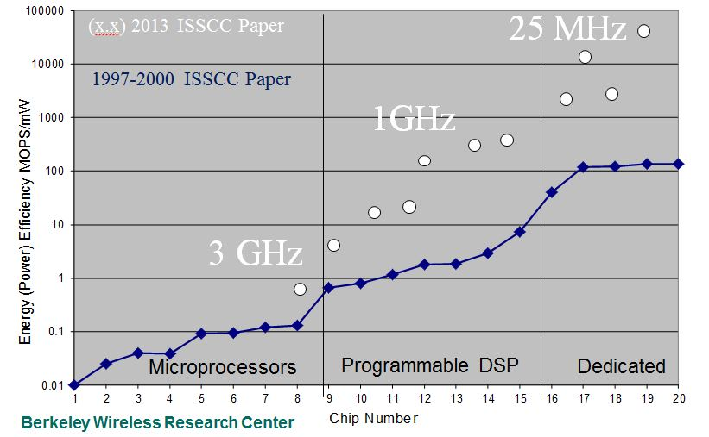
Clock rates
Dedicated designs with ultra high parallelism can operate in the near sub-threshold regime (.5 V and 25 MHz for 125 GOPS)
The quad core Intel Sandy Bridge requires a 3 GHz clock to achieve 81 GOPS
BUT it is fully flexible! Is there any other way to get this flexibility

Slide 31
Reconfigurable interconnect can provide application flexibility with high efficiency
Hierarchical interconnect with logic blocks
Hierarchical interconnect with LUTs
Commercial FPGA
with embedded blocks
Commercial FPGA
Microprocessors
Mobile Processors
Dedicated

Slide 32
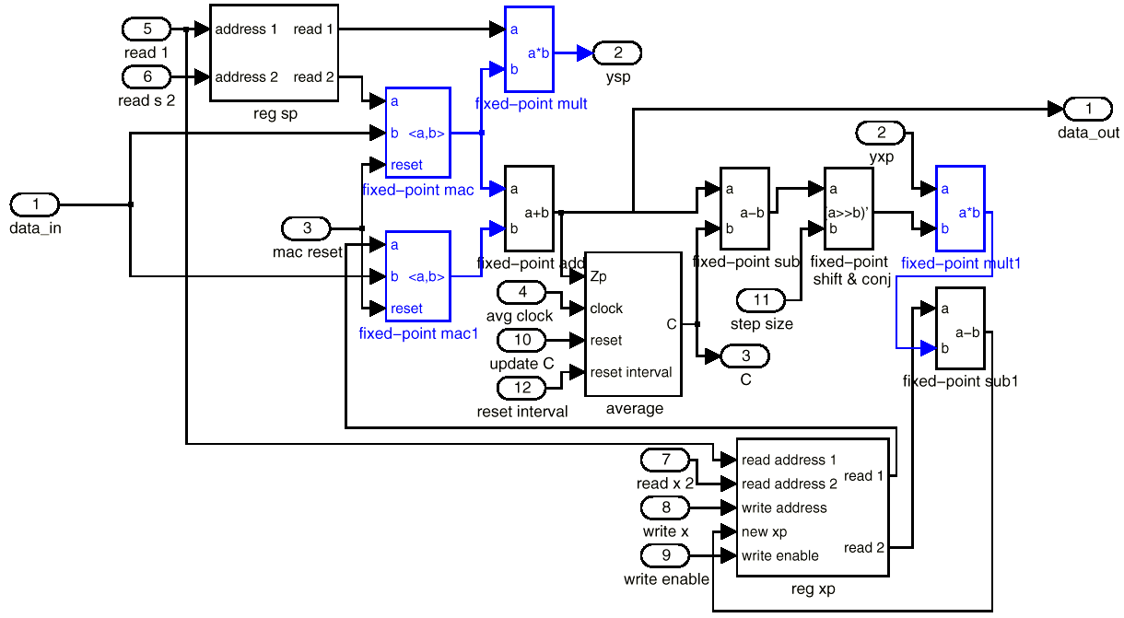
And there is a programming model – dataflow diagrams

Slide 33
The Most Important Technology Requirement
Continue the increase in the number of transistors (feature scaling, 3D integration, …)
Facilitates architectures with ultra high parallelism
Allows operation in near sub-threshold
Reduces the need for time multiplexing
Extra transistors to reduce leakage (power down, sleep modes, cascodes)
Improved memory energy efficiency (8T, 10T cells)
Allows many efficient specialized blocks that are only active part of the time “Dark Silicon”

Slide 34
Conclusions
CMOS technology scaling that improves performance and energy efficiency has ended but CMOS will continue
Reconfigurable interconnect is the most promising approach to fully flexible chips
More energy efficient memory structures are critical
Parallel architectures with the appropriate parallel units will be the key to continuing a “Moore’s Law” for energy and power efficiency

