Slide 1
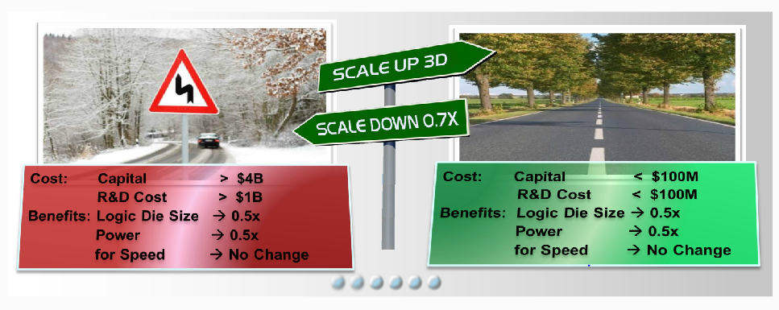
“Atoms Don’t Scale”=> What is Beyond 7nm (2019) ?
MonolithIC 3D™ - the Future of Semiconductor Scaling
Notes:
1
1

Slide 2
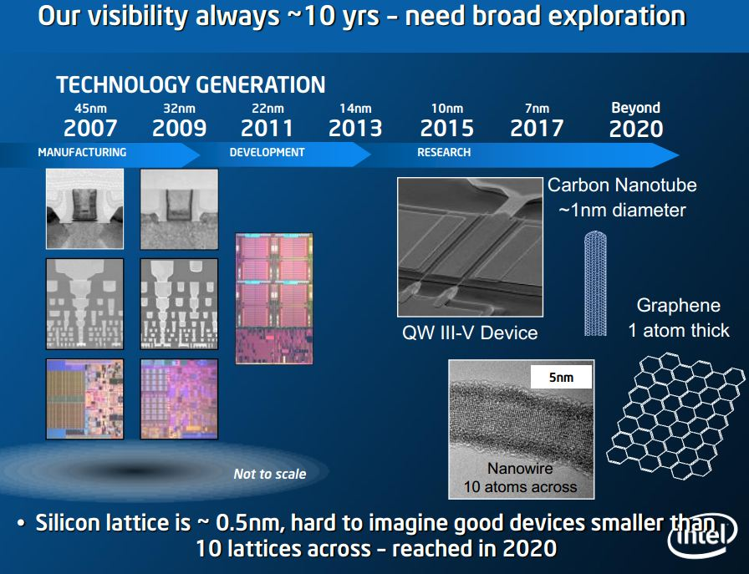
Intel, Steve Punta Oct 2012: Beyond 7nm ??? http://www.intel.com/content/dam/www/public/emea/eu/en/documents/eric/day2-steve-putna.pdf

Slide 3
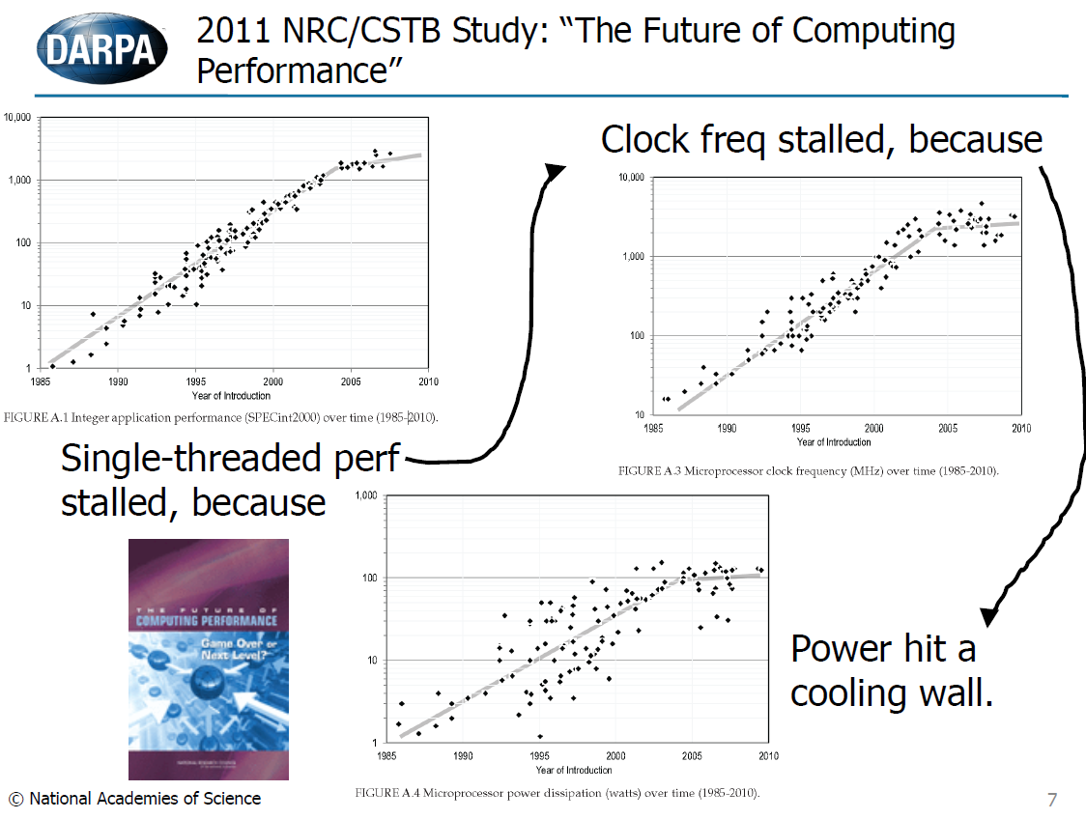
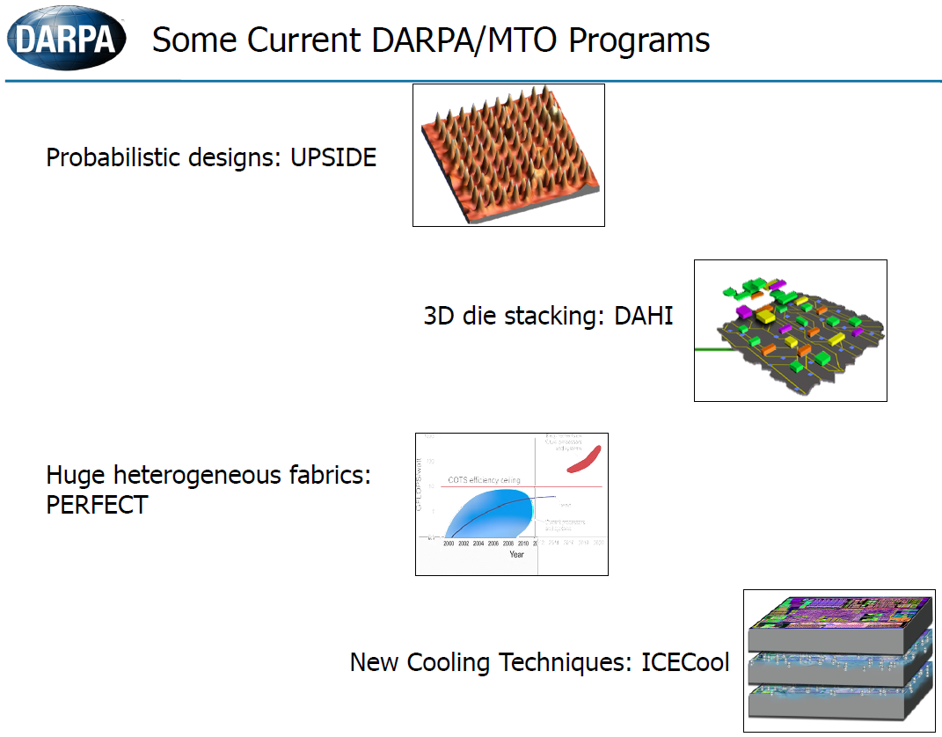
EDA at the End of Moore’s Law*
Bob Colwell, Director MTO, DARPA
*CRA/CCC & ACM SIGDA, Pittsburgh, March 2013

Slide 4
The end of Moore's Law –
The End of Dimensional Scaling
Mike Mayberry, VP Technology and Manufacturing Group Intel (5/2013)
  .. has looked down the highway of conventional silicon development and reckons things become foggy beyond about the 7-nm node
  < http://www.eetimes.com/electronics-news/4414897/More-varied-research-needed-says-Intel>
The end of Moore's Law is on the horizon, says AMD (4/2013)
  Gustafson, chief graphics product architect at AMD, claimed "You can see how Moore's law is slowing down” http://www.zdnet.com/amd-sees-the-era-of-moores-law-coming-to-a-close-7000013413/
William Dally Nvidia’s vice president of R&D & chief scientist (3/2013)
  “Chip stacking is increasingly seen as an alternative to moving to the next semiconductor node at a time when process technology is providing less bang for the buck” http://www.eetimes.com/electronics-news/4410792/Nvidia-R-D-chief-sketches-road-to-chip-stacks
Broadcom CTO Henry Samueli says (5/2013)
  “Broadcom is starting to prepare customers for the end of CMOS scaling in the next 15 years, and it is working out plans for 3-D chip stacks.” <http://www.eetimes.com/electronics-news/4415006/Broadcom--Time-to-prepare-for-the-end-of-Moore-s-Law>

Slide 5
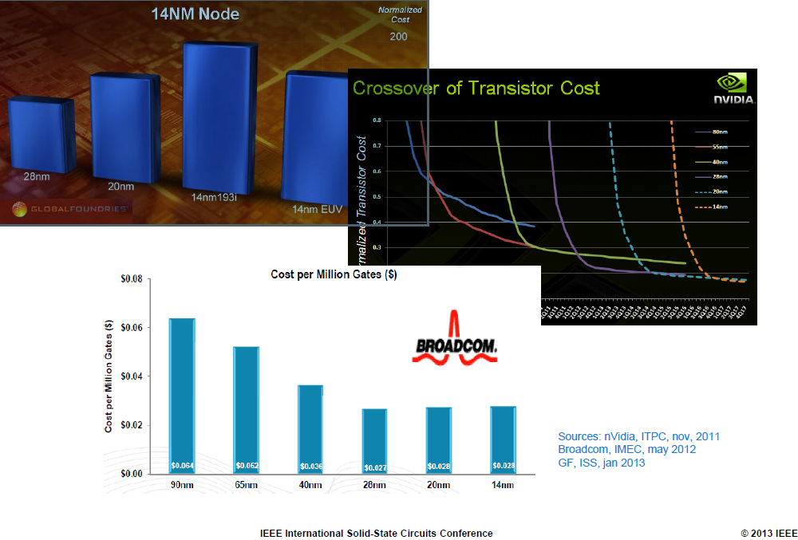
Martin van den Brink -EVP & CTO, ASML
ISSCC 2013

Slide 6
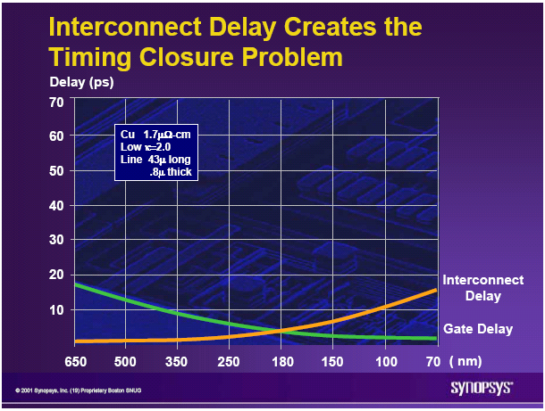
The Current 2D-IC is Facing Escalating Challenges - I
On-chip interconnect is
  Dominating device power consumption
  Dominating device performance
  Penalizing device size and cost

Slide 7
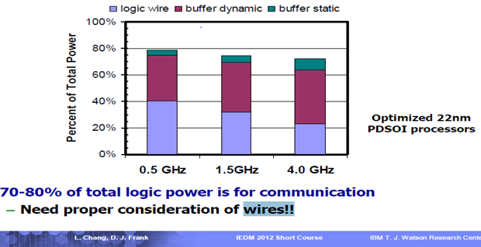
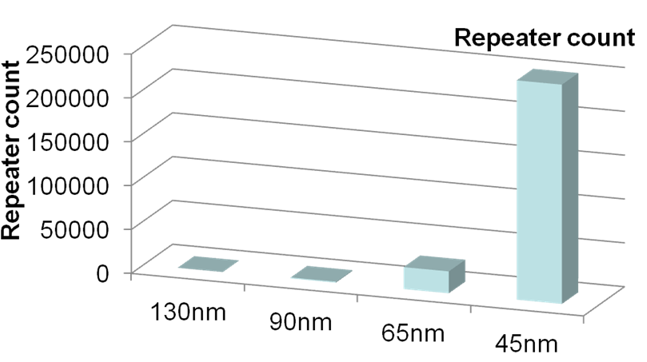
Connectivity Consumes 70-80% of Total Power @ 22nm
Repeaters Consume Exponentially More Power and Area
At 22nm, on-chip connectivity consumes 70-80% of total power
Repeater count increases exponentially
At 45nm, repeaters are > 50% of total leakage
MonolithIC 3D™ Inc. Patents Pending
Source: IBM POWER processors
R. Puri, et al., SRC Interconnect Forum, 2006

Slide 8
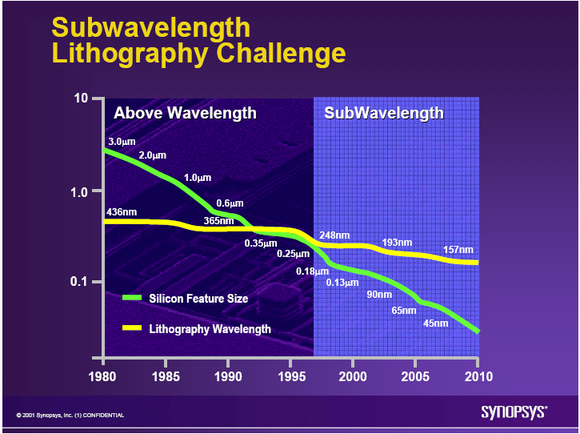
The Current 2D-IC is Facing Escalating Challenges - II
Lithography is
  Dominating Fab cost
  Dominating device cost and diminishing scaling’s benefits
  Dominating device yield
  Dominating IC development costs

Slide 9
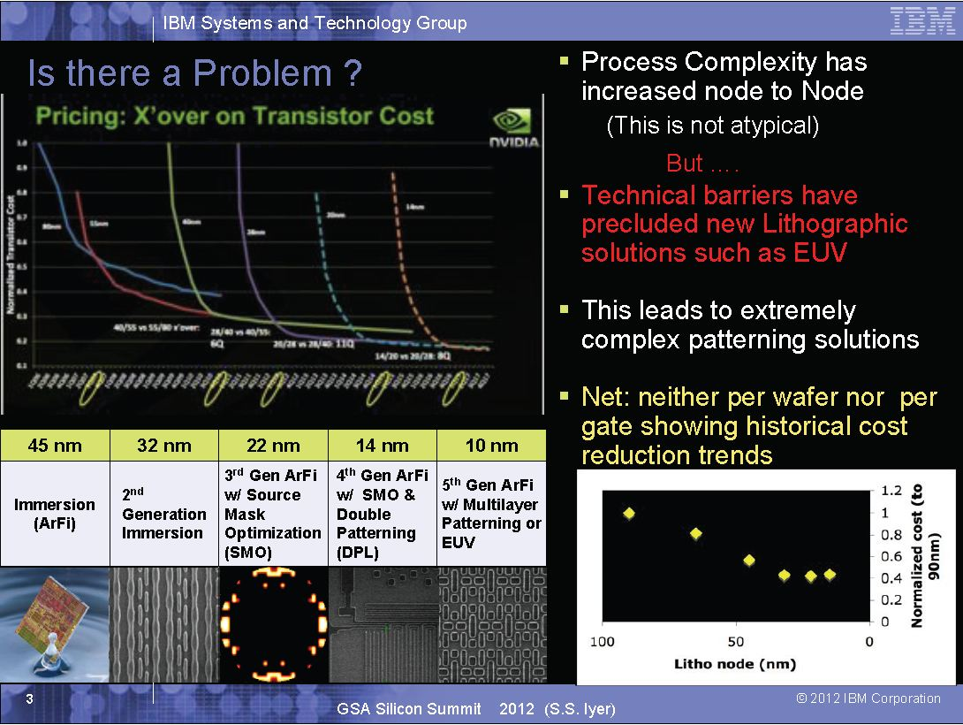
“Net: neither per wafer nor per gate showing historical cost reduction trends”

Slide 10
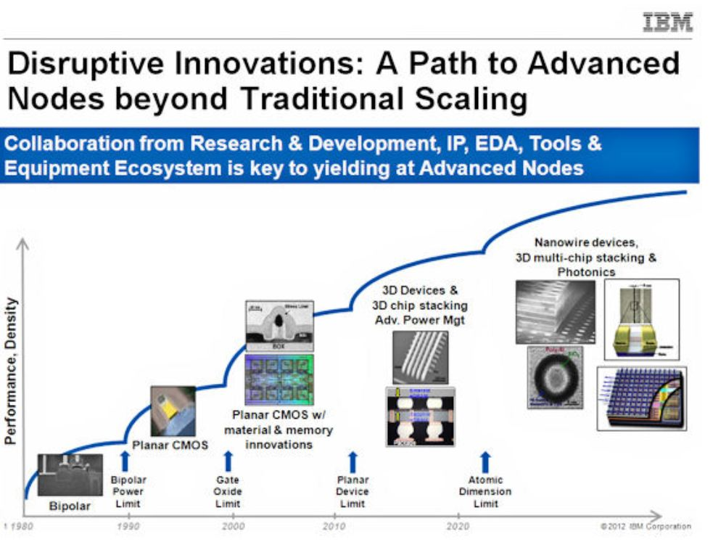
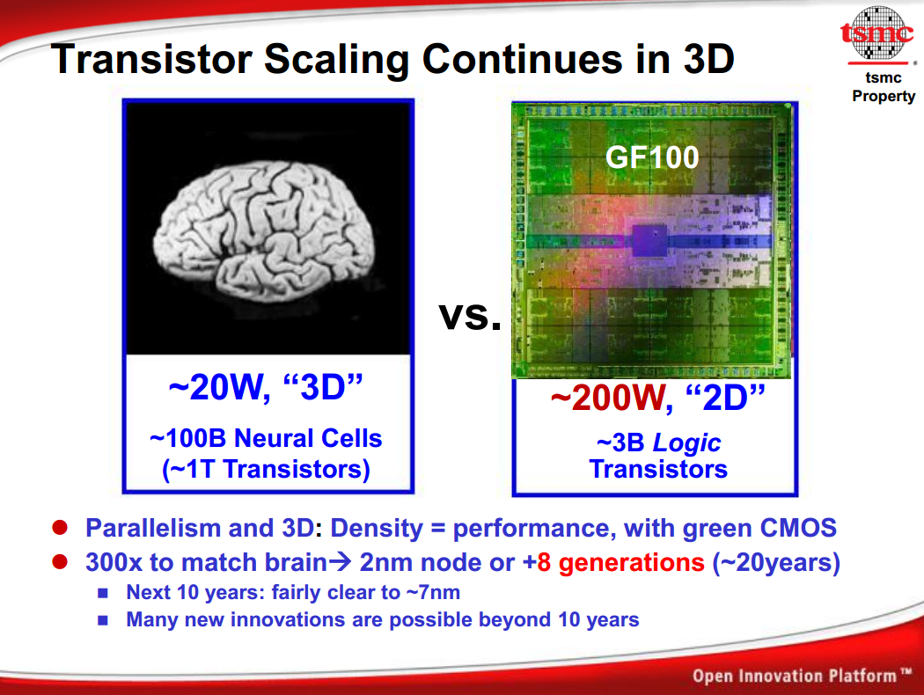
THE SOLUTION: 3D IC
MonolithIC 3D™ Inc. Patents Pending
10

Slide 11
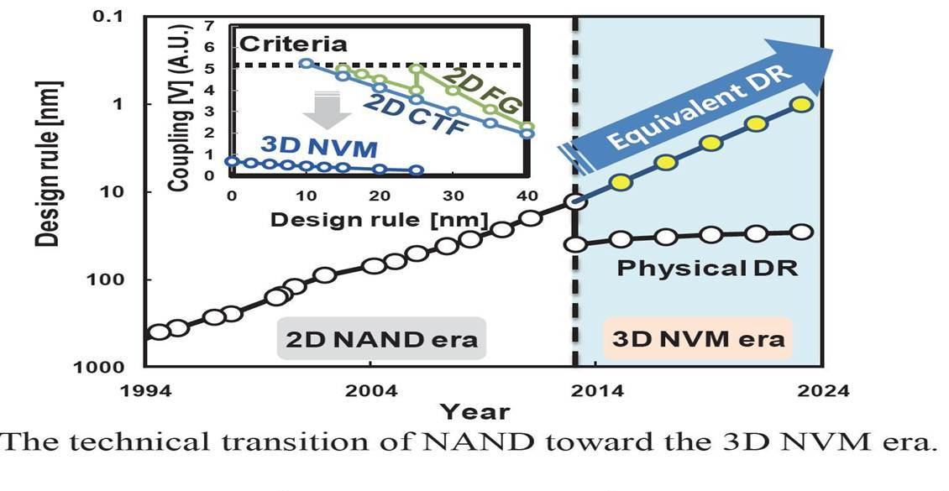
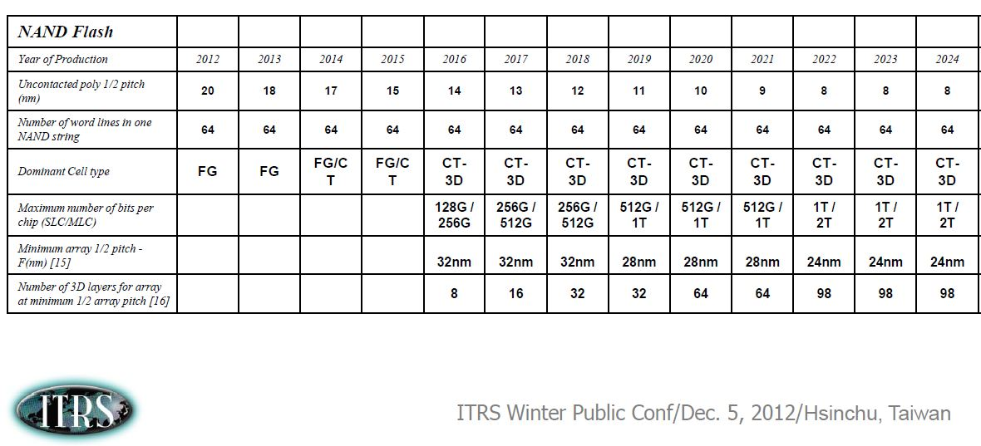
Toshiba, Samsung, Intel..– NAND Vendors are already Adopting Monolithic 3D
*2011 Symposium on VLSI Technology Digest of Technical Papers
Jungdal Choi and Kwang Soo Seol
Semiconductor R&D Center, Samsung Electronics Co., Ltd.

Slide 12
Conclusions:
Dimensional Scaling (“Moore’s Law”) is already exhibiting diminishing returns
The road map beyond 2017 (7nm) is unclear
While the research community is working on many interesting new technologies (see below), none of them seem mature enough to replace silicon for 2019
    - Carbon nanotube - Indium gallium arsenide
    - Graphene - Spintronics
    - Nanowire - Molecular computing
    - Photonics - Quantum computing
3D IC is considered, by all, as the near term solution, and Monolithic 3D IC is well positioned to be so, as it uses the existing infrastructure!
  It is safe to state that Monolithic 3D is the only alternative that could be ready for high volume in 2019 !!

Slide 13
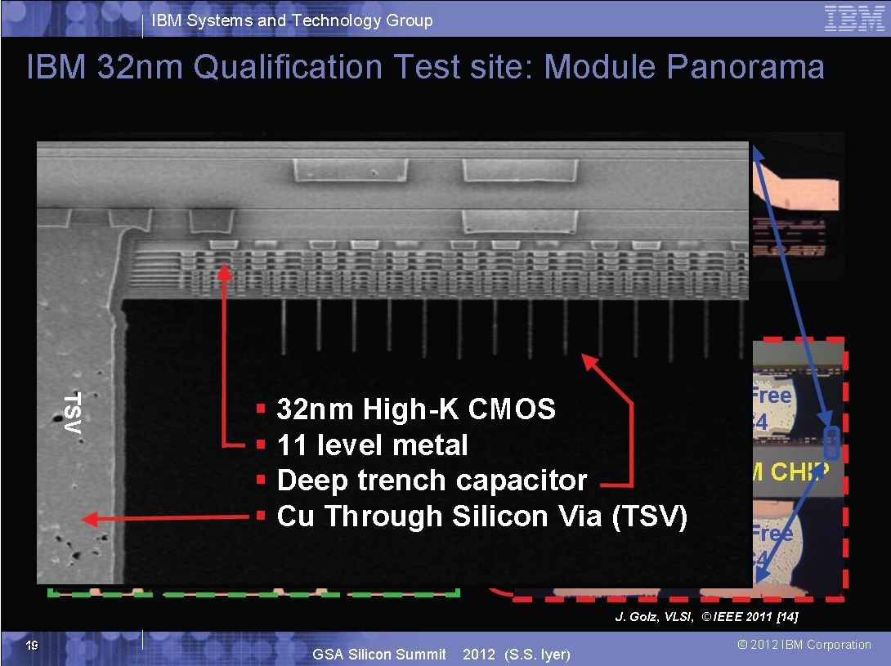
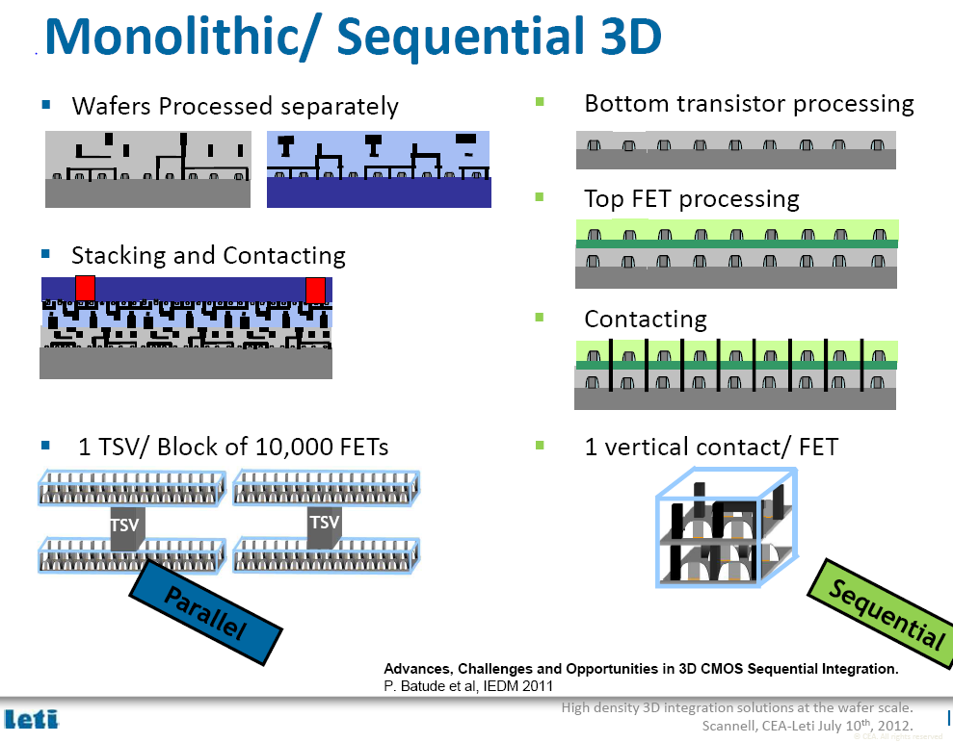

Slide 14
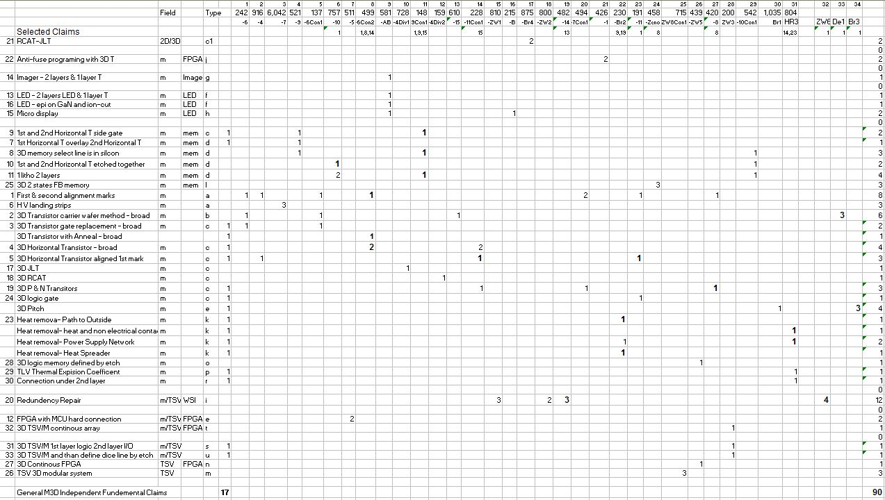
34 Granted Patents

Slide 15
Very Low Risk
The Technology is already developed
The base burn-rate is very low
>90 Patents filed
34 Fundamental patents allowed (32 Issued) as of today
Full exclusivity on the monolithic 3D IC market
Full exclusivity on ‘wafer scale integration’
Many other high value patents

Slide 16
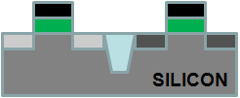
Thin Layer Transfer Technology (“Smart-Cut®”)
→ The Technology Behind SOI *
Cleave using 400ºC
anneal or
mechanical force
Hydrogen implant
of top layer
Flip top layer and
bond to bottom layer
Oxide
p- Si
Donor Wafer
Oxide
H+
p- Si
p- Si
H+
< 100nm
Oxide
Oxide
Oxide
Oxide
Oxide
Base Wafer
Similar process (bulk-to-bulk) used for manufacturing all SOI wafers today
Smart-Cut® is a register trade mark of Soitec

Slide 17
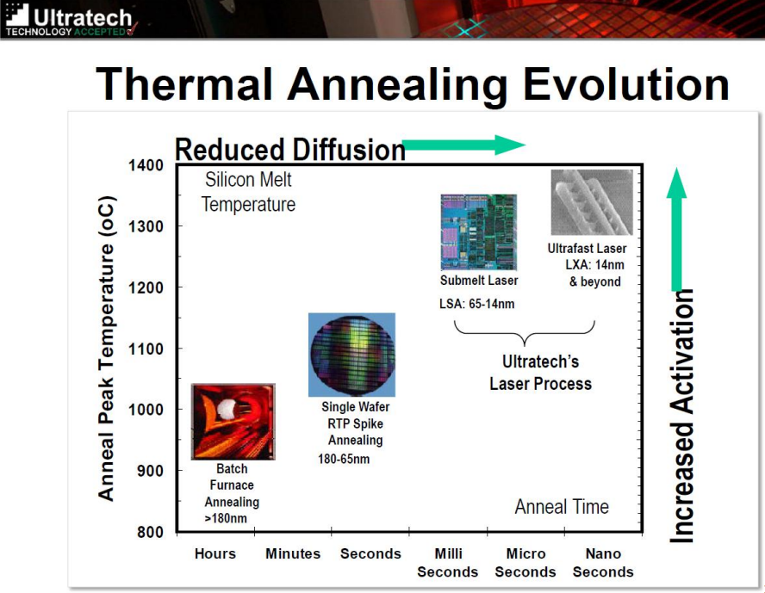
Shorter Annealing Time with Scaling

Slide 18
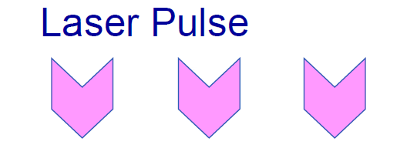
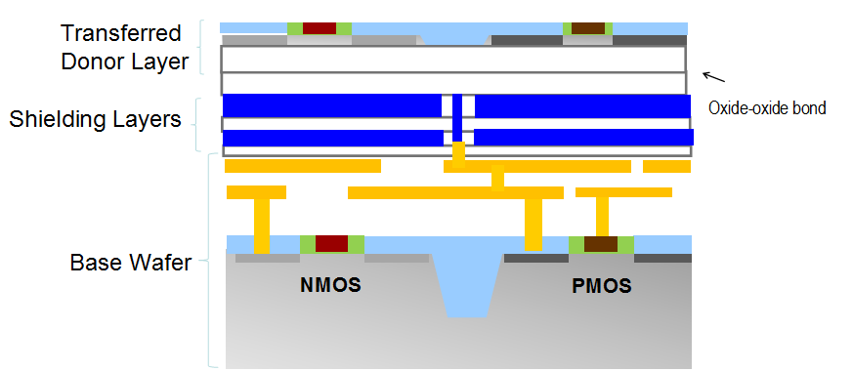
The Top Layer has a High Temperature >1000°C)
without Heating the Bottom Layers (<400°C) !!!
}
>1000°C
}
<400°C

Slide 19
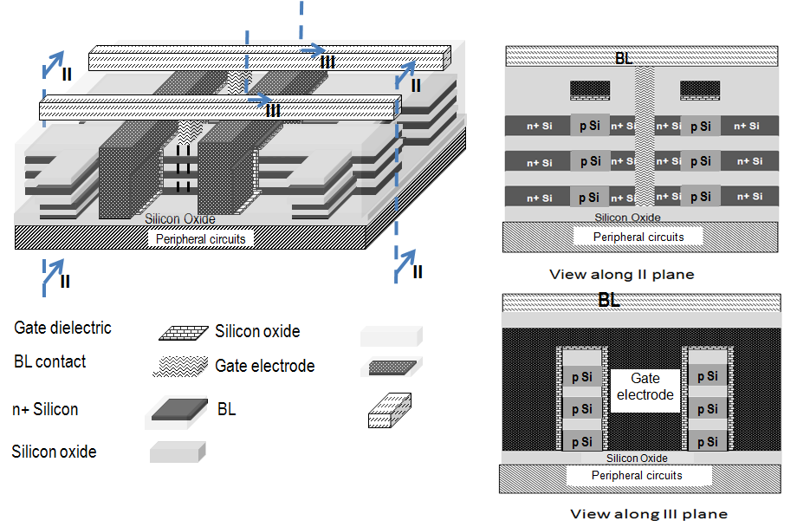
3D DRAM 3.3x Cost advantage vs. 2D DRAM
 | Conventional stacked capacitor DRAM | Monolithic 3D DRAM with 4 memory layers
Cell size | 6F² | Since non self-aligned, 7.2F²
Density | x | 3.3x
Number of litho steps | 26 (with 3 stacked cap. masks) | ~26 (3 extra masks for memory layers, but no stacked cap. masks)

Slide 20
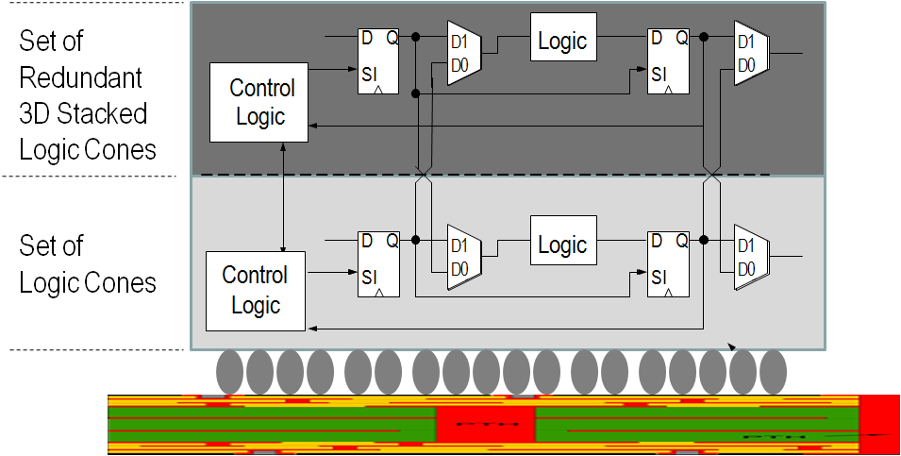
Innovation Enabling ‘Wafer Scale Integration’
– 99.99% Yield with 3D Redundancy
Gene Amdahl -“Wafer scale integration will only work with 99.99% yield, which won’t happen for 100 years” (Source: Wikipedia)
Swap at logic cone granularity
Negligible design, or power penalty
Redundant 1μ above, no performance penalty
Server-Farm in a Box
Watson in a Smart Phone
…

Slide 21
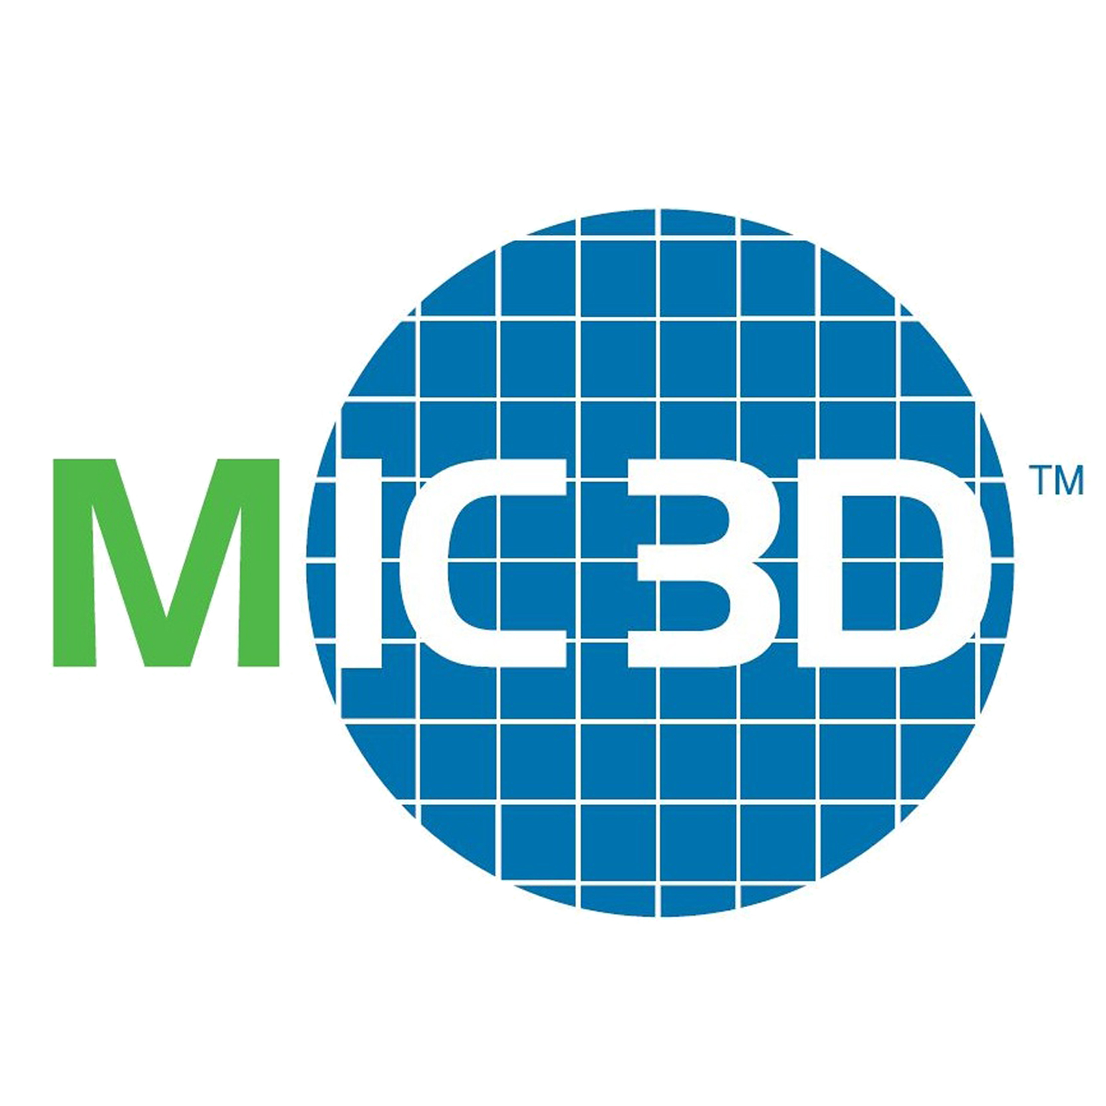
Monolithic 3D Provides an Attractive Path to…
LOGIC
MEMORY
OPTO-ELECTRONICS
Monolithic 3D Integration with Ion-Cut Technology
3D-CMOS: Monolithic 3D Logic Technology
3D-FPGA: Monolithic 3D Programmable Logic
3D-GateArray: Monolithic 3D Gate Array
3D-Repair: Yield recovery for high-density chips
3D-DRAM: Monolithic 3D DRAM
3D-RRAM: Monolithic 3D RRAM
3D-Flash: Monolithic 3D Flash Memory
3D-Imagers: Monolithic 3D Image Sensor
3D-MicroDisplay: Monolithic 3D Display
3D-LED: Monolithic 3D LED
Can be applied to many market segments

