Slide 1

Monolithic 3D Integrated Circuits
Deepak C. Sekar, Paul Lim, Brian Cronquist,
Israel Beinglass and Zvi Or-Bach
MonolithIC 3D Inc.
Presentation at TU Munchen, 12th May 2011

Slide 2
Outline
Introduction
Paths to Monolithic 3D
IntSim+3D: A 2D/3D-IC Simulator
Conclusions

Slide 3
Outline
Introduction
Paths to Monolithic 3D
IntSim+3D: A 2D/3D-IC Simulator
Conclusions

Slide 4
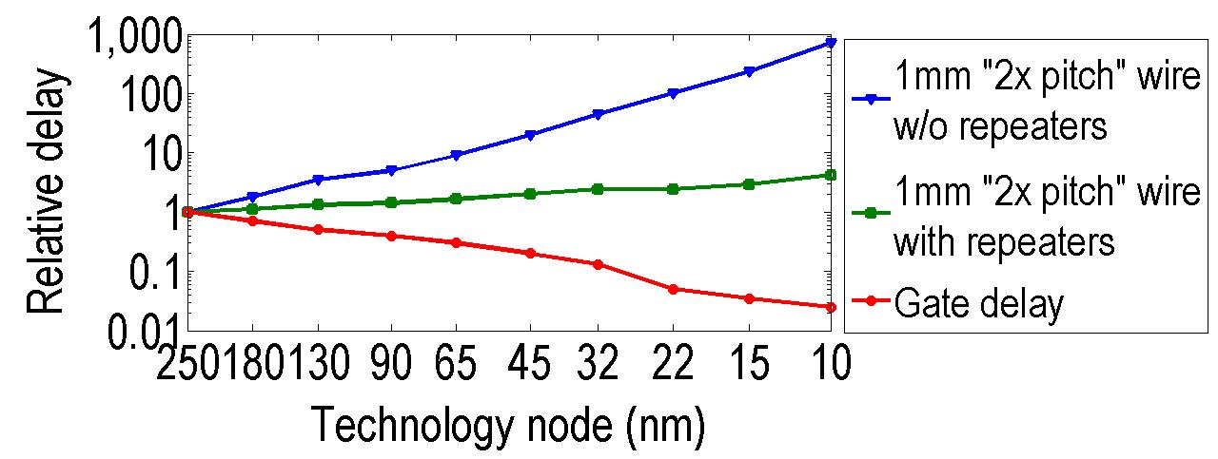
Introduction
Transistors improve with scaling, interconnects do not
Even with repeaters, 1mm wire delay ~50x gate delay at 22nm node

Slide 5
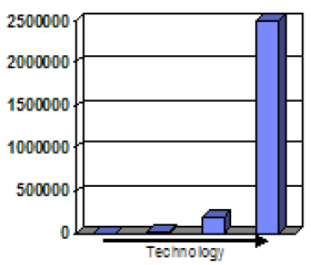
The repeater solution consumes power and area…
Source: IBM POWER processors
R. Puri, et al., SRC Interconnect Forum, 2006
Repeater count
130nm 90nm 65nm 45nm
Repeater count increases exponentially
At 45nm, repeaters >50% of total leakage power of chip [IBM].
Future chip power, area could be dominated by interconnect repeaters
[P. Saxena, et al. (Intel), IEEE J. for CAD of Circuits and Systems, 2004]

Slide 6
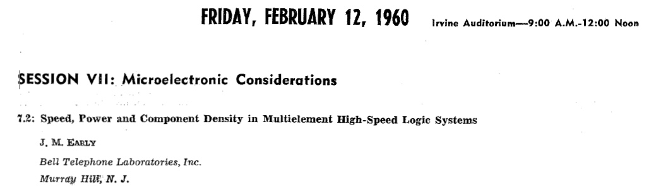
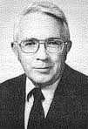
We have a serious interconnect problem
What’s the solution?
Arrange components in the form of a 3D cube → short wires
James Early, ISSCC 1960

Slide 7
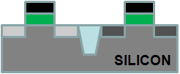
3D with TSV Technology
TSV size typically >1um: Limited by alignment accuracy and silicon thickness
Processed Top Wafer
Align and bond
Processed Bottom Wafer

Slide 8
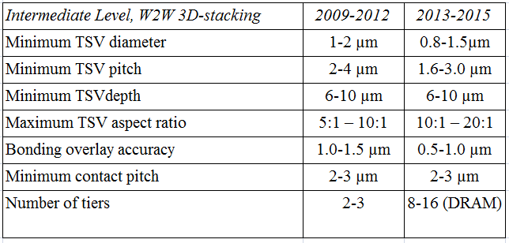
Industry Roadmap for 3D with TSV Technology
ITRS
2010
TSV size ~ 1um, on-chip wire size ~ 20nm → 50x diameter ratio, 2500x area ratio!!!
Cannot move many wires to the 3rd dimension
TSV: Good for stacking DRAM atop processors, but doesn’t help on-chip wires much

Slide 9
Can we get Monolithic 3D?
Requires sub-50nm vertical and horizontal connections
Focus of this talk…

Slide 10
Outline
Introduction
Paths to Monolithic 3D
IntSim+3D: A 2D/3D-IC Simulator
Conclusions

Slide 11
Getting sub-50nm vertical connections
Sub-100nm c-Si, can look through and align
Build transistors with c-Si films above copper/low k
→ Avoids alignment issues of bonding pre-fabricated wafers
Need <400-450ºC for transistor fabrication → no damage to copper/low k

Slide 12
Layer Transfer Technology (or “Smart-Cut”)
→ Defect-free c-Si films formed @ <400ºC
Hydrogen implant
of top layer
Flip top layer and
bond to bottom layer
Cleave using 400ºC
anneal or sideways
mechanical force. CMP.
Oxide
p Si
Top layer
p Si
Oxide
H
p Si
p Si
H
Oxide
Oxide
Oxide
Oxide
Oxide
Bottom layer
Same process used for manufacturing all SOI wafers today

Slide 13
Sub-400ºC Transistors
Transistor part | Process | Temperature
Crystalline Si for 3D layer | Bonding, layer-transfer | Sub-400ºC
Gate oxide | ALD high k | Sub-400ºC
Metal gate | ALD | Sub-400ºC
Junctions | Implant, RTA for activation | >400ºC
Junction Activation: Key barrier to getting sub-400ºC transistors
In next few slides, will show 2 solutions to this problem… both under development.
For other techniques to get 3D-compatible transistors, check out www.monolithic3d.com

Slide 14
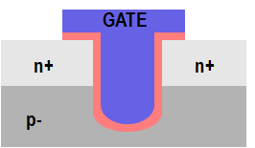
One path to solving the dopant activation problem:
Recessed Channel Transistors with Activation before Layer Transfer
Idea 1: Do high temp. steps (eg. Activate) before layer transfer
Layer transfer
Oxide
n+ Si
p
p Si
p
p- Si wafer
n+
H
n+
p- Si wafer
Idea 2: Use low-temp. processes like etch and deposition to define (novel) recessed channel transistors
Idea 3: Silicon layer very thin (<100nm), so transparent, can align perfectly to features on bottom wafer
Note:
All steps after Next Layer attached to Previous Layer are
@ < 400ºC!
n+
n+
p
p

Slide 15
Recessed channel transistors used in manufacturing today
→ easier adoption
GATE
GATE
GATE
n+
n+
n+
n+
p
p
RCAT recessed channel transistor:
Used in DRAM production
@ 90nm, 60nm, 50nm nodes
Longer channel length → low leakage, at same footprint
V-groove recessed channel transistor: Used in the TFT industry today
J. Kim, et al. Samsung, VLSI 2003
ITRS

Slide 16
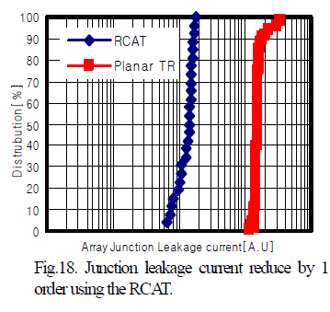
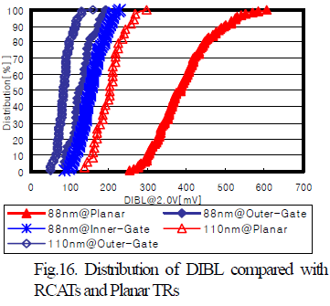
RCATs vs. Planar Transistors:
Experimental data from Samsung 88nm devices
From [J. Y. Kim, et al. (Samsung), VLSI Symposium, 2003]
RCATs → Less junction leakage
RCATs → Less DIBL i.e. short-channel effects

Slide 17
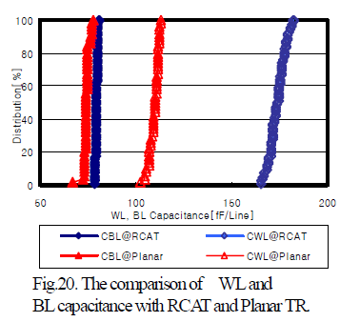
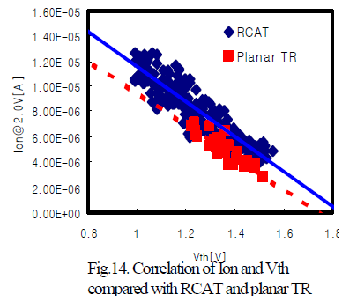
RCATs vs. Planar Transistors (contd.):
Experimental data from Samsung 88nm devices
From [J. Y. Kim, et al. (Samsung), VLSI Symposium, 2003]
RCATs → Similar drive current to standard MOSFETs → Mobility improvement (lower doping) compensates for longer L_{eff}
RCATs → Higher I/P capacitance

Slide 18
Another path to solving the dopant activation problem:
Dopant Segregated Schottky Transistors with Layer Transfer
Form NiSi @ 400ºC
Implant Arsenic at surface
Drive-in anneal @ 400-500ºC
Gate
Gate
Gate
Gate
n+ Si
NiSi
NiSi
NiSi
p Si
p Si
p Si
Arsenic not soluble in Ni, moves to interface.
Cannot diffuse in p Si since temperature (400-500ºC) low.
Explored by Globalfoundries, TSMC, Toshiba, IBM, etc
→ their application = low resistance contacts to FD-SOI devices
Our application = 400-450ºC 3D stacked transistors with layer transfer

Slide 19
Outline
Introduction
Paths to Monolithic 3D
IntSim+3D: A 2D/3D-IC Simulator
Conclusions

Slide 20
IntSim+3D: A Simulator for 2D or 3D-ICs
IntSim+3D
Inputs
Outputs
contains
Gate count
Die area
Frequency
Rent’s parameters
Number of strata
(1 if 2D, >=2 for 3D)
Chip power
Metal level count
Wire pitches
Stochastic signal interconnect models
Logic gate model
Power, Clock, Thermal Interconnect models
Via blockage
Energy-Delay Product repeater insertion Models
Power models

Slide 21
IntSim+3D: Uses a novel algorithm to combine many models
Global interconnect levels
Shared among all strata
Model → [D. C. Sekar, J. D. Meindl, et al., IITC 2006]
Local and semi-global interconnect levels
Each stratum has its own
Models → PhD dissertations of
A. Rahman (MIT),
R. Venkatesan, D. Sekar, J. Davis, R. Sarvari (Georgia Tech)
Logic gates
Critical path model developed by K. Bowman (Georgia Tech)

Slide 22
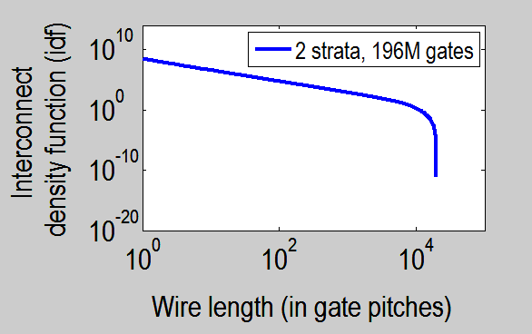
Stochastic Signal Wire Length Distribution Model
Number of wires of length l = Function(Number of gates, die size, strata, feature size, Rent’s constants)
Number of wires of length between l and l+dl = idf(l) dl
Models from J. Davis, A. Rahman, J. Meindl, R. Reif, et al.
[A. Rahman, PhD Thesis, MIT 2001] [J. Davis, PhD Thesis, Georgia Tech, 1999]
2D model → fits experimental data reasonably well [J. Davis, PhD Thesis, GT, 1999]
3D model → same methodology

Slide 23
Logic gate model
Two input NAND gates with average wire length, fan-out user defined
.
.
.
Find W for a certain performance target

Slide 24
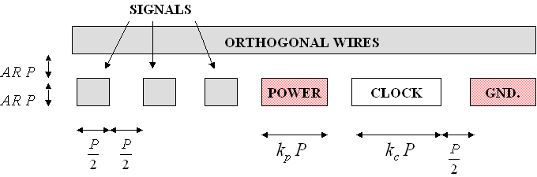
Global interconnect model
Global wire pitch obtained based on two conditions:
Signal bandwidth maximized with power grid IR drop requirement being reached
Wire pitch big enough to drive a clock H tree of a certain length
Results match well with commercial processors [D. C. Sekar, et al., IITC 2006]

Slide 25
Local and semi-global interconnect model
Condition 1:
Wiring area available = Wiring needed for routing the stochastic wiring distribution
Condition 2:
RC delay of longest signal wire in each wiring pair = fraction of clock period
For wires with repeaters, new Energy-Delay Product repeater insertion model used
Condition 3:
Wire efficiency (e_{w}) = 1 – fraction of wiring area lost to power wiring, via blockage
[Sarvari, et al. - IITC’07] [Q. Chen, et al. – IITC’00]

Slide 26
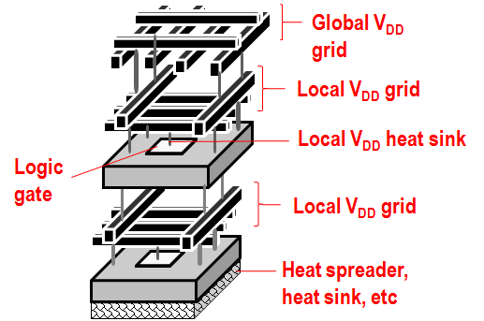
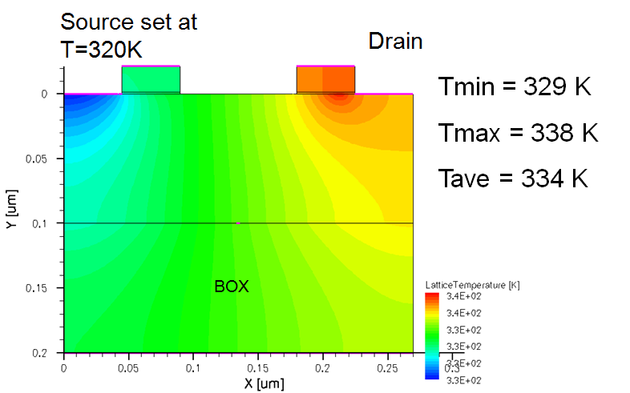
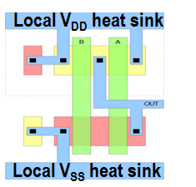
Thermal model
contact
Idea: Use V_{DD}/V_{SS} contacts of each stacked gate to remove heat from it. Design standard cell library to have low temp. drop within each stacked gate.
Low (thermal) resistance V_{DD} and V_{SS} distribution networks ensure low temp. drop between heat sink and logic gate
IntSim+3D: Computes temp. rise of 3D stacked layers using models.

Slide 27
Algorithm used to combine together all these models
User inputs parameters
Logic gate sizing
Select rough initial power estimate
Design multilevel interconnect network (including power distribution) for 3D chip with this power estimate
Find power predicted by IntSim+3D
Is predicted power = initial power? If yes, this is the final interconnect network. If no, choose new initial power estimate = average of previous initial power estimate and IntSim+3D estimate. Go to step 4.
Output data
Iterative process used for designing chip

Slide 28
Demo
IntSim+3D
App
Utility of IntSim+3D:
Pre-silicon optimization and estimation of frequency, power, die size, supply voltage, threshold voltage and multilevel interconnect pitches
Study scaling trends and estimate benefits of different technology and design modifications
Undergraduate and graduate courses in universities for intuitive understanding of how a VLSI chip works

Slide 29
IntSim+3D the next generation version of a CAD Tool called IntSim
IntSim:
Developed at Georgia Tech by Deepak C. Sekar, Ragu Venkatesan, Reza Sarvari, Jeff Davis and James Meindl.
Described in [D. C. Sekar, et al., Proc. ICCAD 2007]
Used and referenced by multiple researchers at Georgia Tech, UC Davis, Stanford, U. of Illinois at Chicago, Sandia, etc.
IntSim → 2D
IntSim+3D → 2D+3D

Slide 30
Compare 2D and 3D-ICs
22nm node | 2D-IC | 3D-IC 2 Device Layers | Comments
Frequency | 600MHz | 600MHz
Metal Levels | 10 | 10
Average Wire Length | 6um | 3.1um
Av. Gate Size | 6 W/L | 3 W/L | Since less wire cap. to drive
Die Size (active silicon area) | 50mm² | 24mm² | 3D-IC → footprint 12mm²
Power | Logic = 0.21W | Logic = 0.1W | Due to smaller Gate Size
 | Reps. = 0.17W | Reps. = 0.04W | Due to shorter wires
 | Wires = 0.87W | Wires = 0.44W | Due to shorter wires
 | Clock = 0.33W | Clock = 0.19W | Due to less wire cap. to drive
 | Total = 1.6W | Total = 0.8W
3D with 2 strata → 2x power reduction, ~2x active silicon area reduction vs. 2D

Slide 31
Scaling with 3D or conventional 0.7x scaling?
Analysis with 3DSim Same blocked scaled | 2D-IC @22nm | 2D-IC @ 15nm | 3D-IC 2 Device Layers @ 22nm
Frequency | 600MHz | 600MHz | 600MHz
Metal Levels | 10 | 12 | 10
Die Size (Active silicon area) | 50mm² | 25mm² | 24mm²
Average Wire Length | 6um | 4.2um | 3.1um
Av. Gate Size | 6 W/L | 4 W/L | 3 W/L
Power | 1.6W | 0.7W | 0.8W
3D can give you similar benefits vis-à-vis a generation of scaling!
Without the need for costly lithography upgrades!!!
Let’s understand this better…

Slide 32
Theory: 2D Scaling vs. 3D Scaling
 | 2D Scaling (0.7x Dennard scaling) |  | Monolithic 3D Scaling (2 device layers)
 | Ideal | Today, V_{dd} scales slower
Chip Footprint | 2x reduction |  | 2x reduction
 | 0.7x reduction |  | 0.7x reduction
Wire capacitance | 0.7x reduction |  | 0.7x reduction
Wire resistance | >0.7x increase |  | 0.7x reduction
Gate Capacitance | 0.7x reduction |  | Same
Driver (Gate) Resistance (Vdd/Idsat) | Same | Increases | Same
Similarities: Wire length, wire capacitance
2D scaling scores: Gate capacitance
3D scaling scores: Wire resistance, driver resistance
Overall benefits seen with IntSim+3D have basis in theory

Slide 33
Outline
Introduction
Paths to Monolithic 3D
IntSim+3D: A 2D/3D-IC Simulator
Conclusions

Slide 34
Conclusions
Monolithic 3D Technology possible and practical:
- Recessed Channel Transistors
- Dopant segregated Schottky transistors
- Other techniques
Discussed IntSim+3D, a CAD tool to simulate 2D and 3D-ICs
- Useful for architecture exploration, technology predictions and teaching
- Open source tool, anyone can contribute!
3D scaling
→ benefits similar to 2D scaling, but without costly litho upgrades

Slide 35
Acknowledgements
Prof. Franz Kreupl → For hosting me at Munich
Prof. James Meindl → IntSim’s 2D version was developed when I was doing my Ph.D. with him
Past colleagues at Georgia Tech such as Ragu Venkatesan, Keith Bowman, Jeff Davis, Reza Sarvari, Azad Naeemi
Bin Yang → for helpful discussions on Schottky FETs

Slide 36
Backup slides

Slide 37
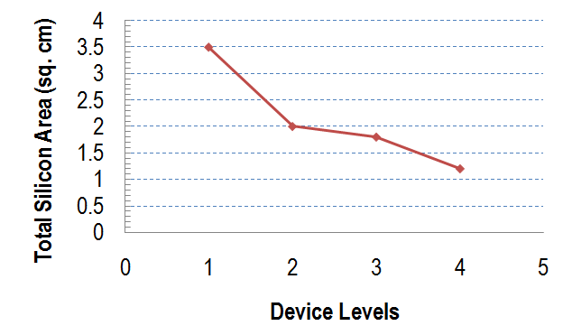
Monolithic 3D: A Much Sought-After Goal
From J. Davis, J. Meindl, et al., Proc. IEEE, 2001
Frequency = 450MHz, 180nm node, ASIC-like chip
Tremendous benefits when vertical connectivity ~ horizontal connectivity. 3x reduction in silicon area compared to a 2D implementation, even @ 180nm node!
Notes:
37

Slide 38
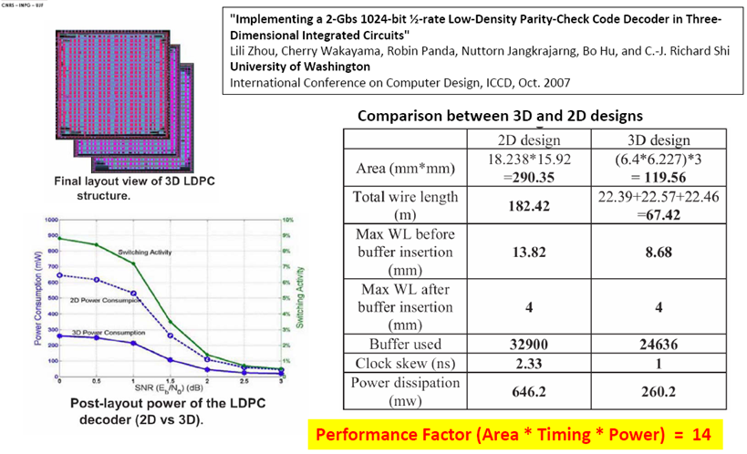
Benefits of Monolithic 3D:[ICCD 2007]
Notes:
38

Slide 39
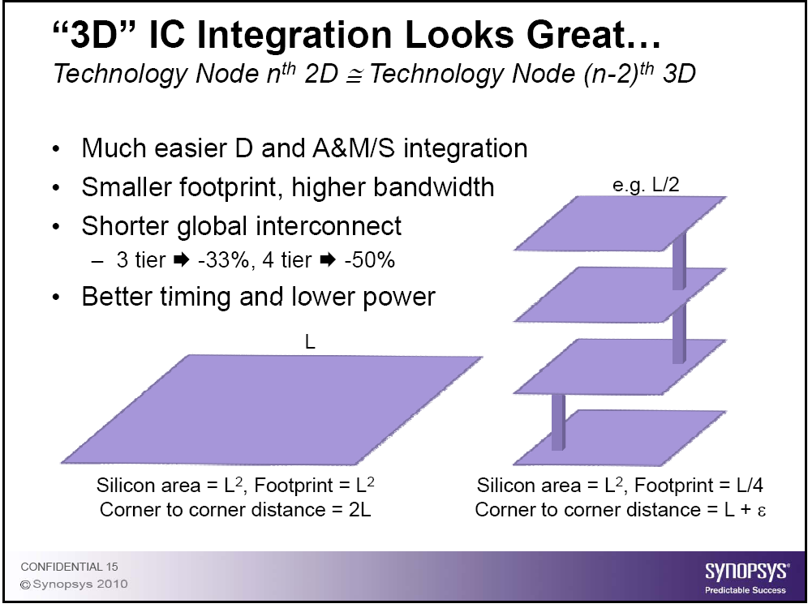
Benefits of Monolithic 3D: Synopsys
Notes:
39

Slide 40
The Monolithic 3D Challenge
A process on top of copper interconnect should not exceed 400ºC
    How to bring mono-crystallized silicon on top below 400ºC
    How to fabricate advanced transistors below 400ºC
Misalignment of pre-processed wafer to wafer bonding step is ~1μ
    How to achieve 100nm or better connection pitch
    How to fabricate thin enough layer for inter-layer vias of ~50nm

Slide 41
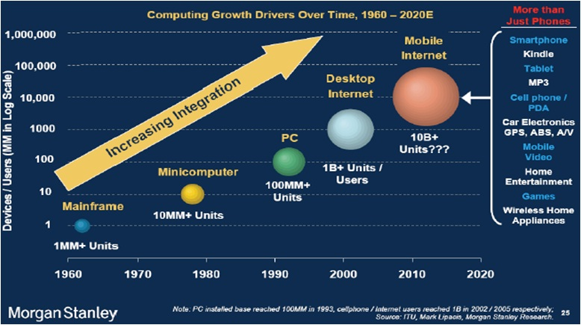
3D-ICs: The Heat Removal Question
Sub-1W smartphones, cellphones and tablets the wave of the future
Heat removal not a key issue there → can 3D stack. Also, shorter wires → net power reduced.
Notes:
41

Slide 42
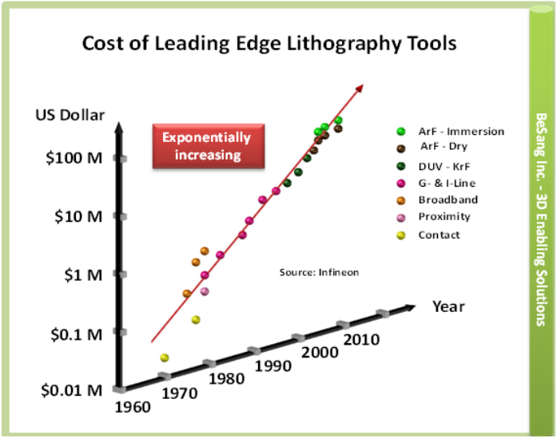
Escalating Cost of Litho to Dominate Fab and Device Cost

Slide 43
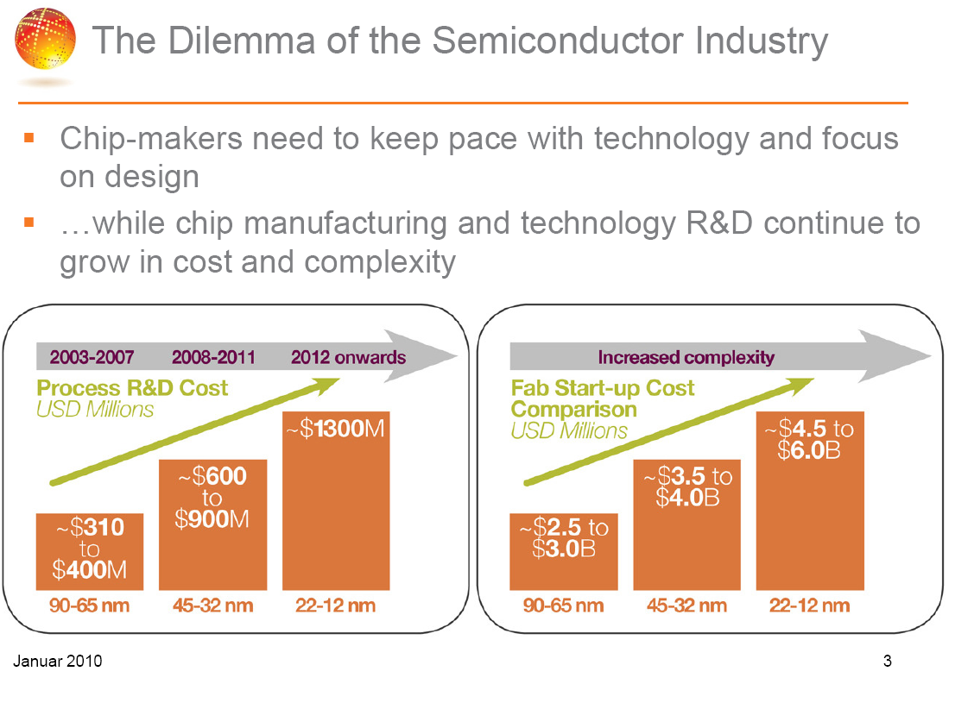
Courtesy: GlobalFoundries
Notes:
43

Slide 44
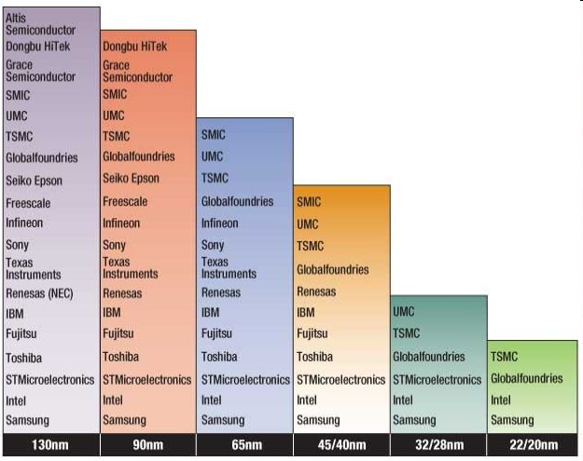
Severe Reduction in Number of Fabs
(Source: IHS iSuppli)

