Slide 1
The Monolithic 3D-IC
A Disruptor to the Semiconductor Industry

Slide 2
Monolithic 3D Provides an Attractive Path to…
3D-CMOS: Monolithic 3D Logic Technology
3D-FPGA: Monolithic 3D Programmable Logic
3D-GateArray: Monolithic 3D Gate Array
3D-Repair: Yield recovery for high-density chips
3D-DRAM: Monolithic 3D DRAM
3D-RRAM: Monolithic 3D RRAM
3D-Flash: Monolithic 3D Flash Memory
3D-Imagers: Monolithic 3D Image Sensor
3D-MicroDisplay: Monolithic 3D Display
LOGIC
Monolithic 3D Integration with Ion-Cut Technology
Can be applied to many market segments
MEMORY
OPTO-ELECTRONICS

Slide 3
Monolithic 3D to Re-Engineer and Revive Gate Arrays
Continuous Array
Mix Match I/O
Logic Fabric
Memory Fabric

Slide 4
MonolithIC GateArray: A Monolithic 3D Gate Array Technology
Transistor masks pre-defined, interconnect layers customized. Low NRE costs, but good performance.
Repeating transistor Structure works well with advance Litho and with Gate Replacement 3D path
Solves memory issue of traditional gate arrays where logic fabric is a poor fit for memory. Once memory portion is moved up, Standard Cell is at least 50% more efficient.
I/O layer
Memory layer
Gate Array Layer 2
Gate Array Layer 1

Slide 5
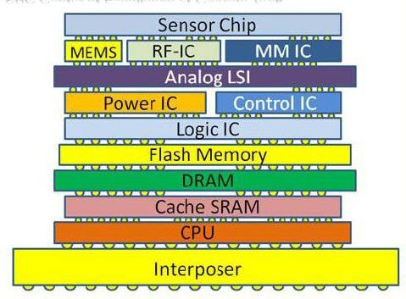
Reinventing GA using 3D
Use different dies for:
Logic Fabric
Memory Fabric
I/O Fabric
Build Reticle Size
~One Mask set with many die/functions size options
Choice of process node and fabrication processes

Slide 6
Traditional GA Wafers vs. Continuous Array Wafers
Scribe lanes
Scribe lanes
GA Logic-only chunk

Slide 8
Assembling Continuous Array Terrain into Customized Hybrid Stacks
Standard TSV pattern
Chip with logic size 9
Chip with TSV visible
3D Hybrid stack with TSVs
TSV prep
IO 0.15 μ
memory 22 nm
SerDes 90 nm
Chiclets assembly actually happens prior to wafer dicing
Chiclets

